Slide 1
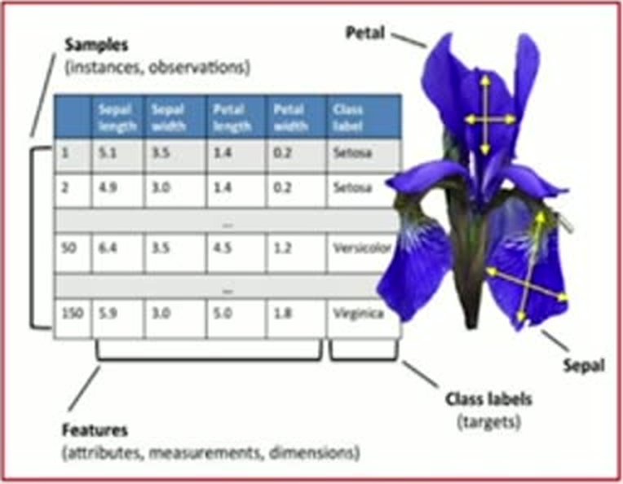
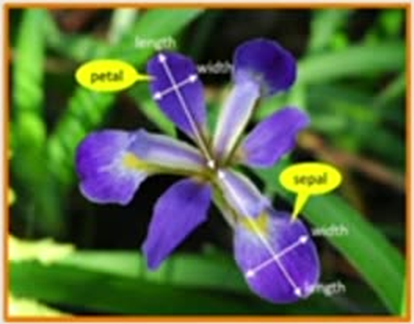
Example of High Dimensional Data
61
(IRIS Dataset)
4 Features: Width and Length of both sepal and petal

