Slide 1
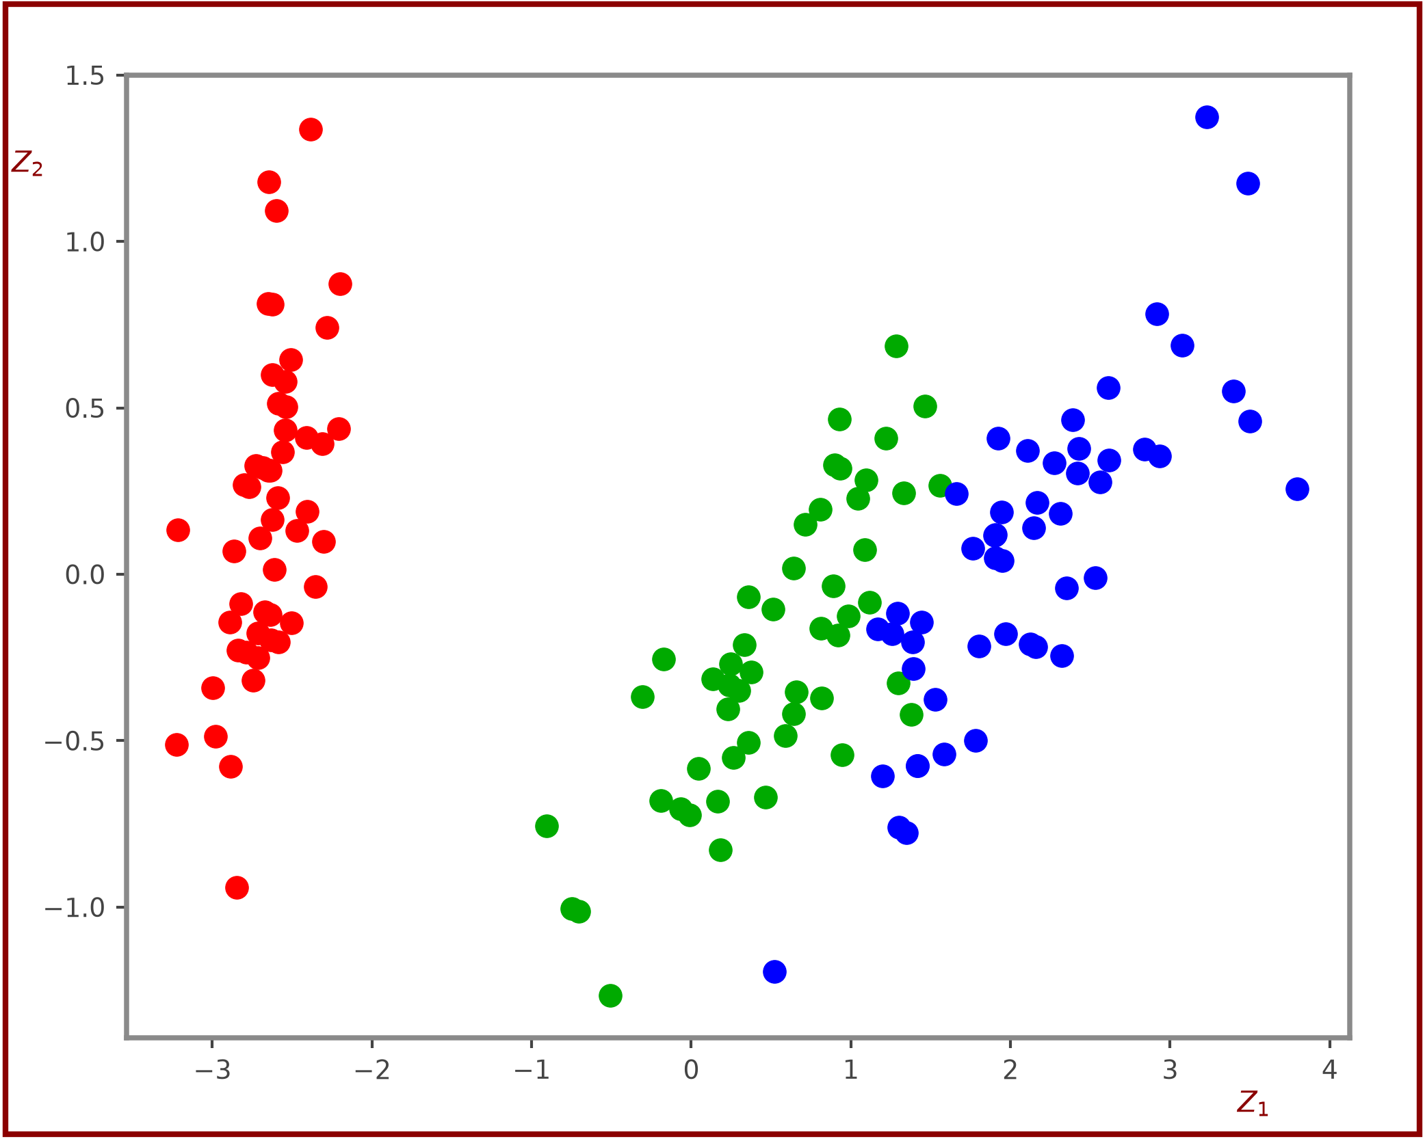
Visualize Reduced Features [ 4 features are reduced to two features]
63
ᵀ
W₁
ᵀ
L₁
PCA
Z₁
W₂
⇒
Z₂
Setosa
Versicolor
Virginica
L₂
Visualize Classes as 2-D (Z₁ vs Z₂)

