Slide 1
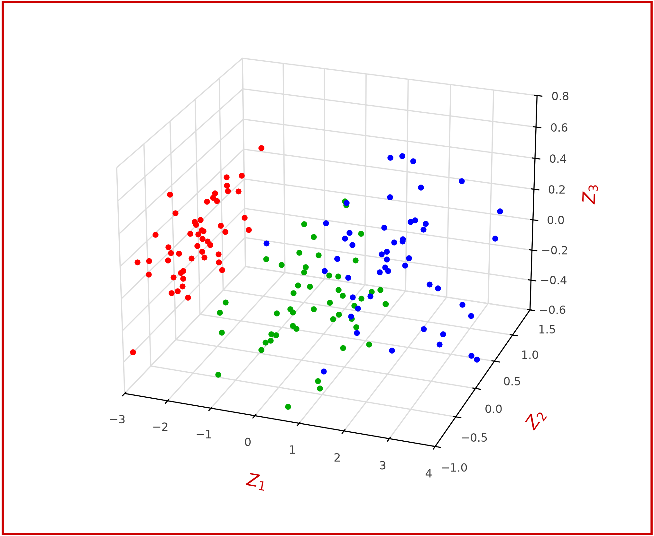
[3] Visualize Reduced Features [ 4 features are reduced to three features]
64
W₁
L₁
W₂
L₂
T
T
Z₁
Z₂
Z₃
PCA
Setosa
Versicolor
Virginica
Visualize Classes as 3-D (z₁ vs Z ₂ vs Z₃)

