Slide 1
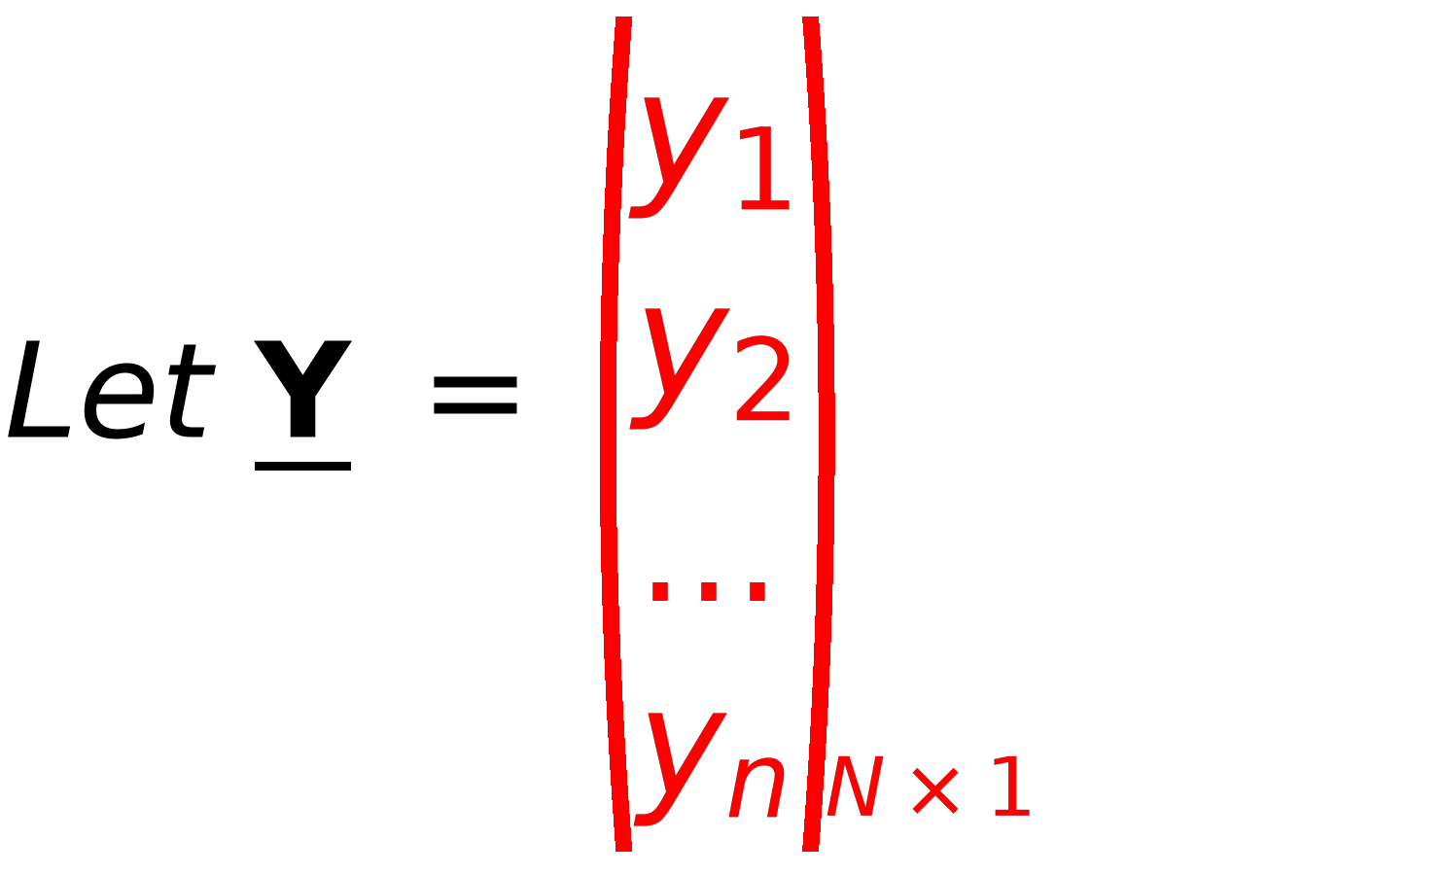
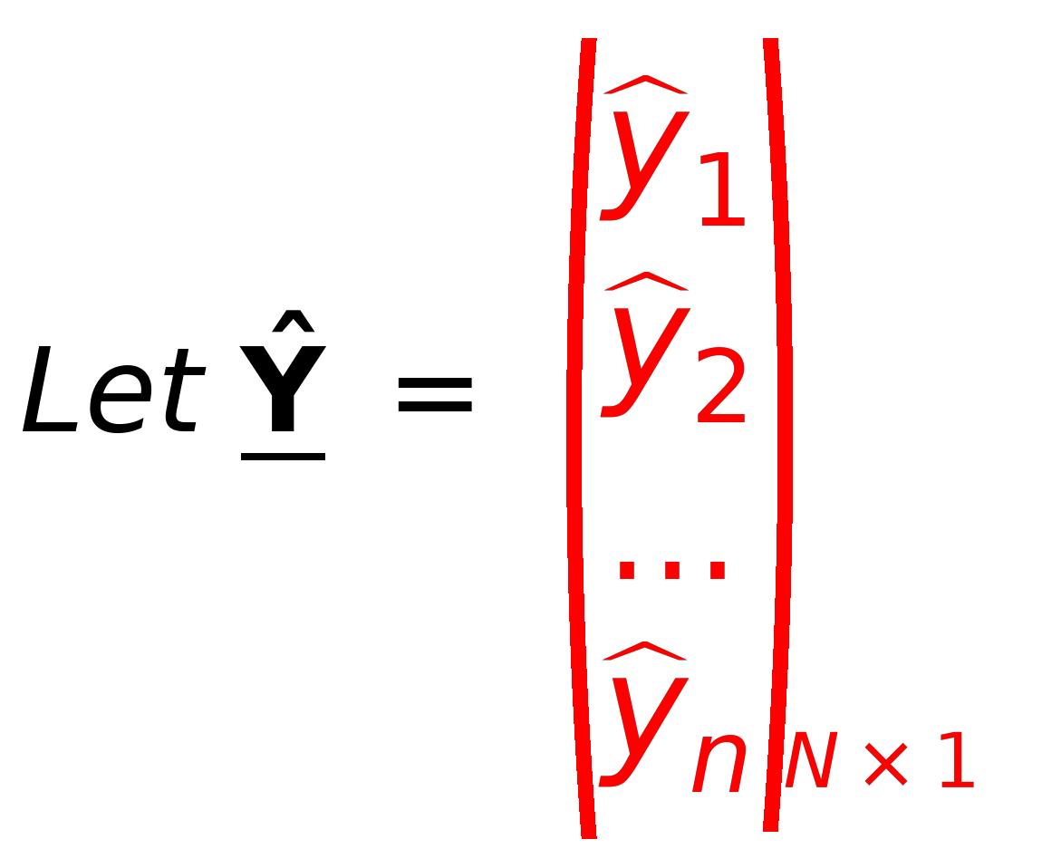
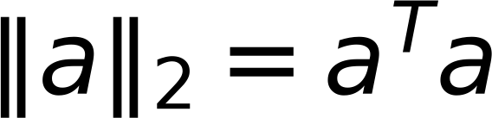
4
Concept of LOSS Function
Remember
Original Labels
Predicted Labels
from Training Samples
from Model Ŷ=XW
Objective is Ŷ=Y
Ŷ = X W
Predicted
Where : X_{N x d+1} is a matrix
⇒
Given
If Ŷ≠Y ⇒ There is an Error (Loss)
Y_{N x 1} is labels vector
Given
⇒
W is Model Parameter
Required
⇒
Define Loss function as squared distance between Ŷ and Y

