Slide 1
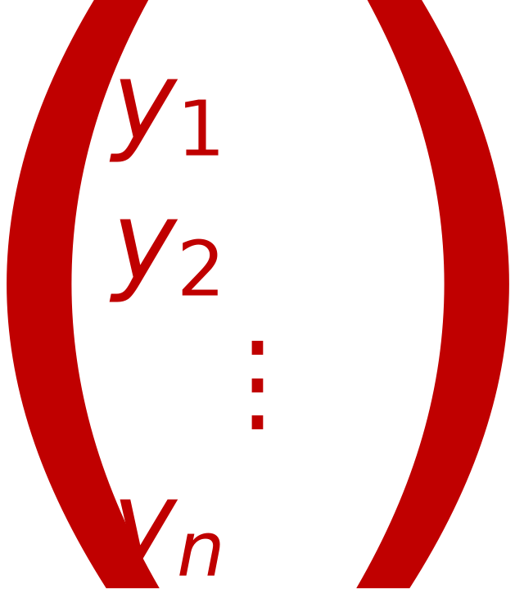
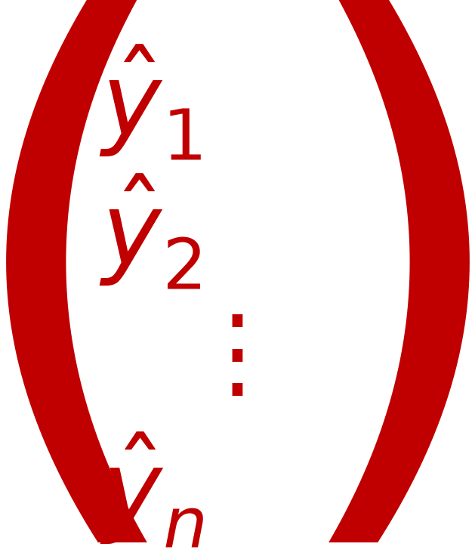
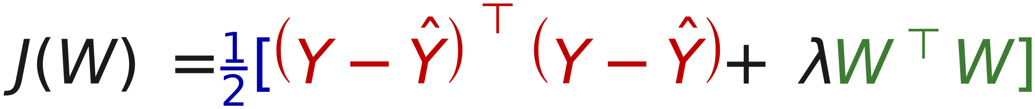
14
LOSS Function that MINIMIZES Overfitting
Let Y =
Let Ŷ =
N_{×1}
Original Labels
N_{×1}
Predicted Labels
from Training Samples
from Model Ŷ = X W
Objective is Ŷ=Y and ||W|| is minimum This is called Ridge Regularization
Objective function J(W) = Loss(X,Y,W) + λ R(W) (λ is a weighting factor)
Define Loss function as squared distance between Ŷ and Y
Loss Term = ||Y-Ŷ||² = (Y-Ŷ)^{T}(Y-Ŷ)
Regularization Term R = ||W||² = W^{T}W
Objective function

