Slide 1
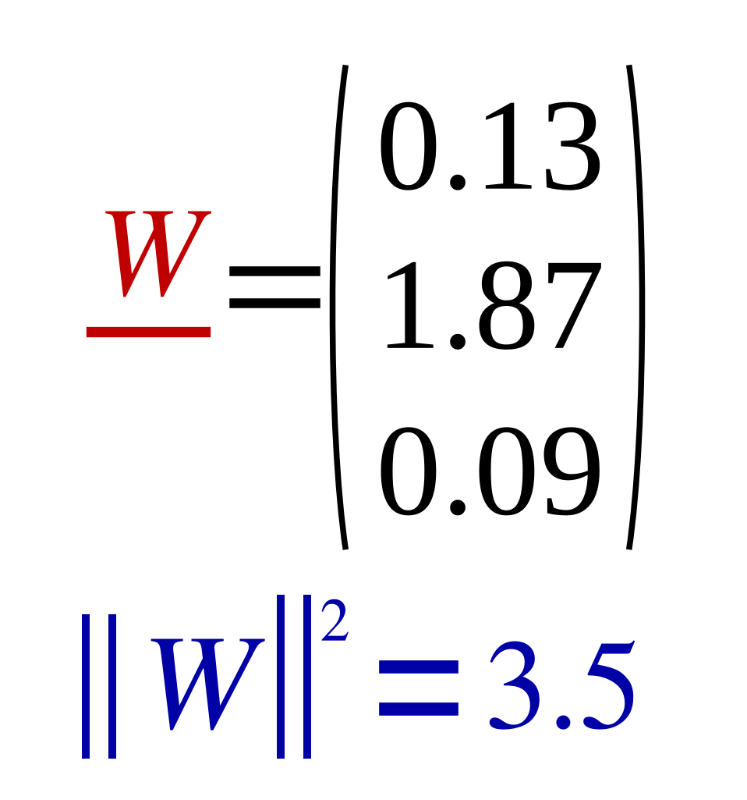
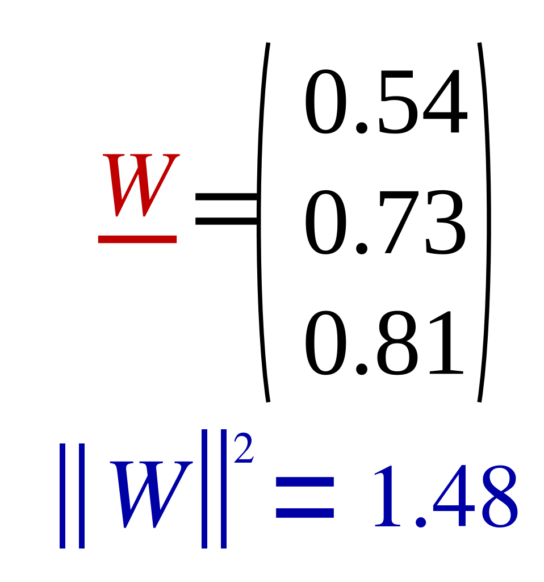
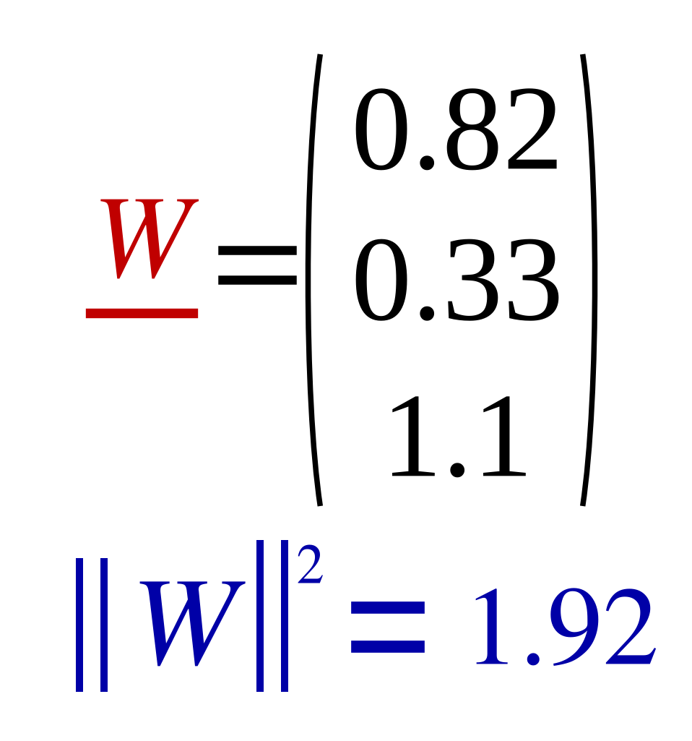
Adding Ridge Regularizer to the model λ=10
18
Train
Test
 | X1 | X2 | X3 | X4 | X5 | X6 | X7 | X8
X1 | 1 | 2 | 3 | 4 | 8 | 9 | 10 | 11
X2 | 1 | 3 | 5 | 6 | 16 | 7 | 5 | 3
y | 2 | 4 | 6 | 8 | 16 | 18 | 20 | 22
 | Test1 | Test2 | Test3
X1 | 30 | 40 | 50
X2 | 15 | 20 | 25
y | 57.4 | 76.5 | 95.6
 | X1 | X2 | X3 | X4 | X5 | X6 | X7 | X8
X1 | 1 | 2 | 3 | 4 | 8 | 9 | 10 | 30
X2 | 1 | 3 | 5 | 6 | 16 | 7 | 5 | 3
y | 2 | 4 | 30 | 8 | 16 | 18 | 20 | 22
 | Test1 | Test2 | Test3
X1 | 30 | 40 | 50
X2 | 15 | 20 | 25
y | 34.6 | 46.4 | 57.4
 | X1 | X2 | X3 | X4 | X5 | X6 | X7 | X8
X1 | 1 | 2 | 3 | 4 | 8 | 9 | 10 | 60
X2 | 1 | 3 | 5 | 6 | 16 | 7 | 5 | 3
y | 2 | 4 | 60 | 8 | 16 | 18 | 20 | 22
 | Test1 | Test2 | Test3
X1 | 30 | 40 | 50
X2 | 15 | 20 | 25
y | 26.8 | 35.4 | 44.1

