Slide 1

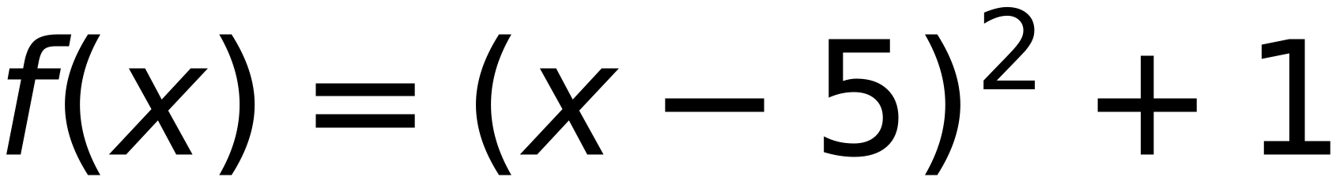

Convex Function,
Learning Rate =0.3,
Start at X=3
31
15
3
3
10
(2, 10)
(?, ?)
step
0.3
initial X
3
5
delta
0.1
X
is in between 4.8 and color red bold
5.1
(5, 1)
f(x)
is in between 1.04 and 1.01
-5
0
5
10
15
Bouncing
x
3
3.3
3.6
3.9
4.2
4.5
4.8
5.1
4.8
5.1
4.8
5.1
4.8
5.1
4.8
5.1
4.8
5.1
f(x)
5
3.89
2.96
2.21
1.64
1.25
1.04
1.01
1.04
1.01
1.04
1.01
1.04
1.01
1.04
1.01
1.04
1.01
x-delta
2.9
3.2
3.5
3.8
4.1
4.4
4.7
5
4.7
5
4.7
5
4.7
5
4.7
5
4.7
5
f(x-delta)
5.41
4.24
3.25
2.44
1.81
1.36
1.09
1
1.09
1
1.09
1
1.09
1
1.09
1
1.09
1
x+delta
3.1
3.4
3.7
4
4.3
4.6
4.9
5.2
4.9
5.2
4.9
5.2
4.9
5.2
4.9
5.2
4.9
5.2
f(x+delta)
4.61
3.56
2.69
2
1.49
1.16
1.01
1.04
1.01
1.04
1.01
1.04
1.01
1.04
1.01
1.04
1.01
1.04
slope
-8
-6.8
-5.6
-4.4
-3.2
-2
-0.8
0.4
-0.8
0.4
-0.8
0.4
-0.8
0.4
-0.8
0.4
-0.8
0.4
next x
3.3
3.6
3.9
4.2
4.5
4.8
5.1
4.8
5.1
4.8
5.1
4.8
5.1
4.8
5.1
4.8
5.1
4.8

