Slide 1

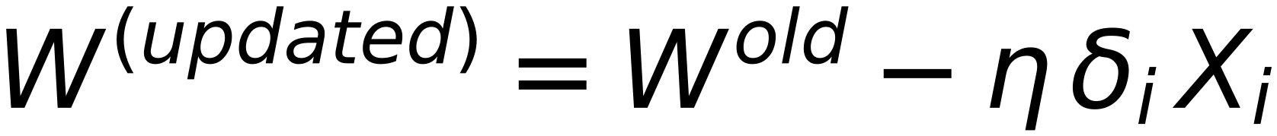
39
Gradient Descent (GD) – Stochastic Gradient Descent SGD)
and
Mini-Batch
Gradient Descent
Stochastic Gradient Descent (SGD) is a variant of GD which computes the gradient of the Error
function with respect to a single training example
In other words, it updates the weights using one training sample at a time
Remember: GD updated the weight vector after passing through ALL training samples.
$$W^{(updated)}=W^{old}-η δ_{i} X_{i}$$
Repeat for ALL misclassified Samples
Why using SGD
SGD is usually more efficient than GD
SGD converges faster than GD
Batch GD is a generalization of GD and SGD
where weights are updated after passing through
“Mini-Batch” of training samples with size n
If n=N (it is GD), and if n=1 (it is SGD)

