Slide 1
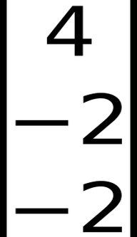
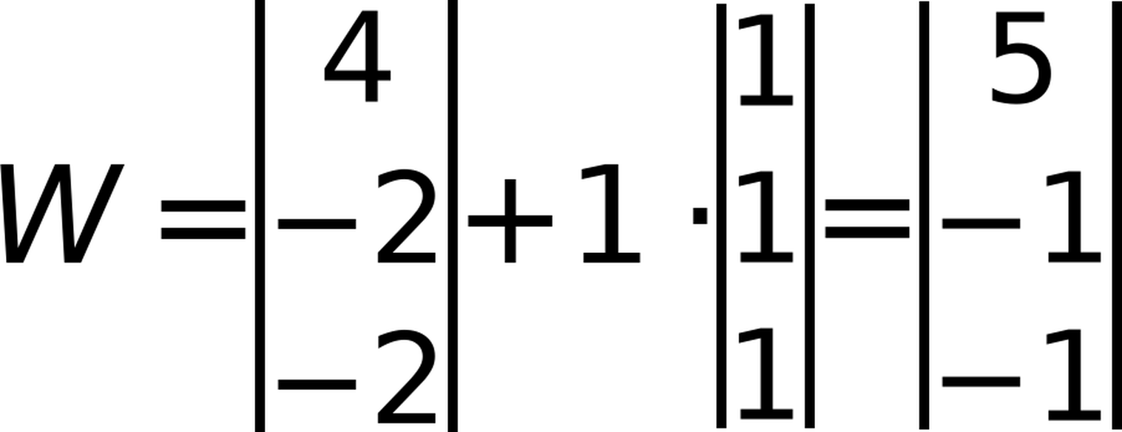
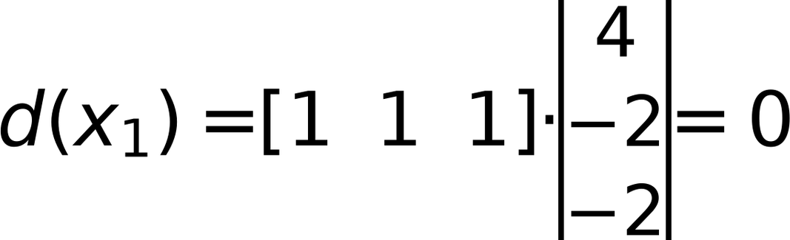
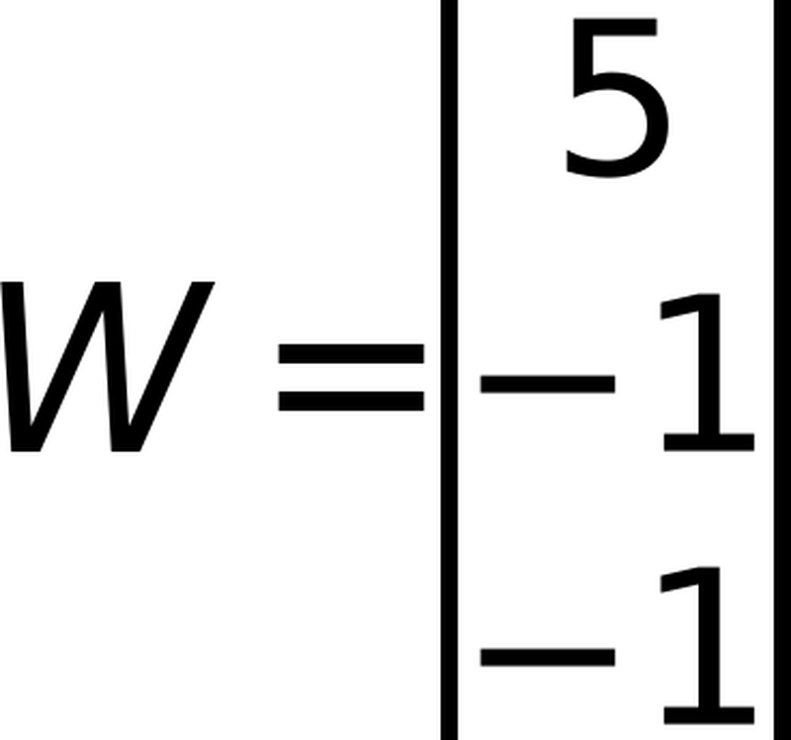
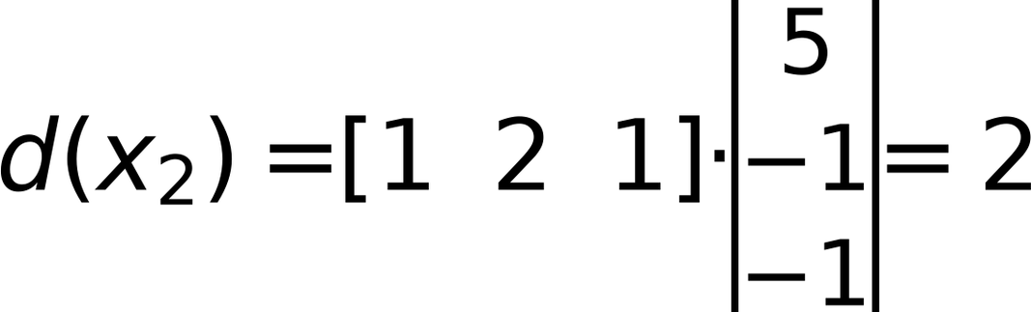
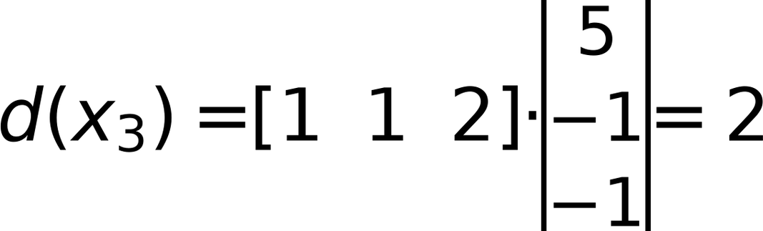
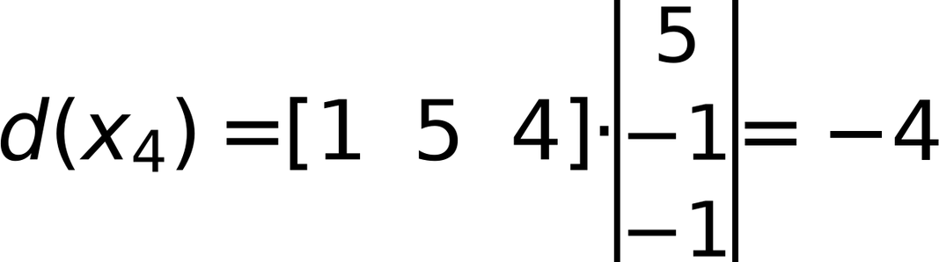
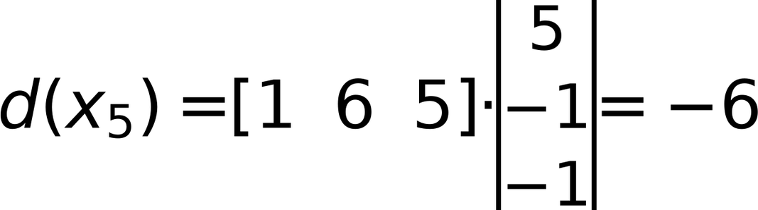
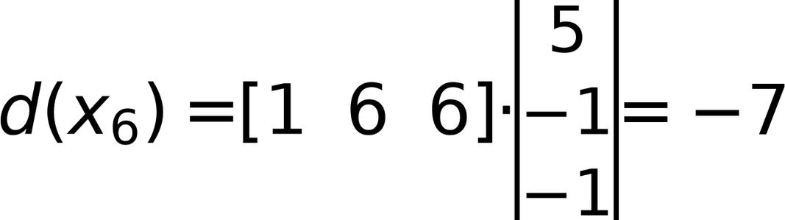
x₁
x₂
x₃
x₄
x₅
x₆
Initial W =
REPEAT using Step η = 1
48
1
2
1
5
6
6
Z1 | Z2 | Z3
0 | 7 | 3
0 | 6 | 2
(
)
(
)
(
)
(
)
(
)
(
)
Check classes of
1
1
2
4
5
6
1
2
2
4
5
6
C1
C1
C1
C2
C2
C2
C1 positive, C2 negative, Zero is unaccepted
⇒
Update Weight
Ugmented Vectors (from Top)
x₁ | x₂ | x₃ | x₄ | x₅ | x₆
1 | 1 | 1 | 1 | 1 | 1
1 | 2 | 1 | 5 | 6 | 6
1 | 1 | 2 | 4 | 5 | 6
C1 | C1 | C1 | C2 | C2 | C2
⇒
Keep same Weight
Iteration 1
⇒
Keep same Weight
⇒
Keep same Weight
⇒
Keep same Weight
⇒
Keep same Weight

