Slide 1
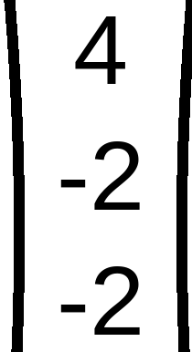
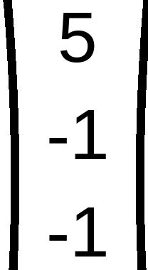
x₁
x₂
x₃
x₄
x₅
x₆
Initial W
REPEAT using Step η = 1
49
(
)
(
)
(
)
(
)
(
)
(
)
Z₁
Z₂
Z₃
1
2
1
5
6
6
Check classes of
0
7
3
1
1
2
4
5
6
0
6
2
C₁
C₁
C₁
C₂
C₂
C₂
C₁ positive C₂ negative Zero is unaccepted
Ugmented Vectors (from Top)
1
1
1
x₁
x₂
x₃
x₄
x₅
x₆
d(x₁) =
=
3
⇒
Keep same Weight
W =
1
1
1
1
1
1
1
2
1
5
6
6
1
1
2
4
5
6
1
2
1
C₁
C₁
C₁
C₂
C₂
C₂
d(x₂) =
=
2
⇒
Keep same Weight
W =
Iteration 2
1
1
2
d(x₃) =
=
2
⇒
Keep same Weight
W =
No change in
W
1
5
4
d(x₄) =
=
−4
⇒
Keep same Weight
W =
Stop
Iterations
1
6
5
d(x₅) =
=
−6
⇒
Keep same Weight
W =
1
6
6
d(x₆) =
=
−7
⇒
Keep same Weight
W =

