Slide 1
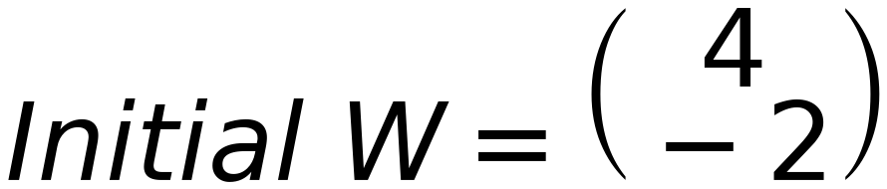
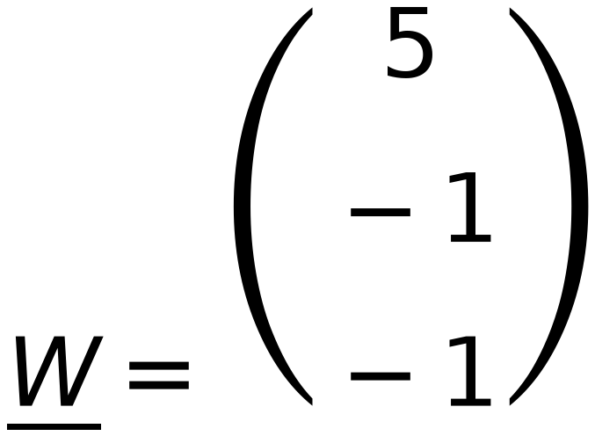



x₁
x₂
x₃
x₄
x₅
x₆
REPEAT using Step
50
(1)
(2)
(1)
(5)
(6)
(6)
Z₁
Z₂
Z₃
Check classes of
(1)
(1)
(2)
(4)
(5)
(6)
C₁ positive C₂ negative Zero is unaccepted
C₁
C₁
C₁
C₂
C₂
C₂
Augmented Vectors (from Top)
x₁
x₂
x₃
x₄
x₅
x₆
(1)
(1)
(1)
(1)
(1)
(1)
(1)
(2)
(1)
(5)
(6)
(6)
(1)
(1)
(2)
(4)
(5)
(6)
7
C₁
C₁
C₁
C₂
C₂
C₂
6
Iteration 2
5
4
+ve
3
No change in W
Stop Iterations
2
1
0
0
1
2
3
4
5
6
7
8

