Slide 1
Introduction to
Machine Learning
1
CSAI 253 - Spring 2024
Prepared By
Dr. Khaled Mostafa ElSayed
kmelsayed@zewailcity.edu.eg
Instructors:
Dr. Khaled Mostafa ElSayed
kmelsayed@zewailcity.edu.eg
Dr. Mohamed Maher Ata
momaher@zewailcity.edu.eg
جامعة العلوم والتكنولوجيا
University of Science and Technology
ZEWAIL CITY

Slide 2
Artificial Intelligence
2
Artificial Intelligence
Rule Based
(Expert Systems)
Data Based
(Machine Learning)

Slide 3
What is Machine Learning?
3
Machine Learning:
•
Designing algorithms that can learn patterns from data (and
exploit them)
•
Approach: human supplies training examples, the machine
learns
•
Example: Show the machine a bunch of spam and legitimate emails and
let it learn to predict if a new email is spam or not

Slide 4
What is Machine Learning?
4
Machine Learning primarily uses the statistically motivated
approach
-
No hand-crafted rules - subtle pattern nuances are often be difficult to
specify
-
Instead, let the machine figure out the rules on its own by building
statistical models of the data
Desirable Property: Generalization
•
The model shouldn't overfit on the training data
•
It should generalize well on unseen (future) test data

Slide 5
Machine Learning in the real-world
5
Broadly applicable in many domains (e.g., finance, robotics,
bio-informatics, vision, natural language, etc.). Some applications:
Spam filtering
Machine Translation (e.g., Google Translate)
Speech/handwriting recognition
Object detection/recognition
Weather prediction
Classifying DNA sequences
Stock market analysis
Automatic vehicle navigation
Search engines (e.g, Google)
Credit-card fraud detection
Webpage clustering (e.g., Google News)
.. and many more

Slide 6
Major Domains
of
Machine/Deep Learning
6
Time Series
Computer
Vision
Speech
Natural
Language
Processing

Slide 7
Programming Languages, Platforms, and
Libraries
7
Popular Languages for ML/DL
Python
R
Matlab
Popular Platforms for ML/DL
+ Keras
Tensor Flow
Pytorch
Popular Libraries (for python)
SciKit Learn
SciPy
NLTK
Spacy
Gensim
OpenCV

Slide 8
Major Machine Learning Paradigms
8
Nomenclature: x denotes an input, y denotes output/label/prediction
[1] Supervised Learning: learning with a teacher
• Given: N labeled training examples {(x₁ , y₁ ), . . . , (x_{N} , y_{N} )}
• Goal: learn mapping f that predicts label y for a test example x
• Example: Spam classification, webpage categorization
[2] Unsupervised Learning: learning without a teacher
• Given: a set of N unlabeled inputs {x₁ , . . . , x_{N} }
• Goal: learn some intrinsic structure in the inputs (e.g., groups/clusters)
• Example: Automatically grouping news stories (Google News)

Slide 9
Major Machine Learning Paradigms
9
[3] Reinforcement Learning: learning by interacting
• Given: an agent acting in an environment (having a set of states)
• Goal: learn a policy (state to action mapping) that maximizes agent's reward
• Example:
• Automatic vehicle navigation, (computer) learning to play Chess

Slide 10
Supervised Learning
10
Given: N labeled training examples {(x₁, y₁), . . . , (x_{N}, y_{N})}
Goal: learn a model that predicts the label y for a test example x
Assumption: The training and the test examples are drawn from the same data distribution
Things to keep in mind:
No single learning algorithm is universally good ("no free lunch")
Different learning algorithms work with different assumptions
Generalization is particularly important for supervised learning

Slide 11
Supervised Learning
11
f : x → y { f is a function from X to Y }
Classification:
y is a discrete variable
Discrete variable: takes a value from a discrete set y ∈ {1, . . . , K }
Example: Category of a web page (sports, politics, business, science, etc.)
Regression:
y is a real-valued variable
Example: Price of a stock

Slide 12
Supervised Learning: Classification
12
Problem Types:
[1] Binary Classification:
y is binary (two classes: 0/1 or -1/+1)
Example: Spam Filtering (tell whether this email is spam or legitimate)
[2] Multi-class Classification:
y is discrete with one of K > 2 possible values
Example: Predicting your class grade (e.g., A, A−, B+, B, B−, other)

Slide 13
Supervised Learning: Classification
13
[3] Multi-label Classification:
When y is a vector of discrete variables
Each input x has multiple labels
Each element of y is one label (individual labels can be binary/multi-class)
Example: Image annotation (each image can have multiple labels)
[4] Structured Prediction: When y is a vector with a structure
Elements of y are not independent but related to each-other
Example: Predicting parts-of-speech (POS) tags for a sentence
Input | The | man | ate | the | really | tasty | sandwich
Output | DET | NOUN | VERB | DET | ADV | ADJ | NOUN

Slide 14
Supervised Learning: Regression
14
Problem Types:
Univariate Regression:
y is a single real-valued number
Example: Predicting the future price of a stock
Multivariate Regression:
y is a real-valued vector
Each element of y tells the value of one response variable
Example: Torque values in multiple joints of a robotic arm

Slide 15
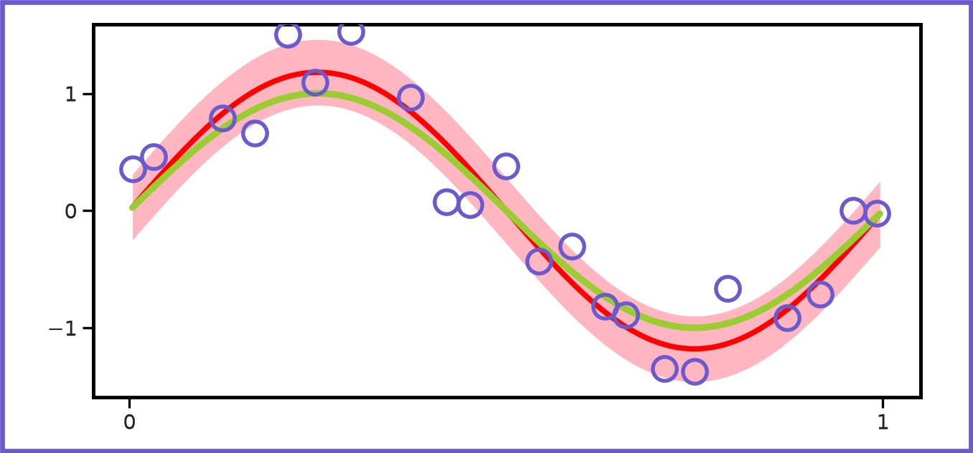
Classification vs Regression
15
Classification is about finding separation boundaries (linear/non-linear):
x
x
x
x
x
x
x
x
x
x
Regression is more like fitting a curve/surface to the data:

Slide 16
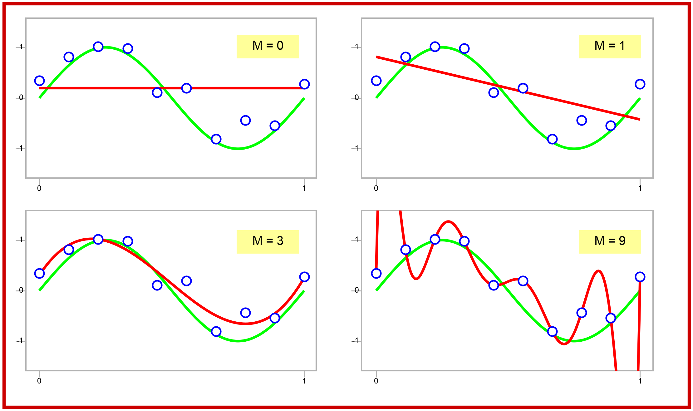
Data Overfit and Underfit
16
The X axis is the input. The Y axis is the response.

Slide 17
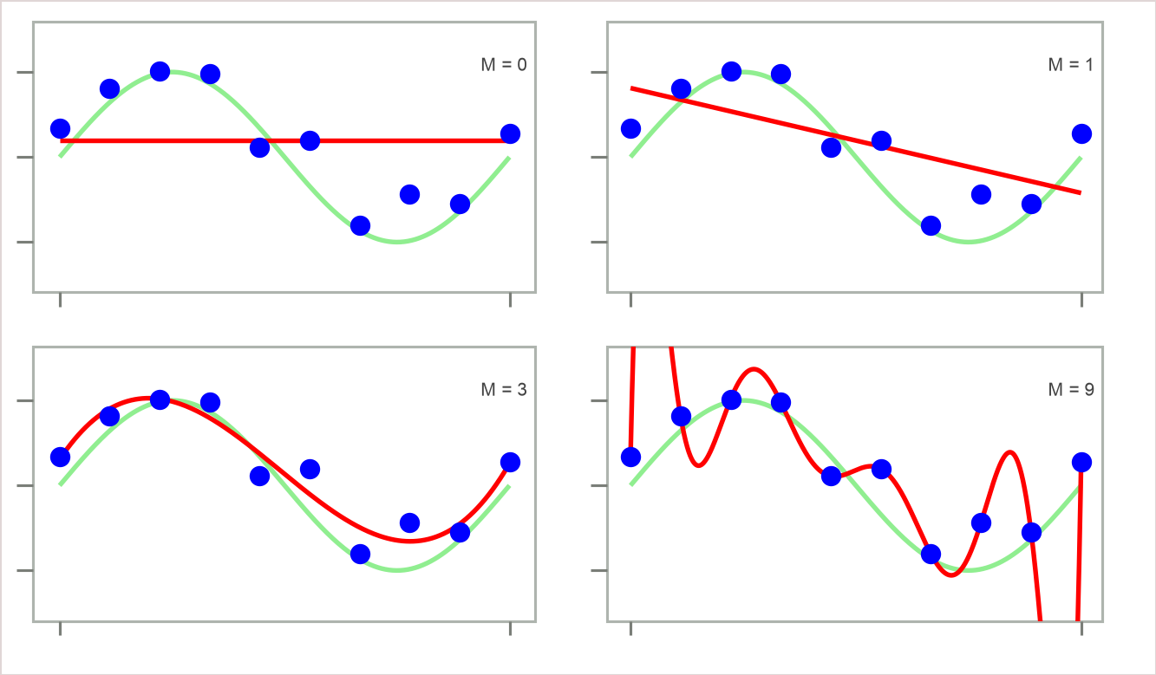
Data Overfit and Underfit
17
Questions:-
• Which of the four red curves fits the data
(blue dots) best?
• Which curve is expected to generalize the
best?
Are they both the same? If yes, why? If no, why not?

Slide 18
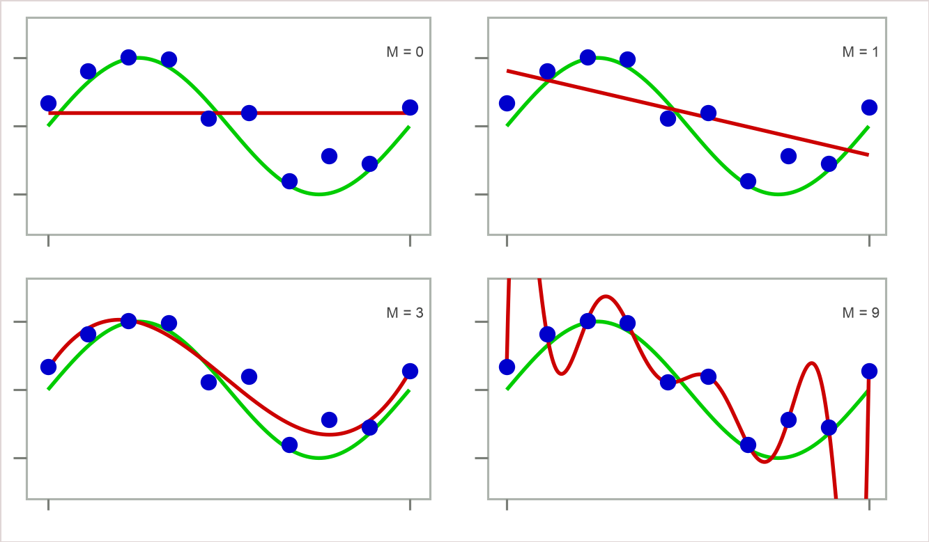
Data Overfit and Underfit
18
Questions:-
• Which of the four red curves fits the data (blue dots) best?
• Which curve is expected to generalize the best?
Are they both the same? If yes, why? If no, why not?
Lesson: Simple models should be preferred over complicated models
Simple models can prevent overfitting
Too simple a model can underfit (e.g., M = 0 above)
General guideline: Choose a model not-too-simple, yet not-too-complex

Slide 19
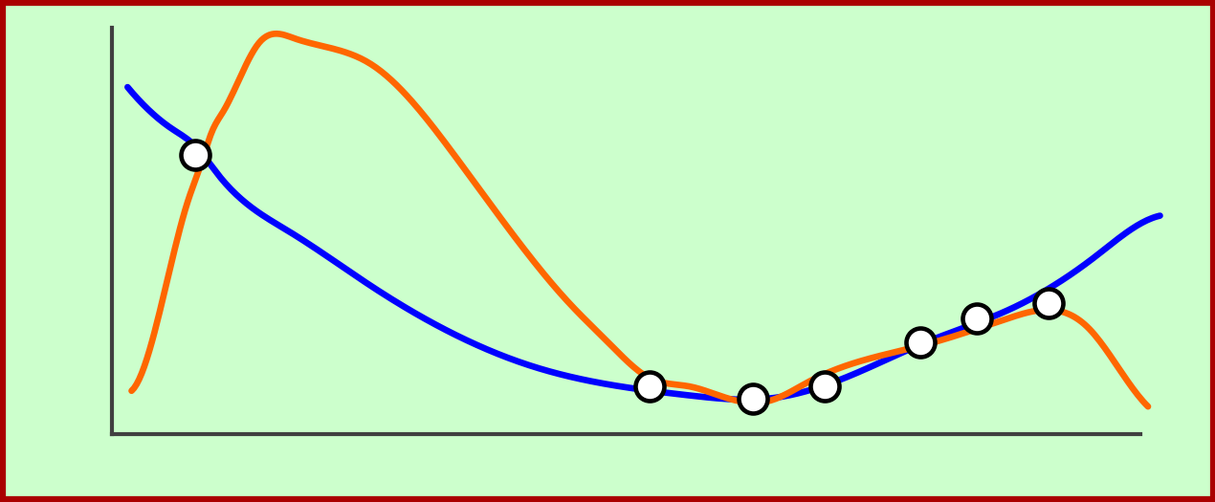
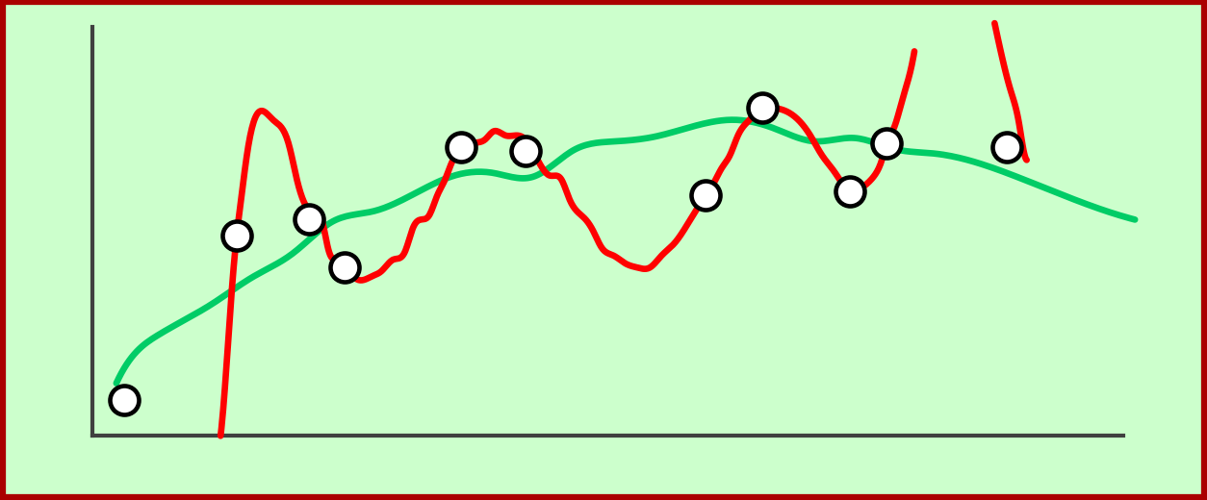
Data Overfit and Underfit
19
Classification
Under-fitting
Appropriate-fitting
Over-fitting
(too simple to
explain the
variance)
(forcefitting -- too
good to be true)
Data
Target
Regression
Fit
y
y
Data
2nd Order Fit
x
x
10th Order Fit

Slide 20
Reinforcement Learning (RL)
20
•
Unlike supervised/unsupervised learning, RL does not receive
examples
•
Rather, it learns (gathers experience) by interacting with the world
•
Defined by an agent and an environment the agent acts in
•
Agent has a set A of actions, environment has a set S of states
•
Goal: Find a sequence of actions by the agent that maximizes
its reward
•
Output: A policy which maps states to actions
•
RL problems always include time as a variable
•
Example problems: Chess, Robot control, autonomous driving

Slide 21
Other Paradigms: Semi-supervised Learning
21
Supervised Learning requires labeled data (the more, the
better!)
Problem 1: Labeling is expensive (usually done by humans)
Problem 2: Sometimes labels are really hard to get
How can we learn well even with small amounts of labeled
data?
One answer: Semi-supervised Learning
Using small amount of labeled + plenty of (freely available)
unlabeled data

Slide 22
Other Paradigms: Active Learning
22
• Similar motivation as semi-supervised learning (saving data labeling cost)
• Standard supervised learning is passive
– Learner has no choice for the data it has to learn from
– Not all labeled examples are really informative
– Spending labeling efforts on uninformative examples isn't really worth it
• Active Learning: allows the learner to ask for specific labeled examples
– .. the ones it considers the most informative
• Active Learning can lead to several benefits:
– Less labeled data needed to learn
– Better classifiers

Slide 23
Data Sets
23
Data Sets

Slide 24
Data Sets for Model
Training
24
Training
(e.g. 75%)
Validation
(e.g. 10%)
Testing
(e.g. 15%)
Used to Train the
Model
Used for Testing during
Training (Stopping criteria)
Used to test
the final Model
Annotated and unannotated data
Do you have labels for your Dataset ???

Slide 25
Data Representation
25
+
Data has form: {(x₁ , y₁), . . . , (x_{N} , y_{N})} (labeled), or {x₁ , . . . , x_{N}} (unlabeled)
Each example X is a set of (numeric) features / attributes / dimensions
X is commonly represented as a D × 1 vector
  Representing a 28 × 28 image: x can be a 784 × 1 vector of pixel values
  Representing a text document: x can be a vector of word-counts of words appearing in that document

Slide 26
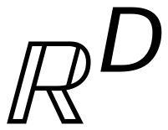
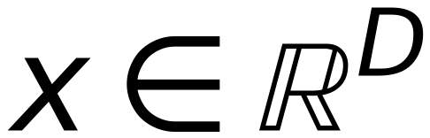
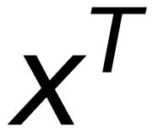
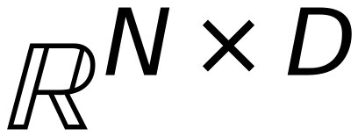
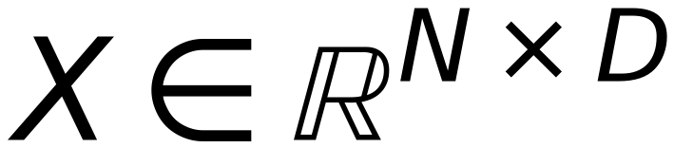








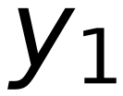
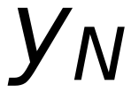
Some Notations
26
$$ℝ^{D}$$
denotes the set of all D × 1 real-valued column vectors
$$x∈ℝ^{D}$$
denotes a D × 1 real-valued column vector
$$x^{T}$$
denotes the transpose of x, a 1 × D row vector
$$ℝ^{N×D}$$
denotes the set of all N × D real-valued matrices
$$X∈ℝ^{N×D}$$
denotes an N × D real-valued matrix
Supervised Learning: Often, we write
$$\{(x_{1},y_{1}),…,(x_{N},y_{N})\} as (X,Y)$$
X is an N × D matrix
Each row of X denotes an example,
$$x_{1}$$
$$x_{11} … x_{1D}$$
each column denotes a feature
$$X =$$
$$=$$
$$x_{ij}$$
denotes the j-th feature of the
$$⋮$$
$$⋮$$
$$x_{N}$$
$$x_{N1} … x_{ND}$$
i-th example
Y is an N × 1 vector. Row i denotes
$$y_{1}$$
the label of the i-th example
$$Y =$$
$$⋮$$
$$y_{N}$$

Slide 27
Non-Numeric
Data Representation
27
What if the data has a non-numeric representation (e.g. Tennis Playing
example)
Features are nominal (Low/High, Yes/No, Overcast/Rainy/Sunny, etc.)
Features with only 2 possible values can be represented as 0/1
What about features having more than 2 possible values?
Can't we just map Sunny to 0, Overcast to 1, Rainy to 2?
P
Play
Y
Out
T
R
Y
Out
T
R
P
Sunny
Low
Yes
1
?
1
1
N
No Play
N
Sunny
High
Yes
0
?
0
1
N
Sunny
High
No
0
?
0
0
Out
Outlook
P
Overcast
Low
Yes
1
?
0
0
P
Overcast
High
No
1
?
0
0
T
Temperature
P
Overcast
Low
No
1
?
0
1
R
Humidity
P
Rainy
Low
Yes
0
?
0
0
N
Rainy
Low
No
1
?
0
1

Slide 28
Data Representation
28
Well, we could map Sunny to 0, Overcast to 1, Rainy to 2..
But such a mapping may not always be appropriate
Imagine color being a feature in some data
Let's code 3 possible colors as Red=0, Blue=1, Green=2
This implies Red is more similar to Blue than to Green !
Solution: For a feature with K > 2 possible values, we usually create K
binary features, one for each possible value
Replace
Y | Out | T | R
P | Sunny | Low | Yes
N | Sunny | High | Yes
N | Sunny | High | No
P | Overcast | Low | Yes
P | Overcast | High | No
P | Overcast | Low | No
N | Rainy | Low | Yes
P | Rainy | Low | No
Y | S? | O? | R? | T | R
1 | 1 | 0 | 0 | 0 | 1
0 | 1 | 0 | 0 | 1 | 1
0 | 1 | 0 | 0 | 1 | 0
1 | 0 | 1 | 0 | 0 | 1
1 | 0 | 1 | 0 | 1 | 0
1 | 0 | 1 | 0 | 0 | 0
0 | 0 | 0 | 1 | 0 | 1
1 | 0 | 0 | 1 | 0 | 0
Out
Outlook
With
S
Sunny
O
Overcast
R
Rainy

Slide 29
The Complete
Machine Learning
Classification Process
29

Slide 30
The Complete ML Classification Process
30
Training Data
Pre
processing
Feature Extraction
Feature Selection
Classification
Post
processing
Cleaned Data
Feature Vectors
Final Features
Predicted Class
Final Result

Slide 31
Pre processing
31
Preprocessing is Problem dependent and data dependent
It may include:
Gap filling
• Thinning
• Contour
• Binarization
• Noise Removal
• Color to Gray
• Opening touched points
• Resizing
• Normalization
• ......

Slide 32
Feature Extraction
32
Features Types are is Problem dependent
Features may include:
• Center of Gravity location,
• Aspect Ratio,
• Length and Width,
• Number of intersections,
• Moments,
• Geometrical Features ,
• Colors,
• Transformations
• .........

Slide 33
Feature Invariants
33
Features Invariants are Problem dependent
• Rotation Invariant
• Scaling Invariant
• Translation invariant
• Mirroring Invariant

Slide 34
Classification
34
Classification Techniques are based on Data separability nature
From the separability point of view data can be classified into :
•
Linearly Separable
(Use Linear classifier)
•
Non-Linearly Separable
(Use Non-Linear classifier)
•
Non-Separable
(Use Kernels with Classifiers)

Slide 35
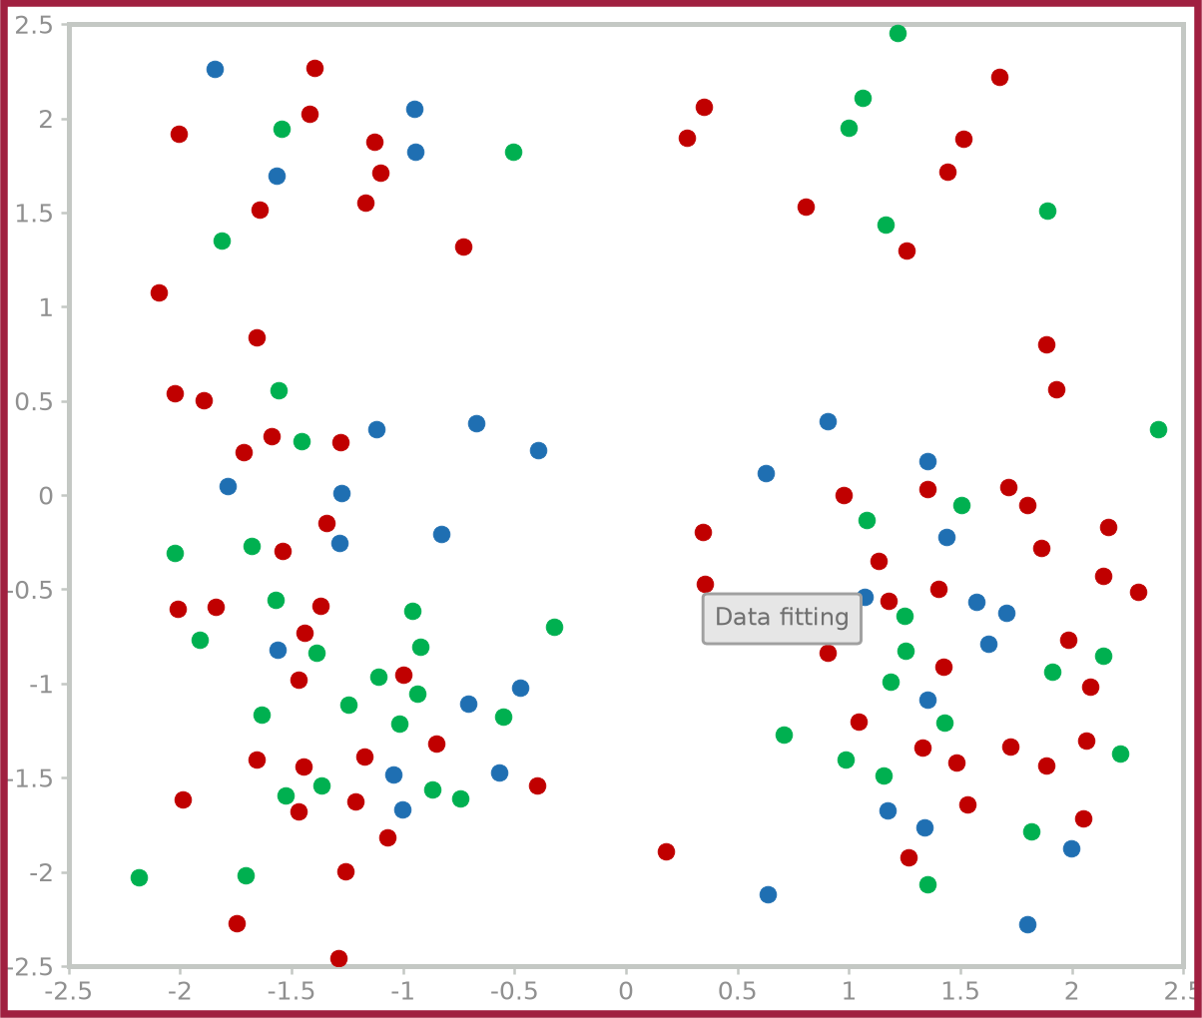
Linearly separable vs. Not linearly separable
35
Linearly separable
Not linearly separable
A linear decision boundary that separates the two classes exists
No linear decision boundary that separates the two classes perfectly exists
x2
x2
Nonlinear boundary
x2
Linear boundary
x1
x1
x1

Slide 36
Classification
36
Examples of Commonly used classifiers:
• Linear Regression
• Logistic Regression
• Neural Network
• Support Vector Machine
• Hidden Markov Model
• Decision Trees
• Bayesian classifier
• .......

Slide 37
Main Classification
Learning Approaches
37
Supervised Learning
Unsuepervised Learning
Data Labels are required for training
No Need for Data Labels
(A.K.A Clustering)

Slide 38
How Training Takes Place to learn the model ?
38
Classification Model
(with Model Parameters)
Predicted Class
(Label)
True Label
of the Sample
Training Sample
Error
Try to update model parameters (Iteratively) to minimize error (Loss Function)

Slide 39
Nearest Neighbor (NN)
and
K -Nearest Neighbor (K -NN)
39

Slide 40
K -Nearest Neighbor (K -NN)
40
• Given: training data D = {(x₁ , y₁ ), . . . , (x_{N} , y_{N} )} and a test point
• Prediction Rule: Look at the K most similar training examples
– For classification: assign the majority class label (majority voting)
– For regression: assign the average response
• The algorithm requires:
– Parameter K : number of nearest neighbors to look for

Slide 41
K -Nearest Neighbors Algorithm
41
• Compute the test point’s distance from each training point
• Sort the distances in ascending (or descending) order
• Use the sorted distances to select the K nearest neighbors
• Use majority rule (for classification) or averaging (for regression)
Note: K -Nearest Neighbors is called a non-parametric method
Unlike other supervised learning algorithms,
K -Nearest Neighbors doesn’t:
– learn an explicit mapping f from the training data
– It simply uses the training data at the test time to make predictions

Slide 42
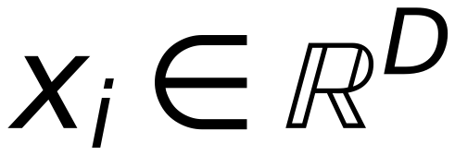
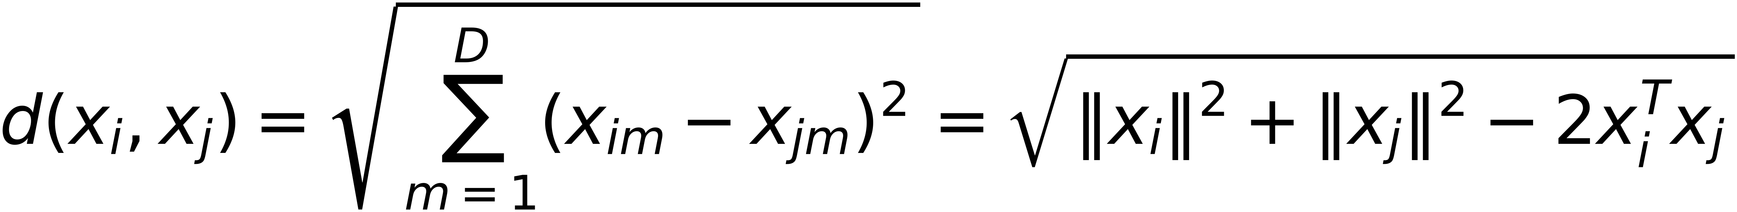
K-NN: Computing the distances
42
• The K-NN algorithm requires computing distances of the test example from each of the training examples
• Several ways to compute distances
• The choice depends on the type of the features in the data
• Real-valued features (
$$x_{i}∈ℝ^{D}$$
): Euclidean distance is commonly
used
$$d(x_{i},x_{j})=\sqrt{\sum_{m=1}^{D}{(x_{im}-x_{jm})^{2}}}=\sqrt{‖x_{i}‖^{2}+‖x_{j}‖^{2}-2x_{i}^{T}x_{j}}$$

Slide 43
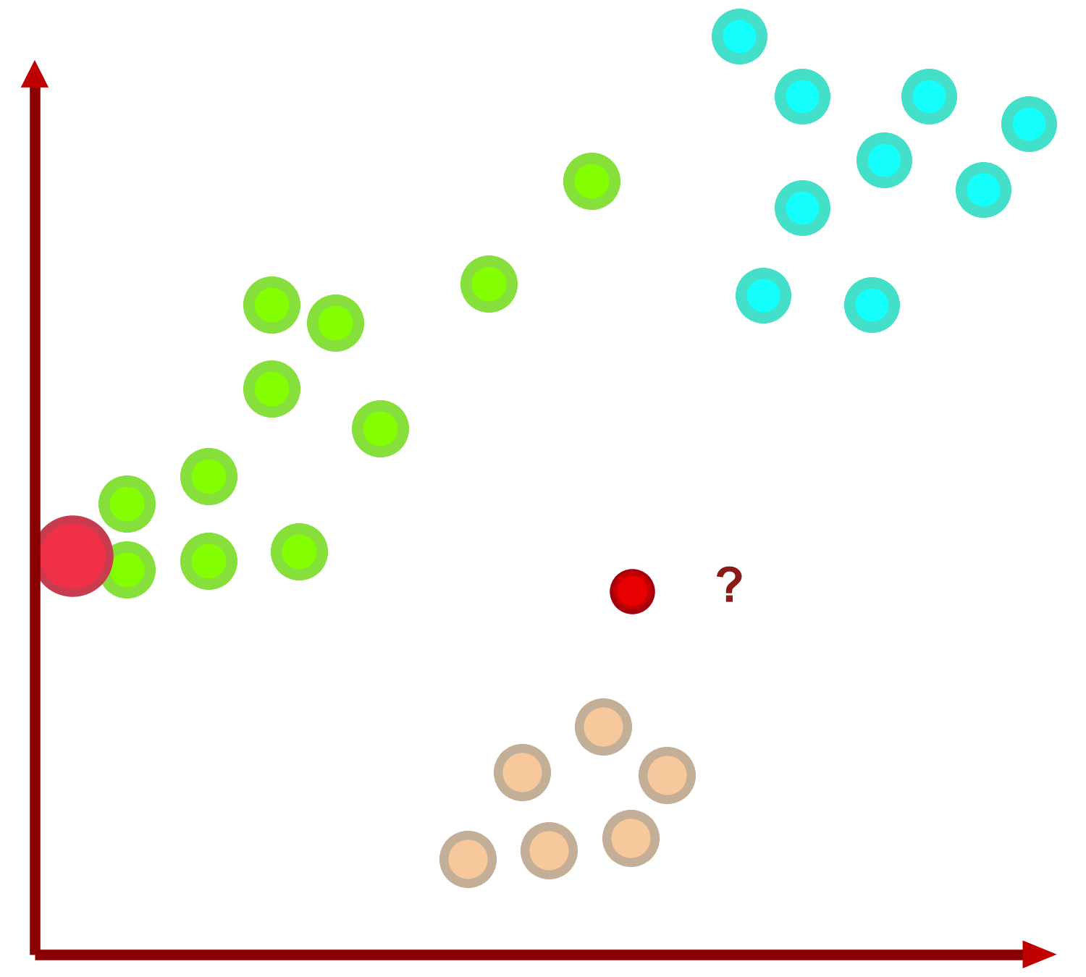
Nearest Neighbors (NN) Example
43
Data of Three Classes and ONE TEST sample

Slide 44
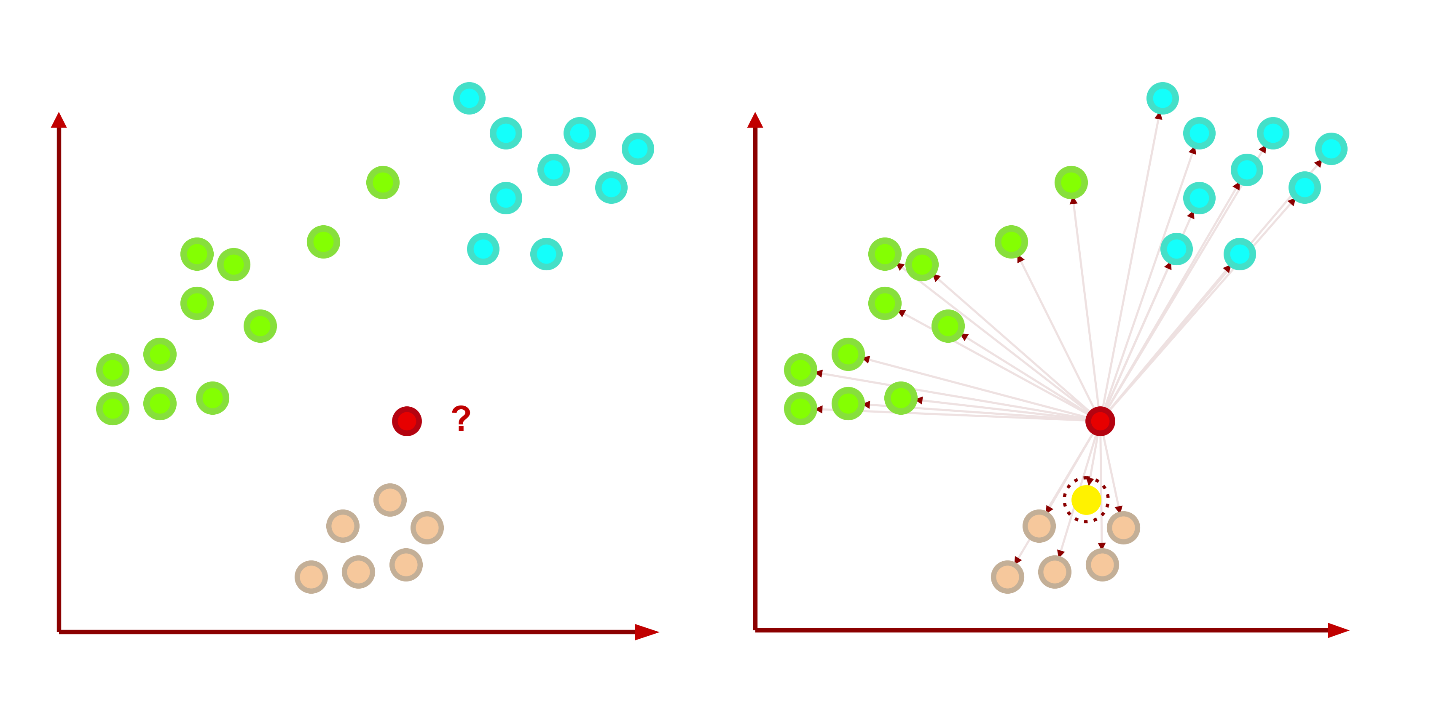
Nearest Neighbors (NN) Example
44
Data of Three Classes
Nearest Neighbor is the Orange class

Slide 45
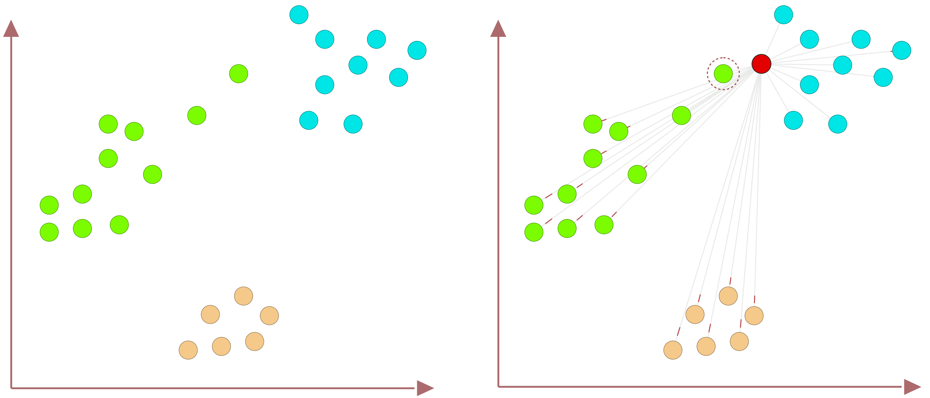
Nearest Neighbors (NN) Outlier Problem
45
Data of Three Classes
Nearest Neighbor is the Green class

Slide 46
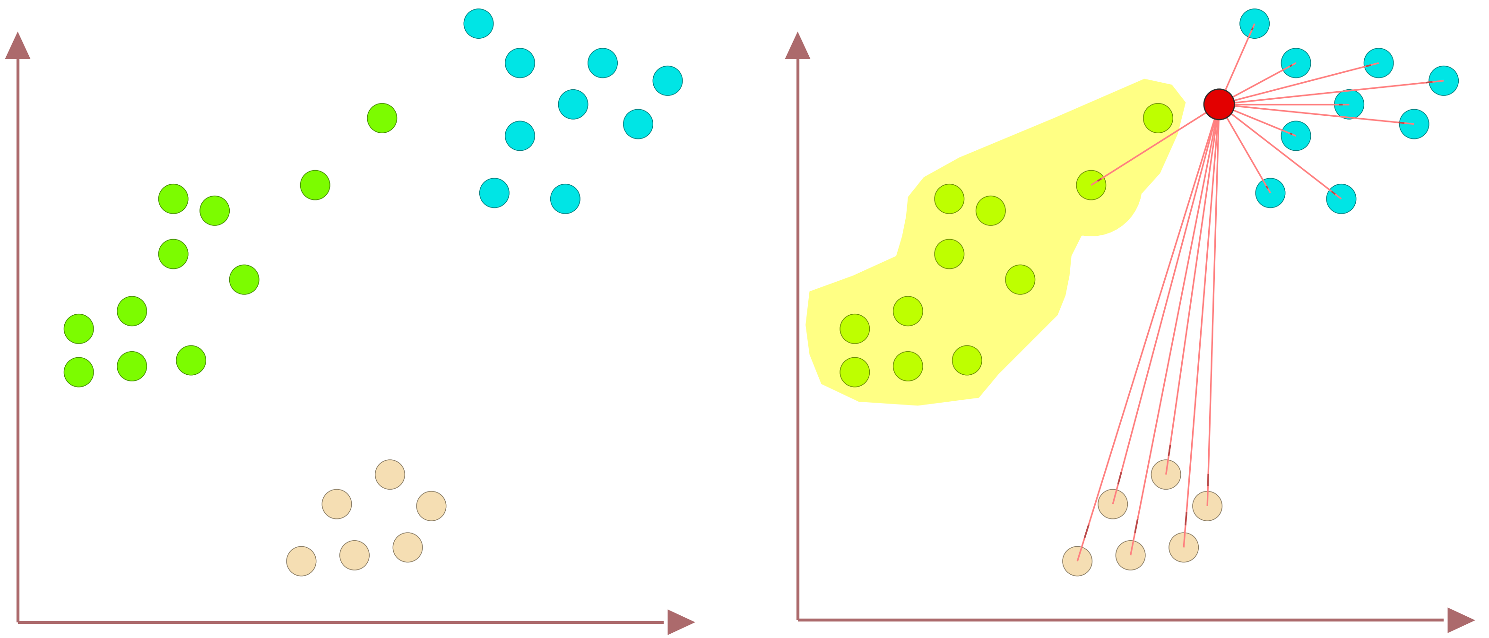
Nearest Neighbors (NN) Outlier Problem
46
Outlier
Sample
Data of Three Classes
Nearest Neighbor is the Green class

Slide 47
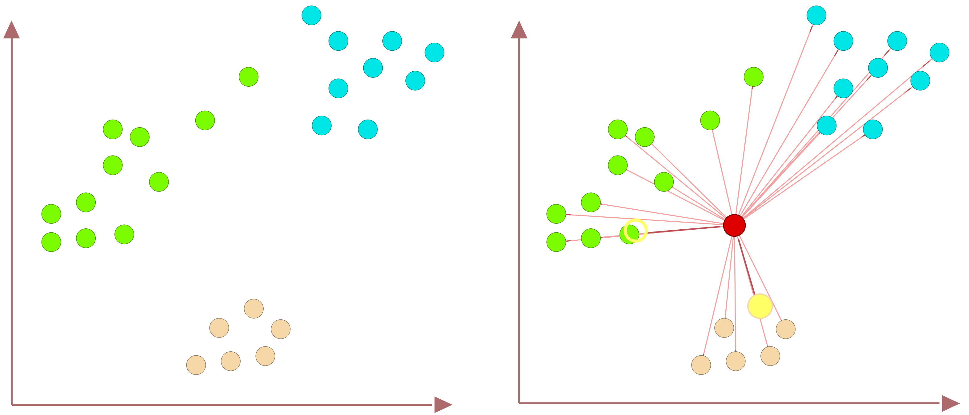
Nearest Neighbors (NN) Equal Distance
47
Data of Three Classes
No Unique Nearest Neighbor

Slide 48
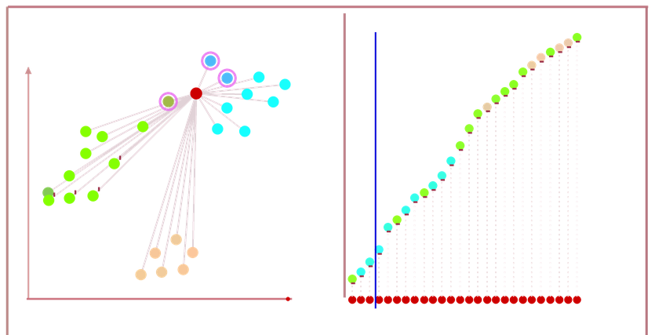
K-Nearest Neighbors (KNN) , K=3
48
K=3, cyan class
Select Nearest 3 Neighbors
Vote on 3 Nearest Neighbors

Slide 49
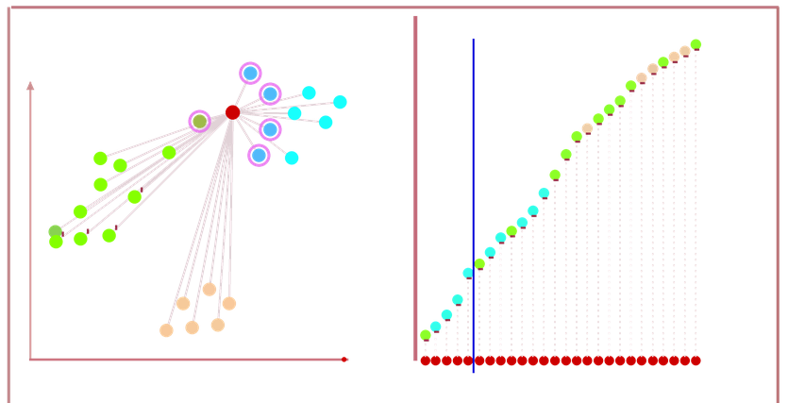
K-Nearest Neighbors (KNN) , K=5
49
K=5, cyan class
Select Nearest 5 Neighbors
Vote on 5 Nearest Neighbors

Slide 50
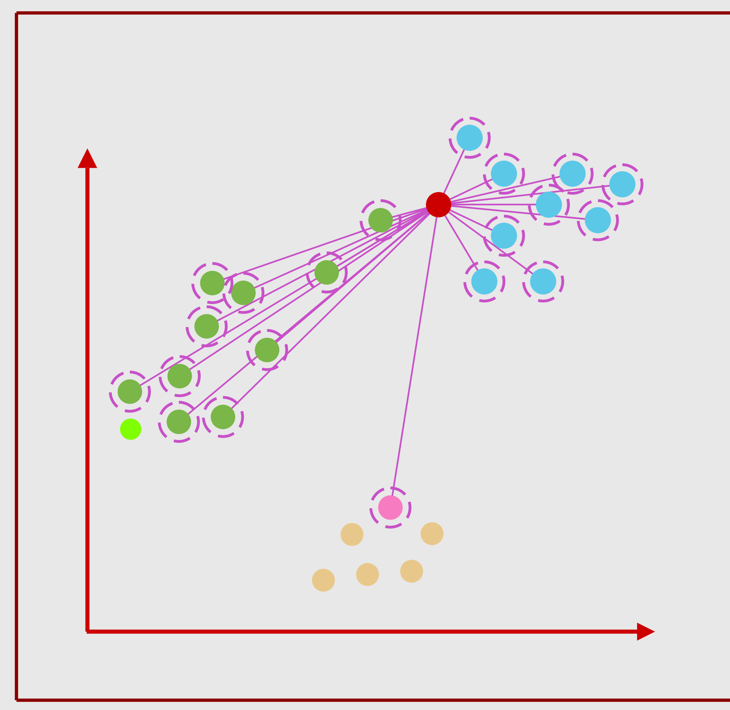
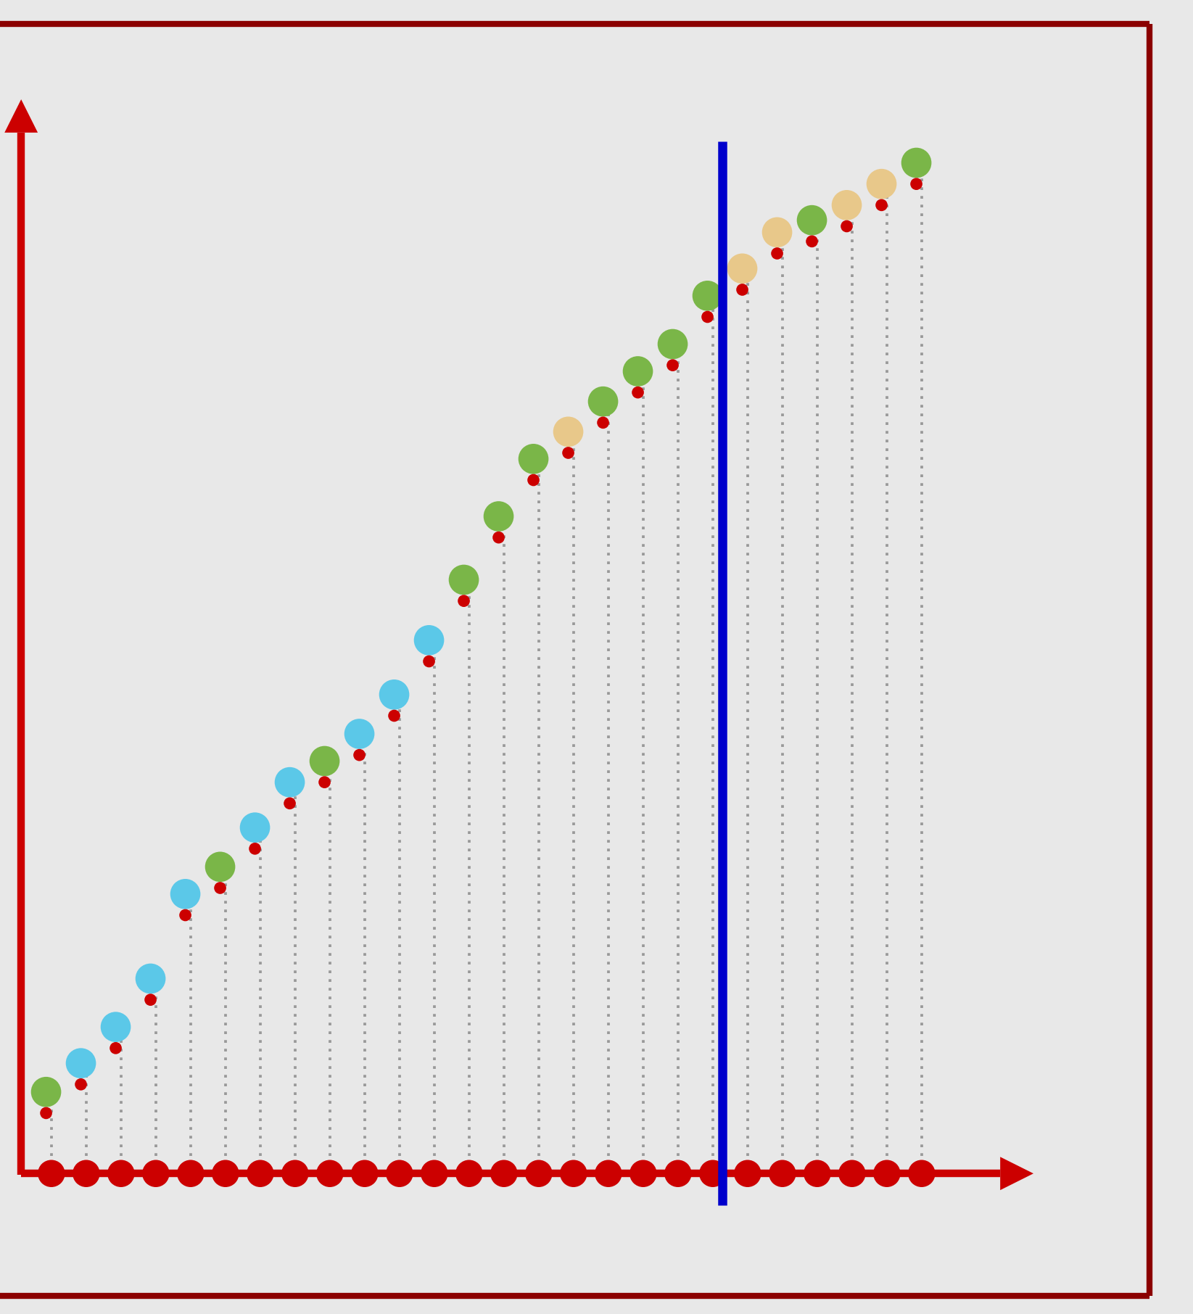
K-Nearest Neighbors (KNN) , K=20
50
K=20, green class
Select Nearest 20 Neighbors
Vote on 20 Nearest Neighbors

Slide 51
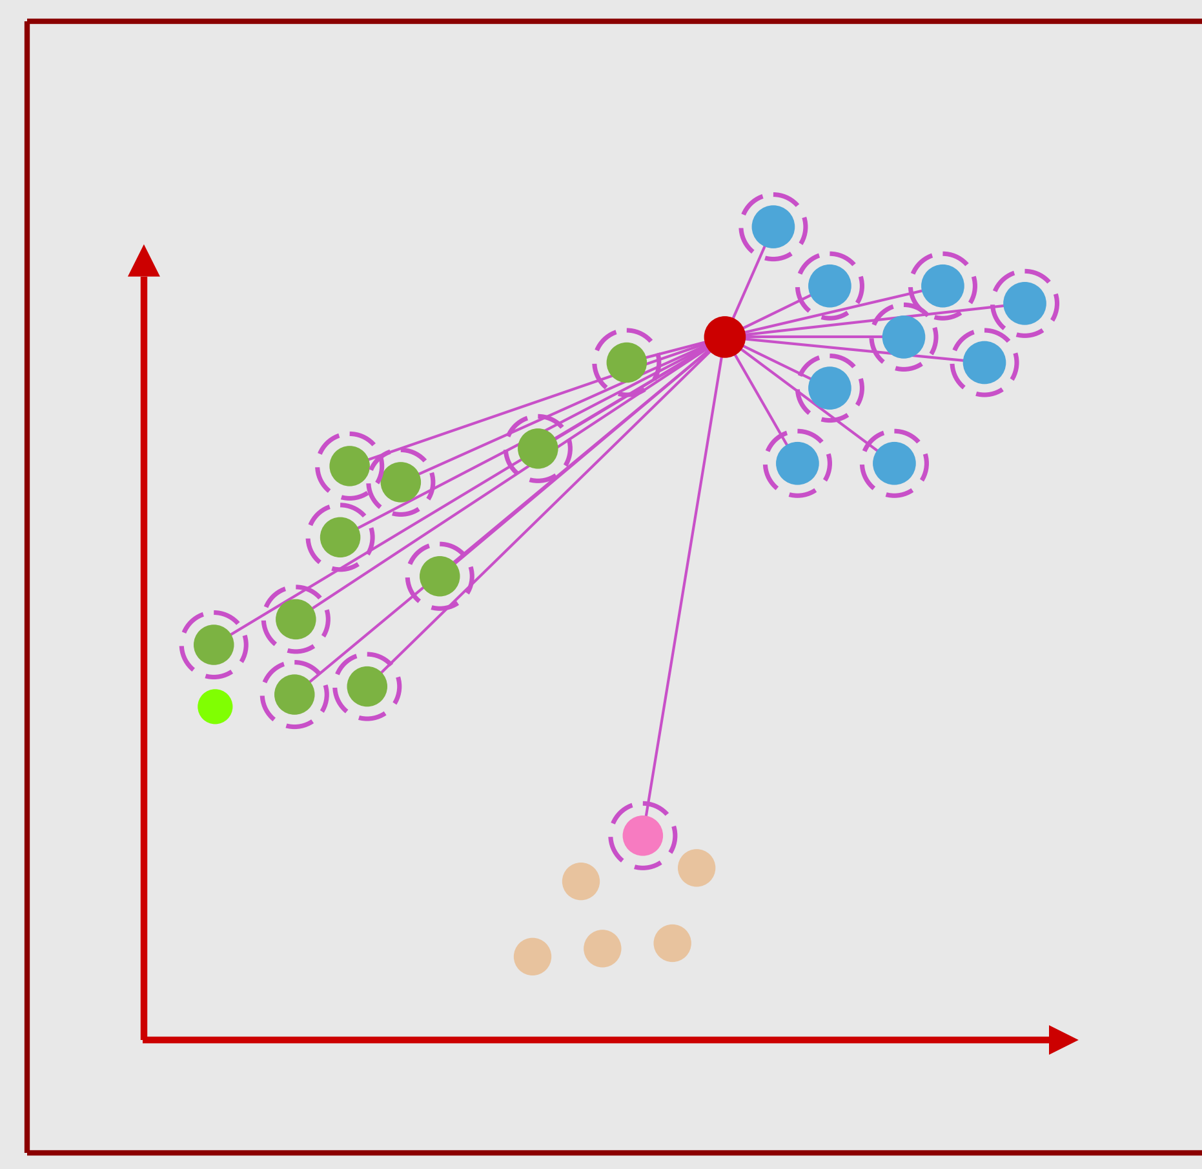
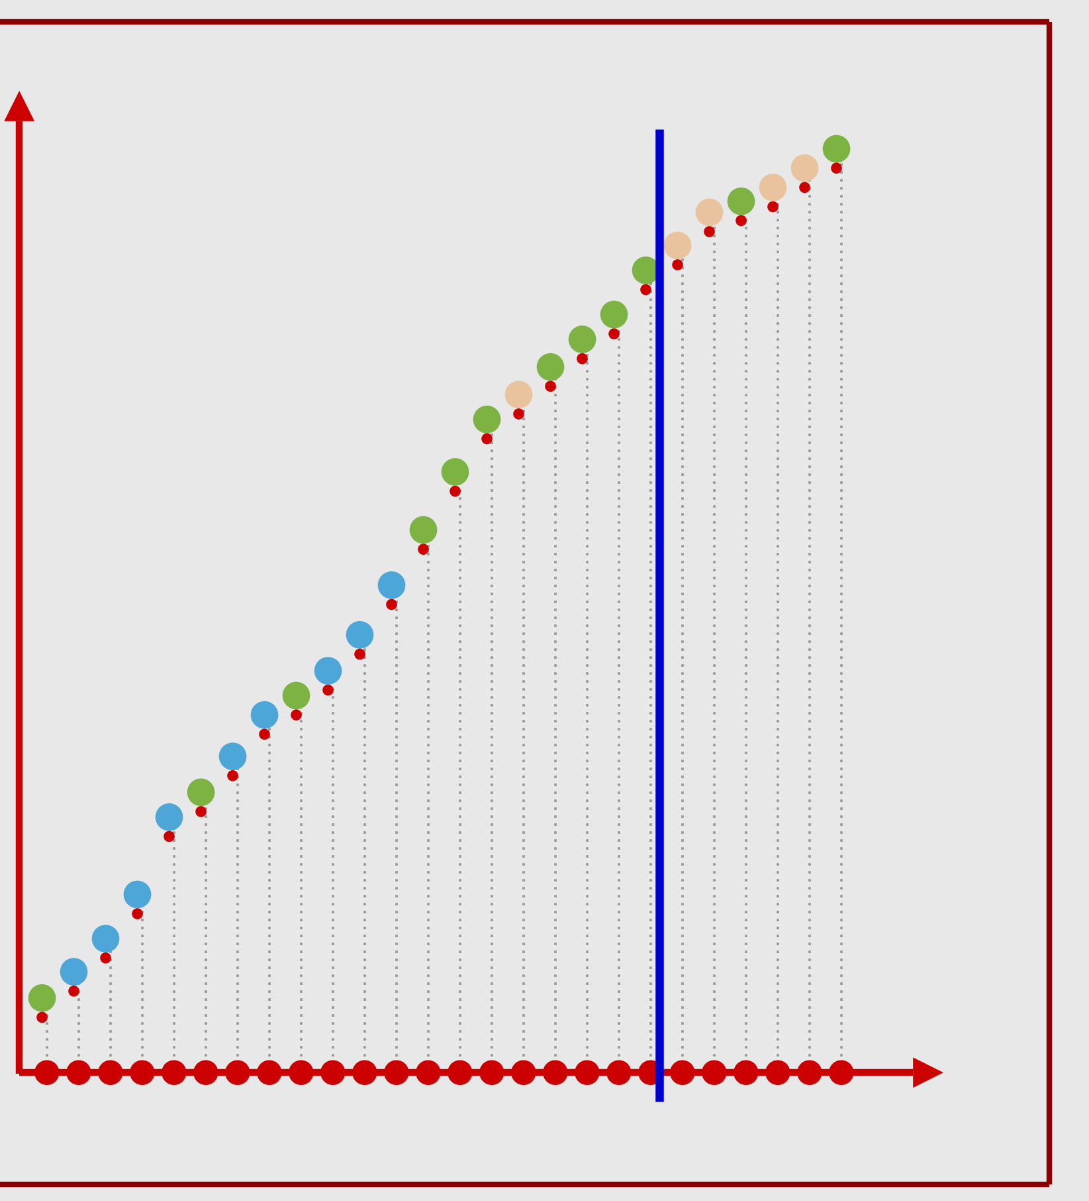
K-Nearest Neighbors (KNN) , K=20
51
K=20, green class
High Bias (Bad)
Select Nearest 20 Neighbors
Vote on 20 Nearest Neighbors

Slide 52
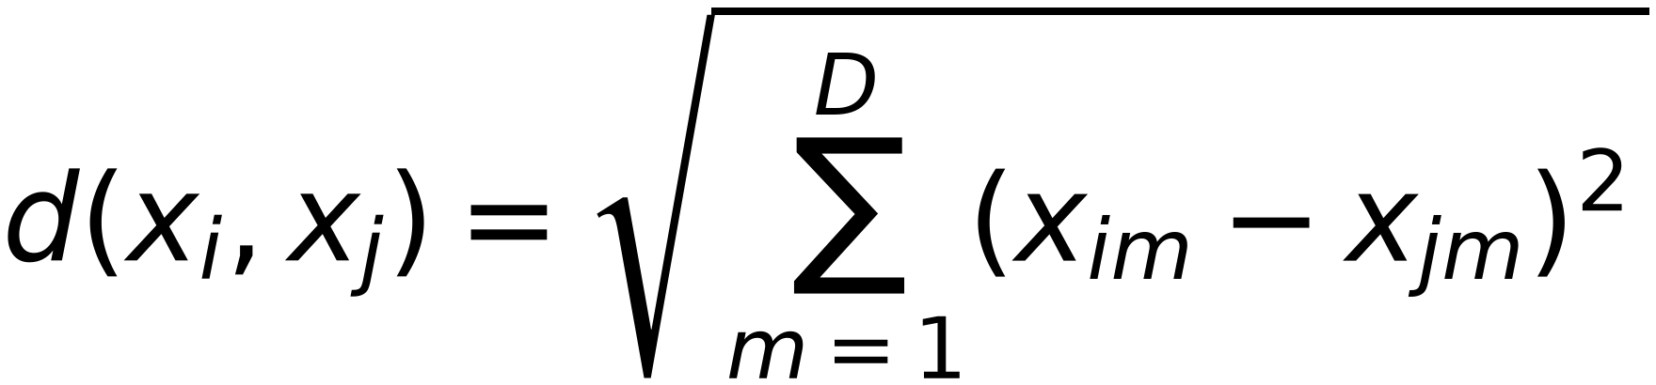
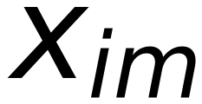
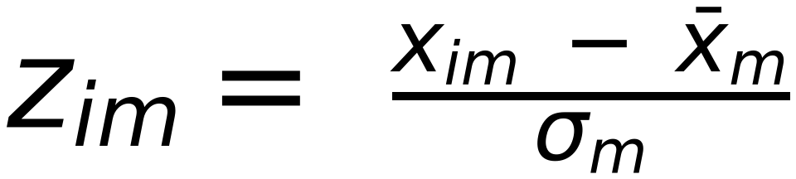
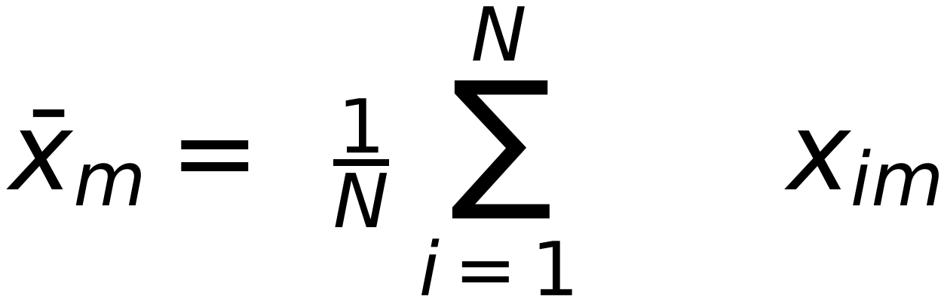
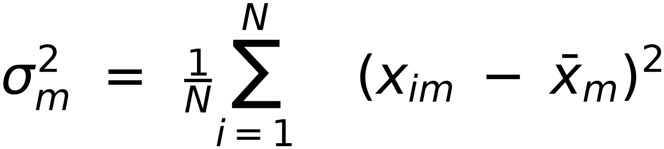
K-NN: Feature Normalization
52
Features should be on the same scale
$$d(x_{i},x_{j})=\sqrt{\sum_{m=1}^{D}{(x_{im}-x_{jm})^{2}}}$$
Example: if one feature has its values in millimeters and another has in centimeters, we would need to normalize
One way is:
Replace
by
(make them
zero mean, unit variance
$$z_{im}= \frac{x_{im} - {\overline{x}}_{m}}{σ_{m}}$$
)
$$x_{im}$$
$${\overline{x}}_{m}= \frac{1}{N} \sum_{i=1}^{N}{ x_{im}}$$
: empirical mean of m^{th} feature
$$σ_{m}^{2} = \frac{1}{N}\sum_{i=1}^{N}{ (x_{im} - {\overline{x}}_{m})^{2}}$$
: empirical variance of m^{th} feature

Slide 53










Example: Distance without Normalization
53
Feature Vector of bars:
Red Class
Blue Class
Green Class
Test
Weight (KG)
2
3
4
7
8
9
12
13
14
7
Length (cm)
100
150
200
150
200
250
150
250
300
120
Squared distance between each vector and test vector
(
425
916
6409
)
(900 6401 16904)
(925 16936 32449)
7
100
Belongs to Red Class

Slide 54


















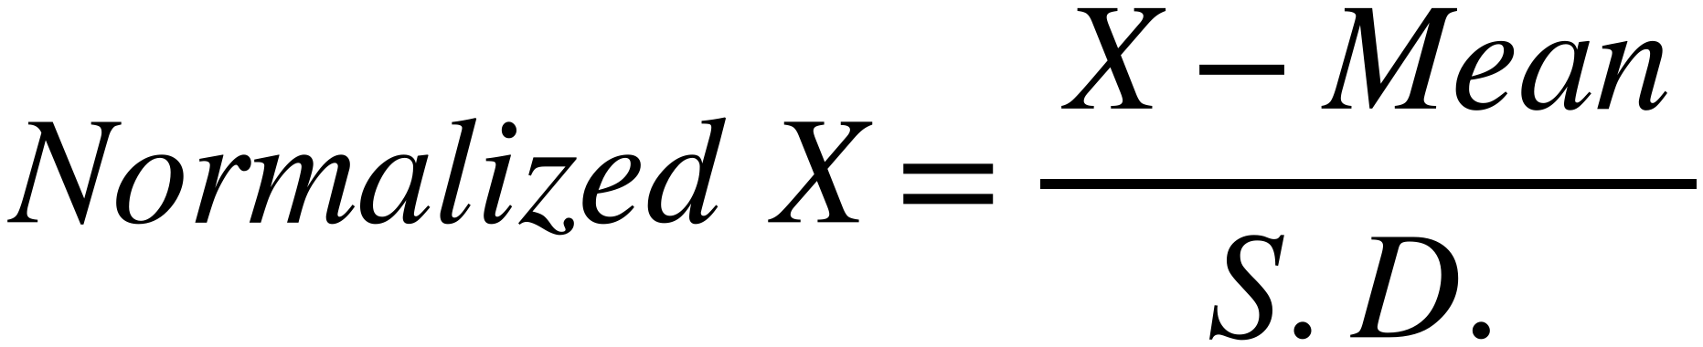
Example: Distance with Normalization
54
Feature Vector for bars:
Red Class
Blue Class
Green Class
Mean
S.D
2
+
Weight (KG)
3
4
7
8
9
12
13
14
8
4.163
Length (cm)
100
150
200
150
200
250
150
250
300
194.44
59.835
Normalized Red Class
Normalized Blue Class
Normalized Green Class
Normalized Test
Weight (KG)
−1.441
−1.201
−0.961
−0.24
0
0.24
0.961
1.201
1.441
−0.24
Length (cm)
−1.578
−0.743
0.093
−0.743
0.093
0.928
−0.743
0.928
1.764
−1.244
Squared distance between each Normalized vector and Normalized test vector
(
1.554
1.175
)
(
)
(
)
2.307
0.251
1.845
4.948
1.693
6.794
11.874
$$Normalized X=\frac{ X-Mean }{S.D.}$$
7
100
Belongs to
Blue Class

Slide 55
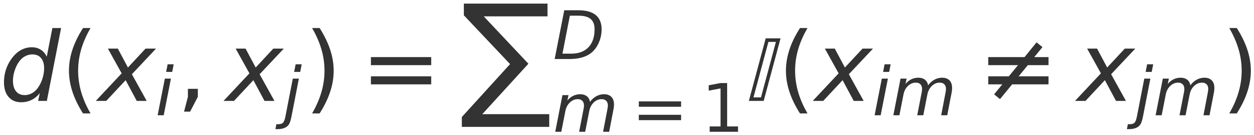
K-NN: Some other distance measures
55
Binary-valued features
$$d(x_{i},x_{j})=\sum_{m=1}^{D}{𝕀(x_{im}≠x_{jm})}$$
– Use Hamming distance:
– Hamming distance counts the number of features where the two examples disagree
Mixed feature types (some real-valued and some binary-valued)?
– Can use mixed distance measures
– E.g., Euclidean for the real part, Hamming for the binary part
Can also assign weights to features:
$$d(x_{i},x_{j})=\sum_{m=1}^{D}{w_{m}d(x_{im},x_{jm})}$$
CS 2710 Foundations of AI [?]

Slide 56
Choice of K - Neighborhood Size
56
• Small K
- Creates many small regions for each class
- May lead to non-smooth decision boundaries and over-fit
• Large K
- Creates fewer larger regions
- Usually leads to smoother decision boundaries (caution: too smooth decision boundary can
under-fit). High bias to classes with larger members
• Choosing K
- Often data dependent and heuristic based
- Or using cross-validation (using some held-out data)
- In general, a K too small or too big is bad!
•

Slide 57
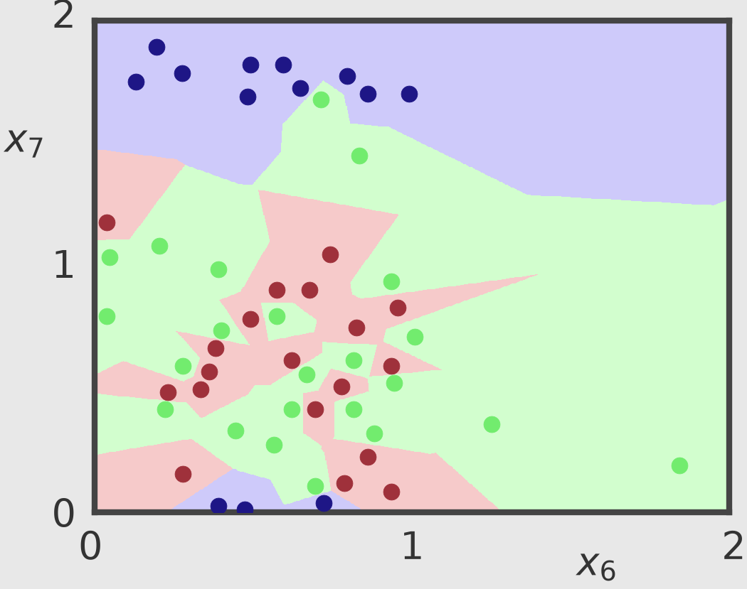
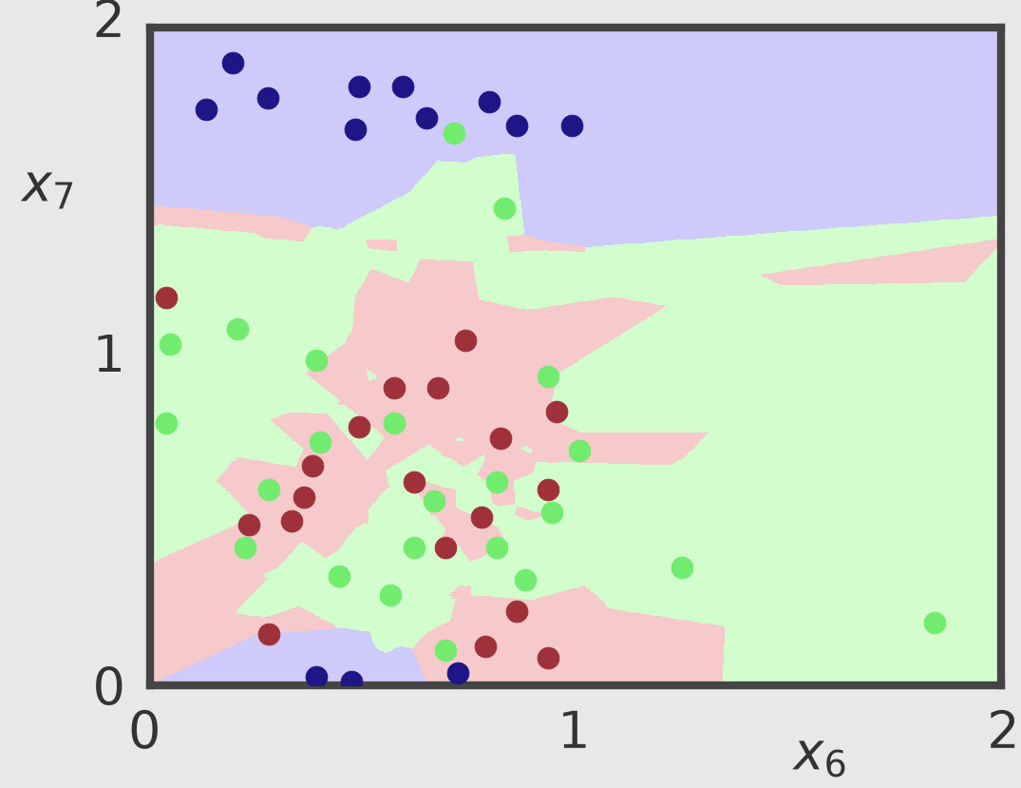
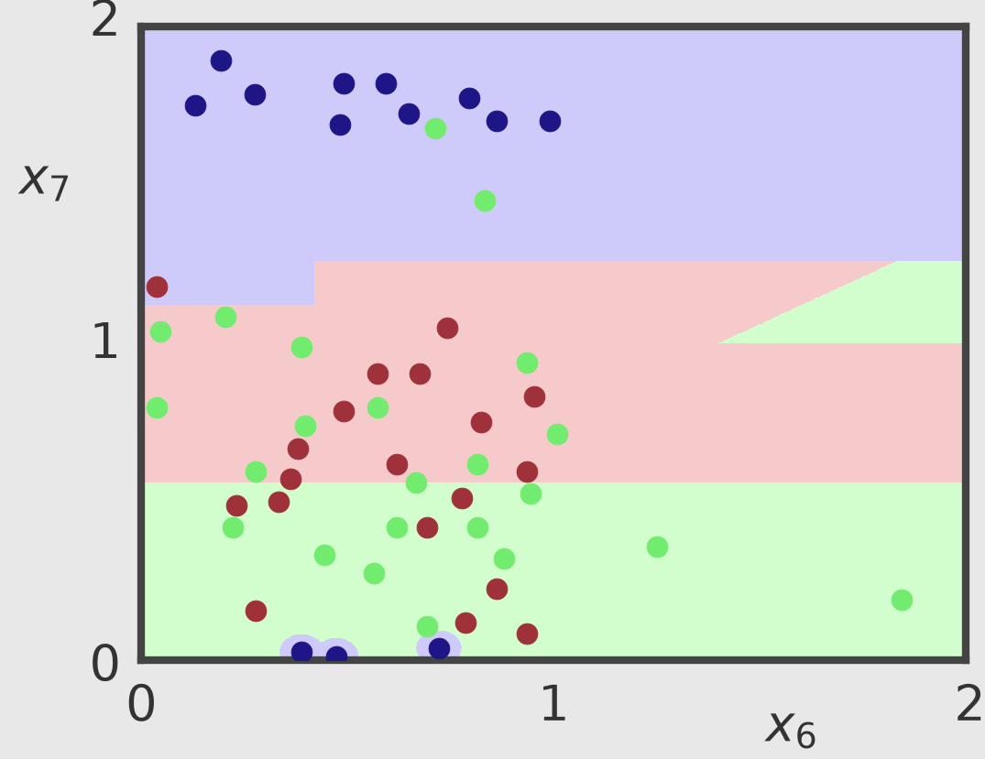
Choice of K - Neighborhood Size
57
K = 1
K = 3
K = 31

Slide 58
K -Nearest Neighbor: Properties
58
What’s nice
• Simple and intuitive; easily implementable
• K -NN approaches the best possible classifier (Bayes optimal)
What’s not so nice..
• Store all the training data in memory even at test time
– Can be memory intensive for large training datasets
– An example of non-parametric, or memory/instance-based methods
– Different from parametric, model-based learning models
• Expensive at test time: O(ND) computations for each test point
– Have to search through all training data to find nearest neighbors
– Distance computations with N training points (D features each)
• Sensitive to noisy features
• May perform badly in high dimensions (curse of dimensionality)

Slide 59
KNN Assignment
59
1) Download “IRIS” Data set (three flowers) [150 Samples]
2) Use PCA to visualize the Dataset (as 2-D) [Optional]
3) Divide the data into 80% Training, 20% test [120 , 30 samples]
4) Apply KNN with K=3, 5, and 7 on Test Samples.
5) Calculate the classification accuracy for each K, Which is the best?
6) Normalize the IRIS dataset and repeat steps 4 and 5. Compare
with previous results, does normalization affect the accuracy ?

Slide 60

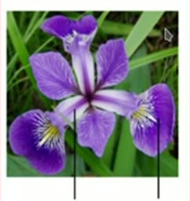
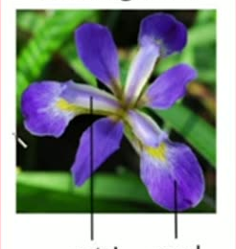
IRIS Dataset
60
iris setosa
iris versicolor
iris virginica
petal
sepal
petal
sepal
petal
sepal
150 Samples, 3 Classes, features of petal and sepal parts of each flower

Slide 61
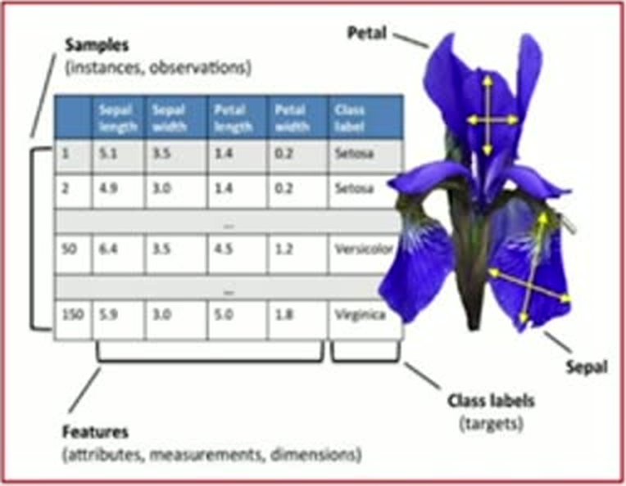
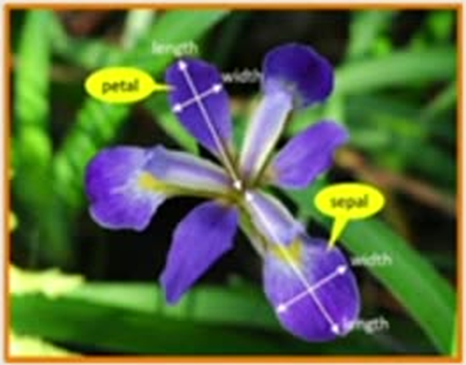
Example of High Dimensional Data
61
(IRIS Dataset)
4 Features: Width and Length of both sepal and petal

Slide 62
IRIS Dataset
62
Serial | sepal.length | sepal.width | petal.length | petal.width | Class
1 | 5.1 | 3.5 | 1.4 | 0.2 | Setosa
2 | 4.9 | 3 | 1.4 | 0.2 | Setosa
3 | 4.7 | 3.2 | 1.3 | 0.2 | Setosa
4 | 4.6 | 3.1 | 1.5 | 0.2 | Setosa
5 | 5 | 3.6 | 1.4 | 0.2 | Setosa
6 | 5.4 | 3.9 | 1.7 | 0.4 | Setosa
7 | 4.6 | 3.4 | 1.4 | 0.3 | Setosa
8 | 5 | 3.4 | 1.5 | 0.2 | Setosa
... | ... | ... | ... | ... | ...
45 | 5.1 | 3.8 | 1.9 | 0.4 | Setosa
46 | 4.8 | 3 | 1.4 | 0.3 | Setosa
47 | 5.1 | 3.8 | 1.6 | 0.2 | Setosa
48 | 4.6 | 3.2 | 1.4 | 0.2 | Setosa
49 | 5.3 | 3.7 | 1.5 | 0.2 | Setosa
50 | 5 | 3.3 | 1.4 | 0.2 | Setosa
51 | 7 | 3.2 | 4.7 | 1.4 | Versicolor
52 | 6.4 | 3.2 | 4.5 | 1.5 | Versicolor
53 | 6.9 | 3.1 | 4.9 | 1.5 | Versicolor
54 | 5.5 | 2.3 | 4 | 1.3 | Versicolor
55 | 6.5 | 2.8 | 4.6 | 1.5 | Versicolor
56 | 5.7 | 2.8 | 4.5 | 1.3 | Versicolor
... | ... | ... | ... | ... | ...
96 | 5.7 | 3 | 4.2 | 1.2 | Versicolor
97 | 5.7 | 2.9 | 4.2 | 1.3 | Versicolor
98 | 6.2 | 2.9 | 4.3 | 1.3 | Versicolor
99 | 5.1 | 2.5 | 3 | 1.1 | Versicolor
100 | 5.7 | 2.8 | 4.1 | 1.3 | Versicolor
101 | 6.3 | 3.3 | 6 | 2.5 | Virginica
102 | 5.8 | 2.7 | 5.1 | 1.9 | Virginica
103 | 7.1 | 3 | 5.9 | 2.1 | Virginica
104 | 6.3 | 2.9 | 5.6 | 1.8 | Virginica
... | ... | ... | ... | ... | ...
148 | 6.5 | 3 | 5.2 | 2 | Virginica
149 | 6.2 | 3.4 | 5.4 | 2.3 | Virginica
150 | 5.9 | 3 | 5.1 | 1.8 | Virginica
150 Samples
3 Classes
Setosa
Versicolor
Virginica
4 Features
No Direct Visualization

Slide 63
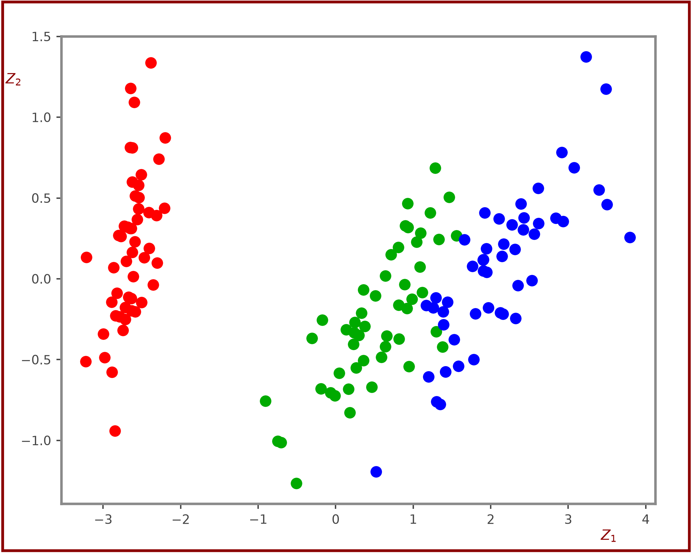
Visualize Reduced Features [ 4 features are reduced to two features]
63
ᵀ
W₁
ᵀ
L₁
PCA
Z₁
W₂
⇒
Z₂
Setosa
Versicolor
Virginica
L₂
Visualize Classes as 2-D (Z₁ vs Z₂)

Slide 64
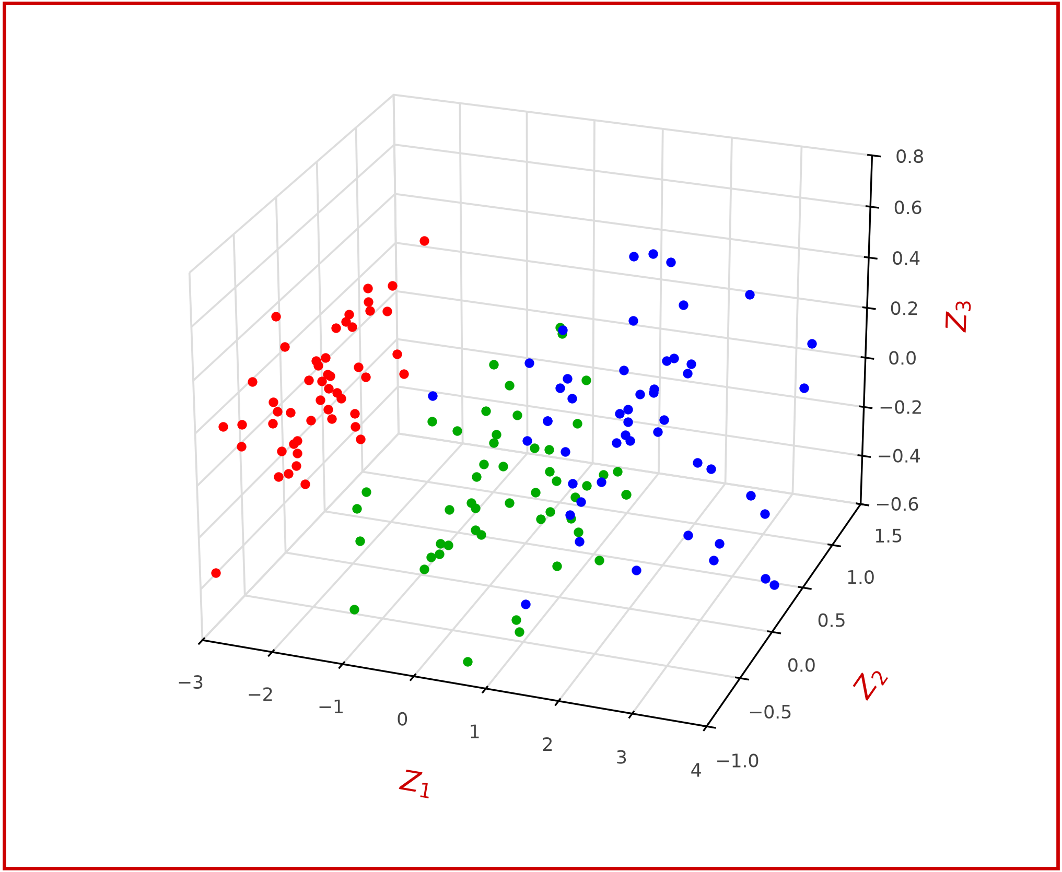
[3] Visualize Reduced Features [ 4 features are reduced to three features]
64
W₁
L₁
W₂
L₂
T
T
Z₁
Z₂
Z₃
PCA
Setosa
Versicolor
Virginica
Visualize Classes as 3-D (z₁ vs Z ₂ vs Z₃)

