Slide 1
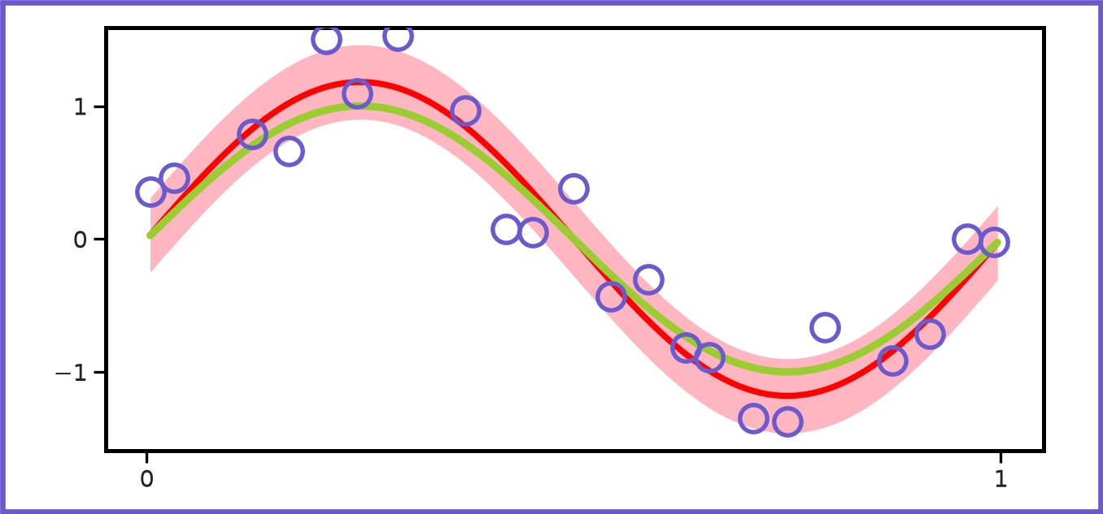
Classification vs Regression
15
Classification is about finding separation boundaries (linear/non-linear):
x
x
x
x
x
x
x
x
x
x
Regression is more like fitting a curve/surface to the data:

