Slide 1
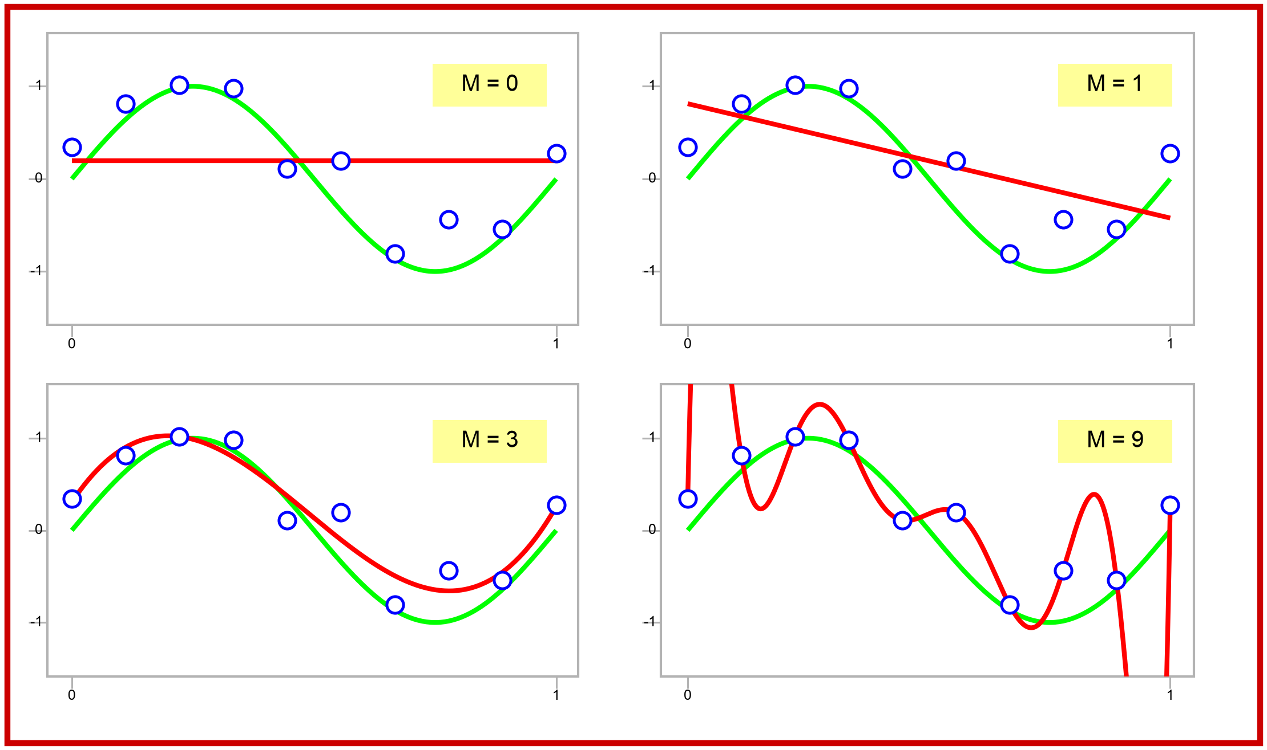
Data Overfit and Underfit
16
The X axis is the input. The Y axis is the response.

