Slide 1
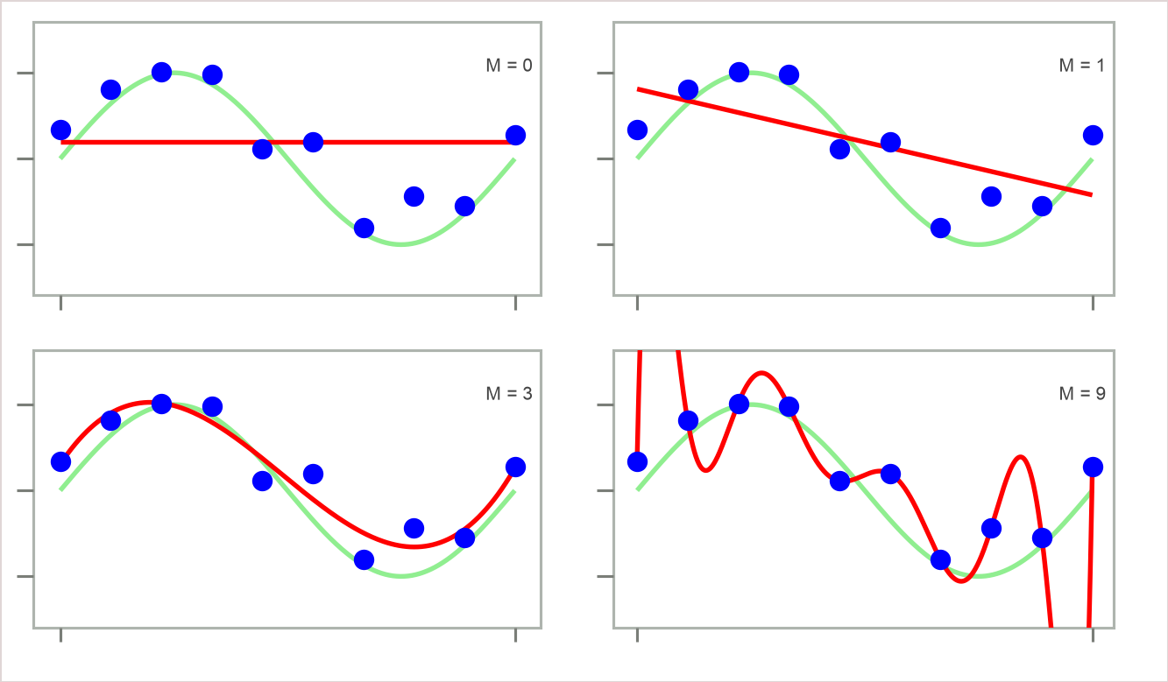
Data Overfit and Underfit
17
Questions:-
• Which of the four red curves fits the data
(blue dots) best?
• Which curve is expected to generalize the
best?
Are they both the same? If yes, why? If no, why not?

