Slide 1
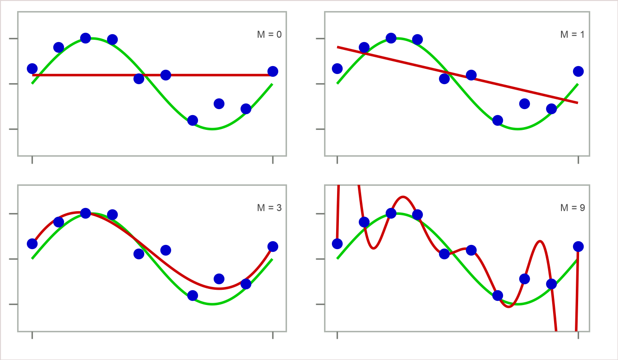
Data Overfit and Underfit
18
Questions:-
• Which of the four red curves fits the data (blue dots) best?
• Which curve is expected to generalize the best?
Are they both the same? If yes, why? If no, why not?
Lesson: Simple models should be preferred over complicated models
Simple models can prevent overfitting
Too simple a model can underfit (e.g., M = 0 above)
General guideline: Choose a model not-too-simple, yet not-too-complex

