Slide 1
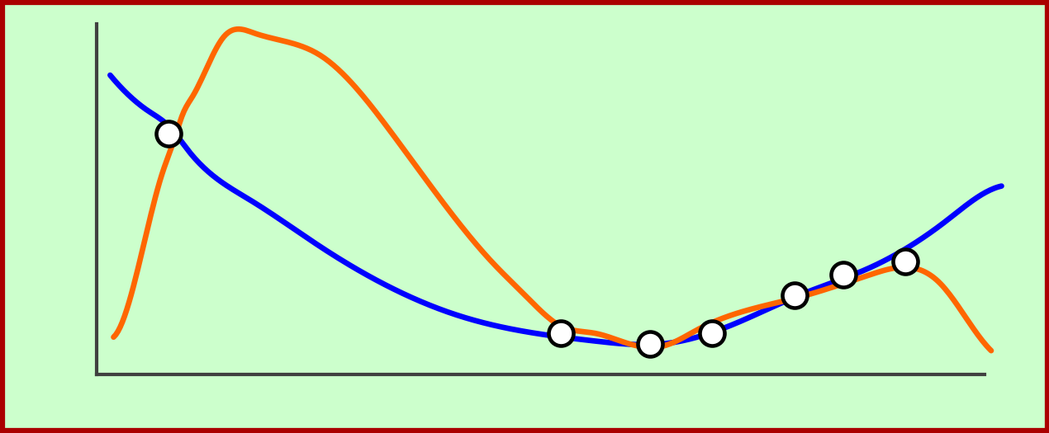
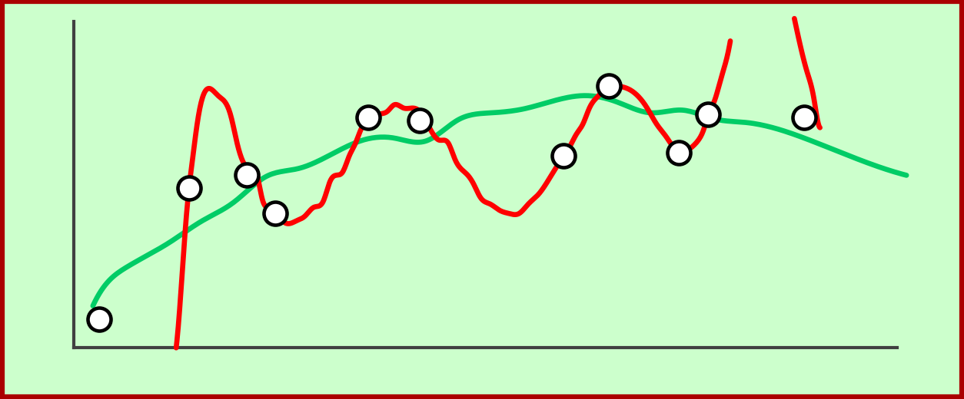
Data Overfit and Underfit
19
Classification
Under-fitting
Appropriate-fitting
Over-fitting
(too simple to
explain the
variance)
(forcefitting -- too
good to be true)
Data
Target
Regression
Fit
y
y
Data
2nd Order Fit
x
x
10th Order Fit

