Slide 1
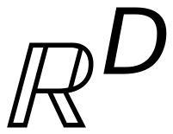
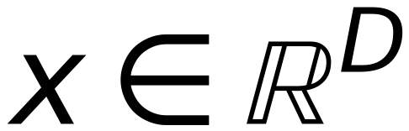
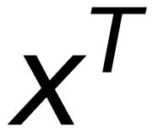










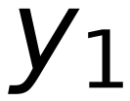
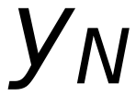
Some Notations
26
$$ℝ^{D}$$
denotes the set of all D × 1 real-valued column vectors
$$x∈ℝ^{D}$$
denotes a D × 1 real-valued column vector
$$x^{T}$$
denotes the transpose of x, a 1 × D row vector
$$ℝ^{N×D}$$
denotes the set of all N × D real-valued matrices
$$X∈ℝ^{N×D}$$
denotes an N × D real-valued matrix
Supervised Learning: Often, we write
$$\{(x_{1},y_{1}),…,(x_{N},y_{N})\} as (X,Y)$$
X is an N × D matrix
Each row of X denotes an example,
$$x_{1}$$
$$x_{11} … x_{1D}$$
each column denotes a feature
$$X =$$
$$=$$
$$x_{ij}$$
denotes the j-th feature of the
$$⋮$$
$$⋮$$
$$x_{N}$$
$$x_{N1} … x_{ND}$$
i-th example
Y is an N × 1 vector. Row i denotes
$$y_{1}$$
the label of the i-th example
$$Y =$$
$$⋮$$
$$y_{N}$$

