Slide 1
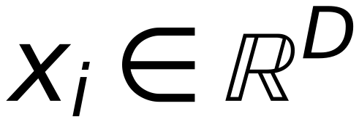
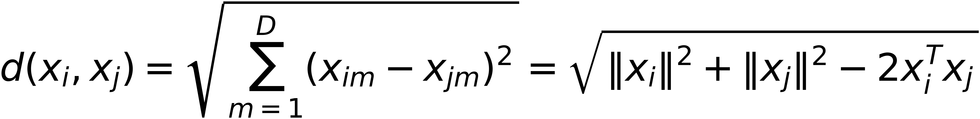
K-NN: Computing the distances
42
• The K-NN algorithm requires computing distances of the test example from each of the training examples
• Several ways to compute distances
• The choice depends on the type of the features in the data
• Real-valued features (
$$x_{i}∈ℝ^{D}$$
): Euclidean distance is commonly
used
$$d(x_{i},x_{j})=\sqrt{\sum_{m=1}^{D}{(x_{im}-x_{jm})^{2}}}=\sqrt{‖x_{i}‖^{2}+‖x_{j}‖^{2}-2x_{i}^{T}x_{j}}$$

