Slide 1
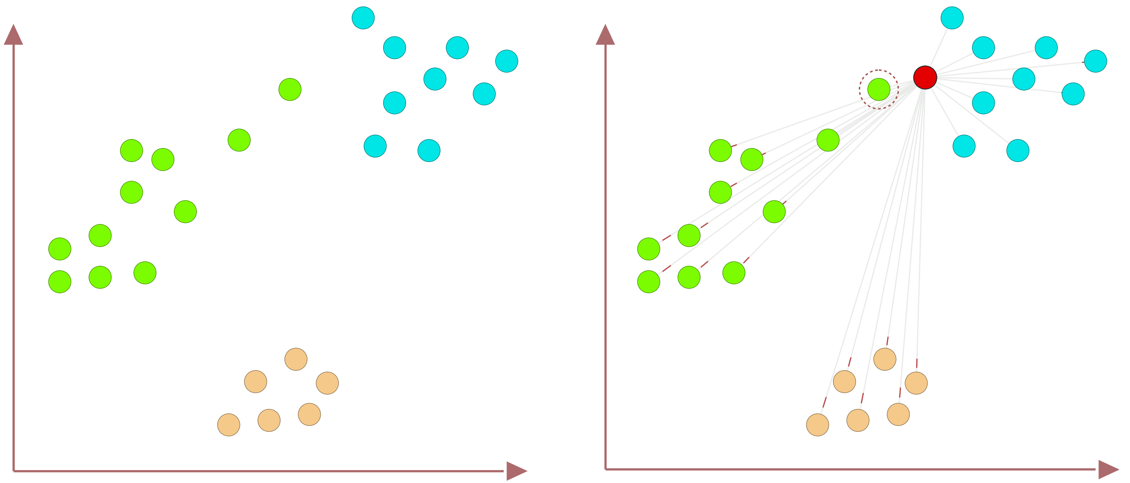
Nearest Neighbors (NN) Outlier Problem
45
Data of Three Classes
Nearest Neighbor is the Green class

