Slide 1
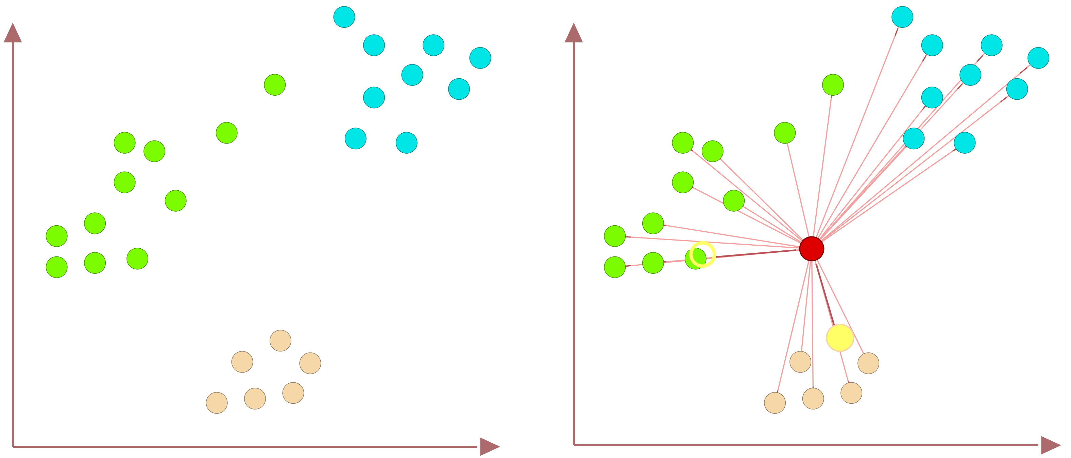
Nearest Neighbors (NN) Equal Distance
47
Data of Three Classes
No Unique Nearest Neighbor

