Slide 1
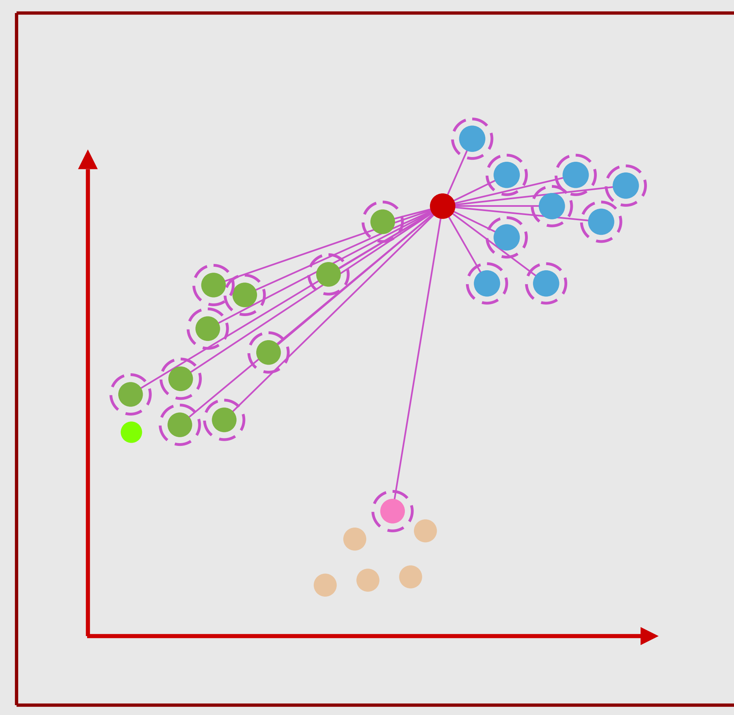
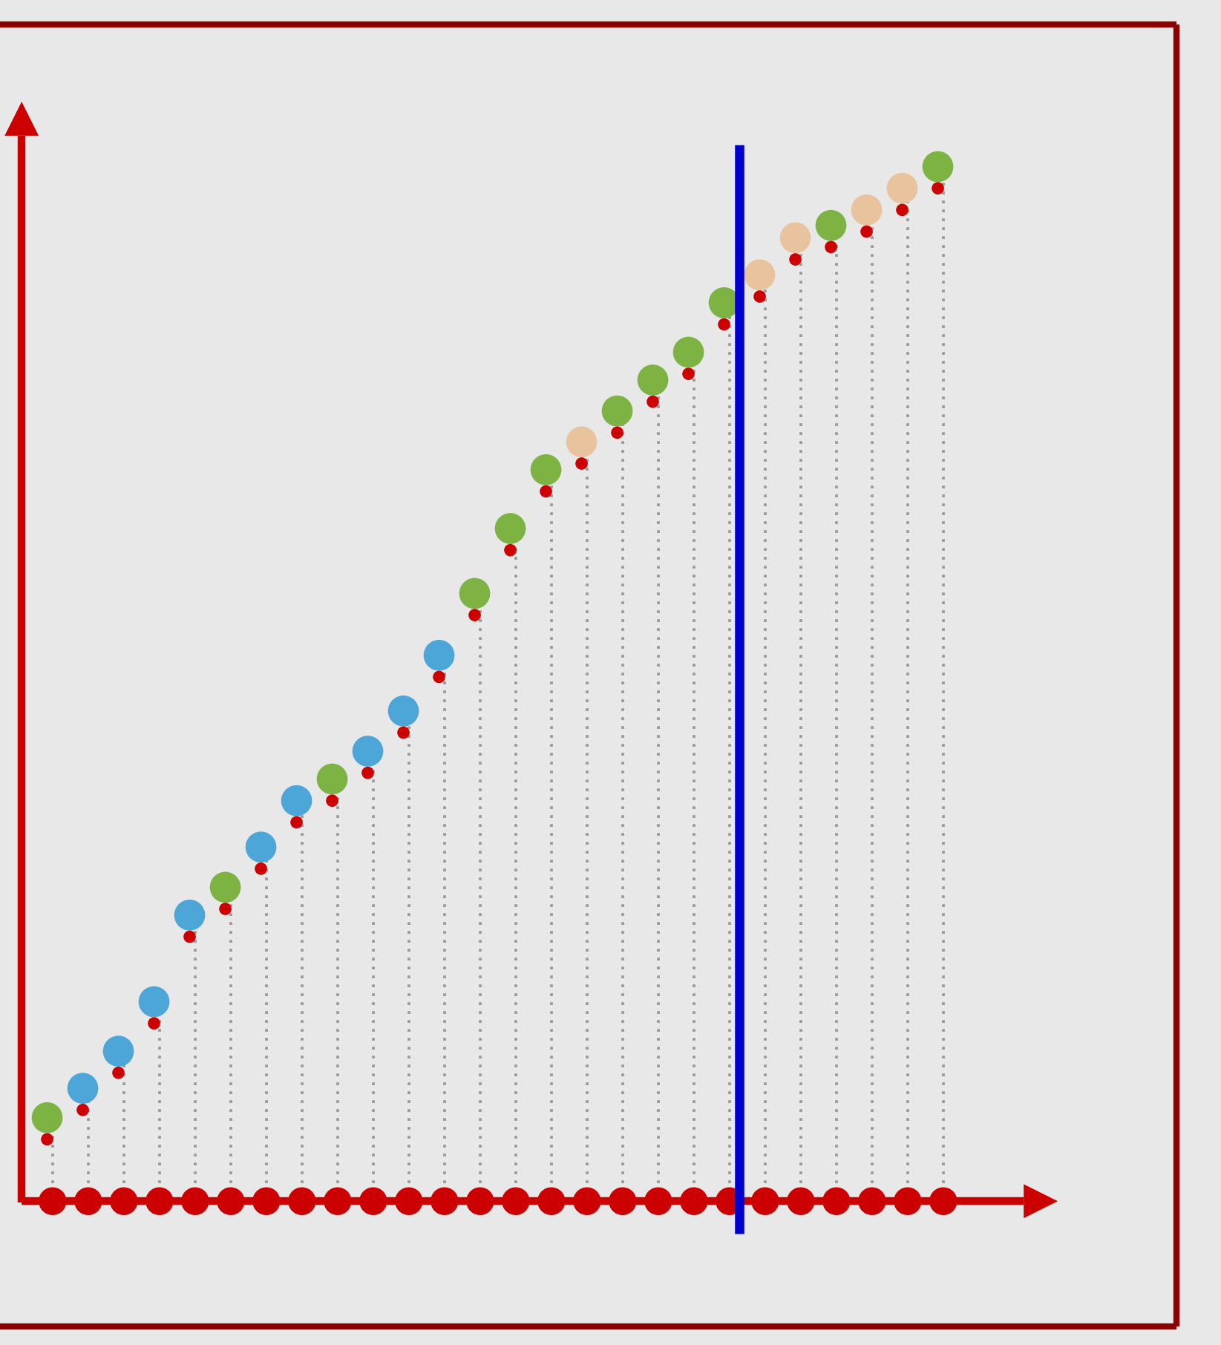
K-Nearest Neighbors (KNN) , K=20
51
K=20, green class
High Bias (Bad)
Select Nearest 20 Neighbors
Vote on 20 Nearest Neighbors

