Slide 1
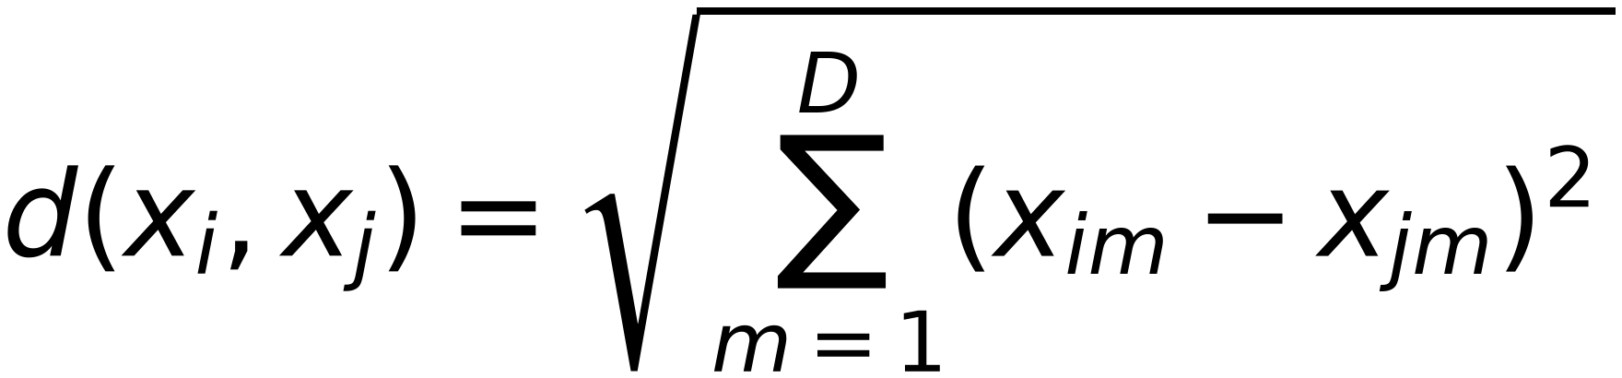

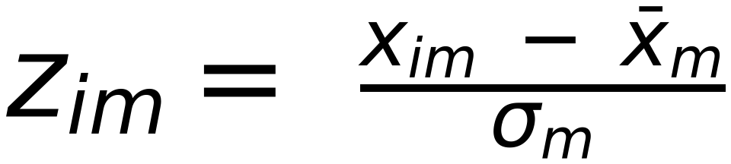
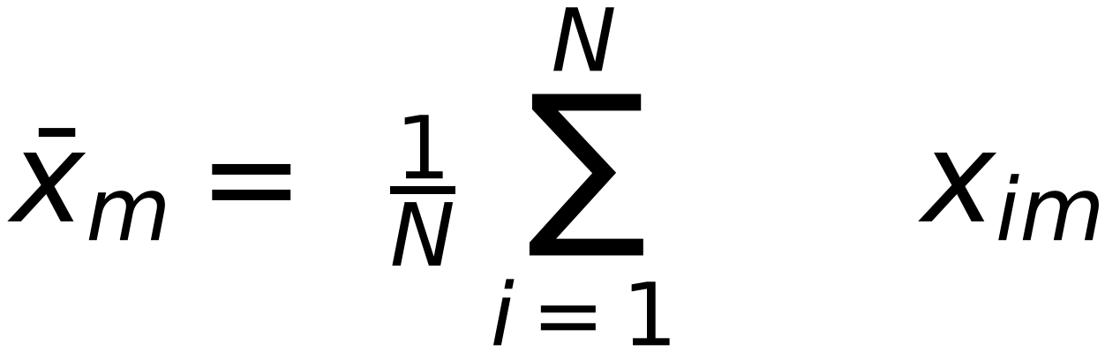
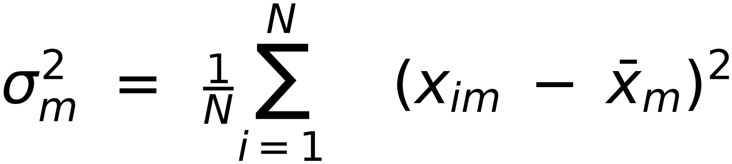
K-NN: Feature Normalization
52
Features should be on the same scale
$$d(x_{i},x_{j})=\sqrt{\sum_{m=1}^{D}{(x_{im}-x_{jm})^{2}}}$$
Example: if one feature has its values in millimeters and another has in centimeters, we would need to normalize
One way is:
Replace
by
(make them
zero mean, unit variance
$$z_{im}= \frac{x_{im} - {\overline{x}}_{m}}{σ_{m}}$$
)
$$x_{im}$$
$${\overline{x}}_{m}= \frac{1}{N} \sum_{i=1}^{N}{ x_{im}}$$
: empirical mean of m^{th} feature
$$σ_{m}^{2} = \frac{1}{N}\sum_{i=1}^{N}{ (x_{im} - {\overline{x}}_{m})^{2}}$$
: empirical variance of m^{th} feature

