Slide 1
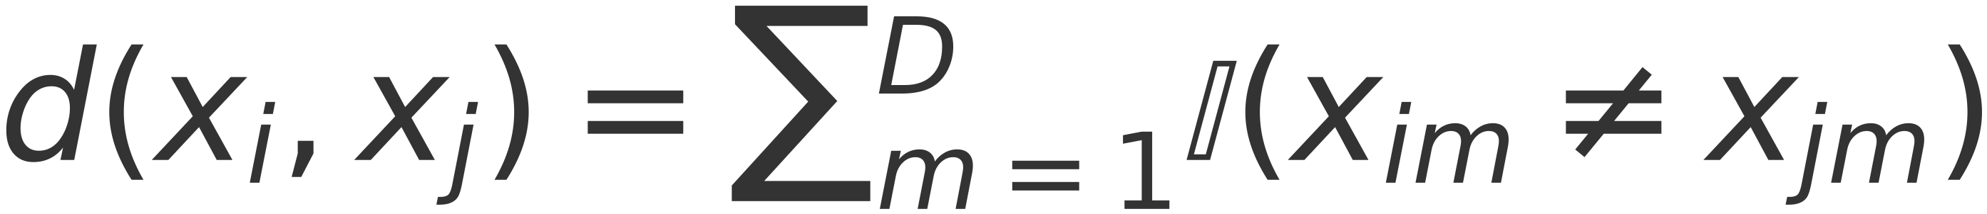
K-NN: Some other distance measures
55
Binary-valued features
$$d(x_{i},x_{j})=\sum_{m=1}^{D}{𝕀(x_{im}≠x_{jm})}$$
– Use Hamming distance:
– Hamming distance counts the number of features where the two examples disagree
Mixed feature types (some real-valued and some binary-valued)?
– Can use mixed distance measures
– E.g., Euclidean for the real part, Hamming for the binary part
Can also assign weights to features:
$$d(x_{i},x_{j})=\sum_{m=1}^{D}{w_{m}d(x_{im},x_{jm})}$$
CS 2710 Foundations of AI [?]

