Slide 1
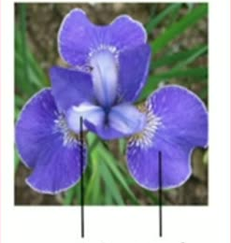
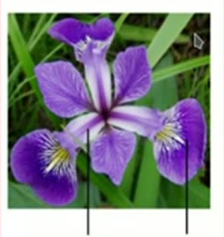
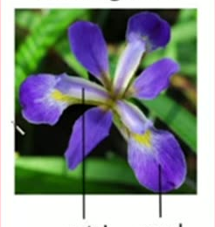
IRIS Dataset
60
iris setosa
iris versicolor
iris virginica
petal
sepal
petal
sepal
petal
sepal
150 Samples, 3 Classes, features of petal and sepal parts of each flower

