Slide 1
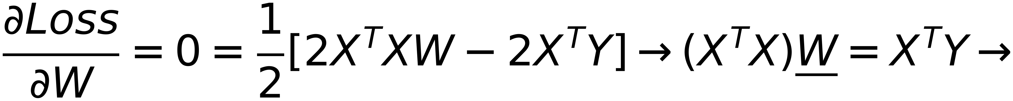
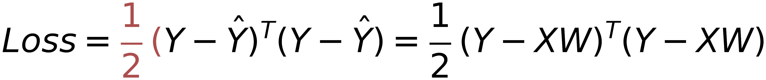
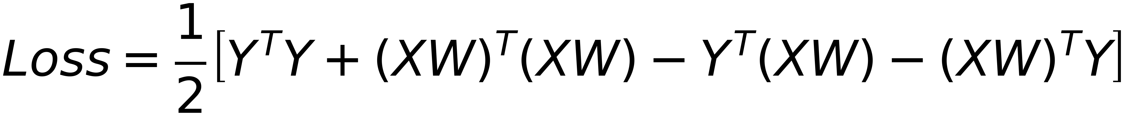
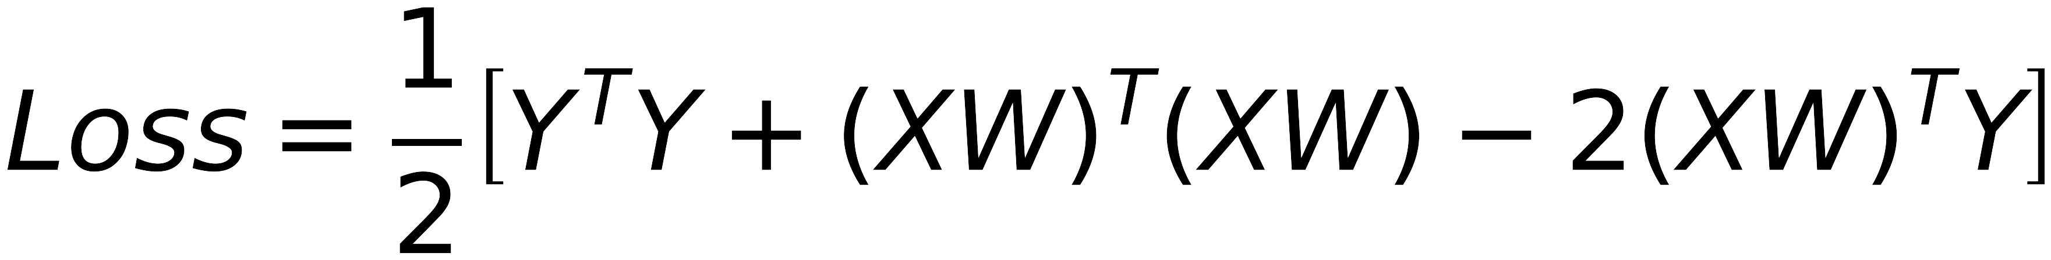

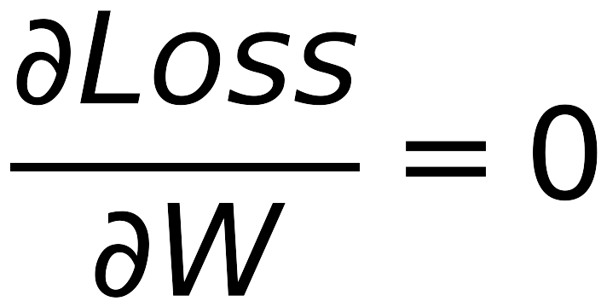
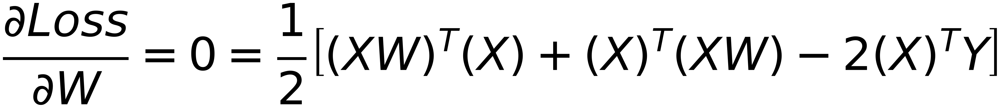


5
Minimization of Loss function to obtain BEST model parameters
$$Loss=\frac{1}{2} (Y-\hat{Y})^{T}(Y-\hat{Y})=\frac{1}{2} (Y-XW)^{T}(Y-XW)$$
Remember
X is a matrix, W is a vector,
$$Loss=\frac{1}{2}\left[Y^{T}Y+(XW)^{T}(XW)-Y^{T}(XW)-(XW)^{T}Y\right]$$
XW is a vector
$$Y^{T}(XW)=(XW)^{T}Y$$
$$Loss=\frac{1}{2}\left[Y^{T}Y+(XW)^{T}(XW)-2(XW)^{T}Y\right]$$
$$\frac{∂Loss}{∂W}=0$$
Get Best W that minimizes the loss
$$\frac{∂Loss}{∂W}=0=\frac{1}{2}\left[(XW)^{T}(X)+(X)^{T}(XW)-2(X)^{T}Y\right]$$
Remember
$$X^{T}(XW)=(XW)^{T}X$$
$$W=(X^{T}X)^{-1}X^{T}Y$$

