Slide 1
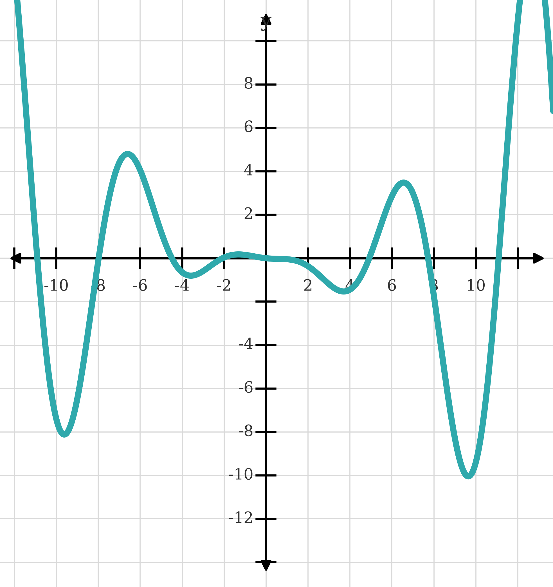
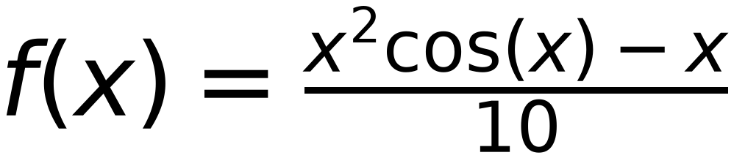
Non-Convex Function
33
May reach different minimum value based on:
initial point and learning rate
x
step
0.1
X
is in between -9.7 and color red bold -9.6
Reach
Local Minima
initial X
-11
f(x)
is in between -8.08 and -8.011
delta
0.1
x
-11
-10.9
-10.8
-10.7
-10.6
-10.5
-10.4
-10.3
-10.2
-10.1
-10
-9.9
-9.8
-9.7
-9.6
-9.7
-9.6
-9.7
f(x)
1.15
-0.04
-1.19
-2.26
-3.27
-4.19
-5.03
-5.77
-6.41
-6.95
-7.39
-7.72
-7.96
-8.08
-8.11
-8.08
-8.11
-8.08
x-delta
-11.1
-11
-10.9
-10.8
-10.7
-10.6
-10.5
-10.4
-10.3
-10.2
-10.1
-10
-9.9
-9.8
-9.7
-9.8
-9.7
-9.8
f(x-delta)
2.39
1.15
-0.04
-1.19
-2.26
-3.27
-4.19
-5.03
-5.77
-6.41
-6.95
-7.39
-7.72
-7.96
-8.08
-7.96
-8.08
-7.96
x+delta
-10.9
-10.8
-10.7
-10.6
-10.5
-10.4
-10.3
-10.2
-10.1
-10
-9.9
-9.8
-9.7
-9.6
-9.5
-9.6
-9.5
-9.6
f(x+delta)
-0.04
-1.19
-2.26
-3.27
-4.19
-5.03
-5.77
-6.41
-6.95
-7.39
-7.72
-7.96
-8.08
-8.11
-8.05
-8.11
-8.05
-8.11
slope
-24.3
-23.4
-22.2
-20.8
-19.3
-17.6
-15.8
-13.8
-11.8
-9.8
-7.7
-5.7
-3.6
-1.5
0.3
-1.5
0.3
-1.5
next x
-10.9
-10.8
-10.7
-10.6
-10.5
-10.4
-10.3
-10.2
-10.1
-10
-9.9
-9.8
-9.7
-9.6
-9.7
-9.6
-9.7
-9.6

