Slide 1
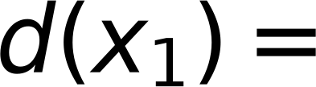

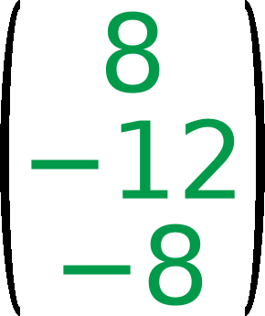



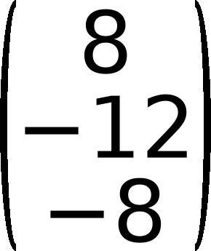



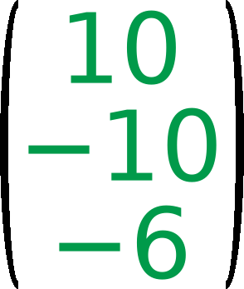

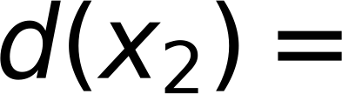


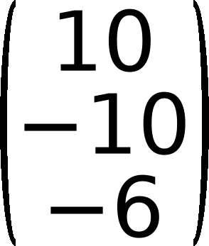

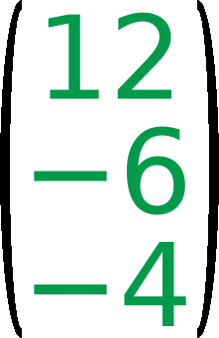
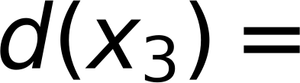


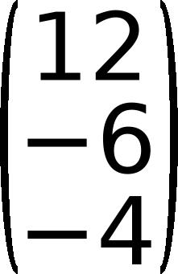

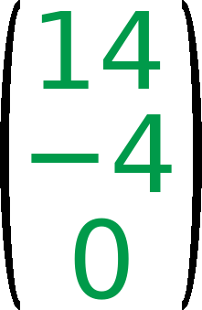
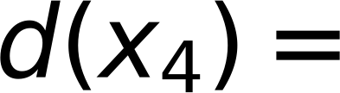



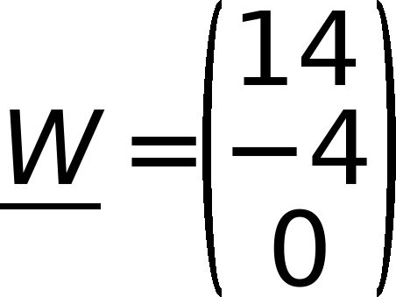
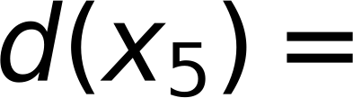


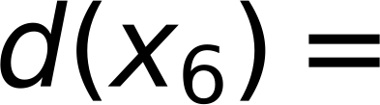


x₁
x₂
x₃
x₄
x₅
x₆
4
Step η = 2
Z₁
Z₁
Z₁
44
Initial W =
1
2
1
5
6
6
-2
Check classes of
-2
0
7
3
1
1
2
4
5
6
0
6
2
C₁
positive,
C₂
C₁
C₁
C₁
C₂
C₂
C₂
negative,
Zero
is unaccepted
Ugmented Vectors ( from Top )
$$(1 1 1)$$
$$\left(\begin{matrix}8 \\ -12 \\ -8\end{matrix}\right)$$
$$\left(\begin{matrix}8 \\ -12 \\ -8\end{matrix}\right)$$
$$\left(\begin{matrix}1 \\ 1 \\ 1\end{matrix}\right)$$
$$\left(\begin{matrix}10 \\ -10 \\ -6\end{matrix}\right)$$
x₁
x₂
x₃
x₄
x₅
x₆
$$d(x_{1})=$$
$$=-12$$
$$⇒$$
Update Weight
$$\underline{W}=$$
$$+2*$$
$$=$$
$$⇐$$
(1)
(1)
(1)
(1)
(1)
(1)
(1)
(2)
(1)
(5)
(6)
(6)
(1)
(2)
(4)
(5)
(6)
(6)
$$(1 2 1)$$
$$\left(\begin{matrix}10 \\ -10 \\ -6\end{matrix}\right)$$
$$\left(\begin{matrix}10 \\ -10 \\ -6\end{matrix}\right)$$
$$\left(\begin{matrix}1 \\ 2 \\ 1\end{matrix}\right)$$
$$\left(\begin{matrix}12 \\ -6 \\ -4\end{matrix}\right)$$
C₁
C₁
C₁
C₂
C₂
C₂
$$d(x_{2})=$$
$$=-16$$
$$⇒$$
Update Weight
$$\underline{W}=$$
$$+2*$$
$$=$$
$$⇐$$
Iteration 3
$$(1 1 2)$$
$$\left(\begin{matrix}12 \\ -6 \\ -4\end{matrix}\right)$$
$$\left(\begin{matrix}12 \\ -6 \\ -4\end{matrix}\right)$$
$$\left(\begin{matrix}1 \\ 1 \\ 2\end{matrix}\right)$$
$$\left(\begin{matrix}14 \\ -4 \\ 0\end{matrix}\right)$$
$$d(x_{3})=$$
$$=-2$$
$$⇒$$
Update Weight
$$\underline{W}=$$
$$+2*$$
$$=$$
$$⇐$$
$$(1 5 4)$$
$$\left(\begin{matrix}14 \\ -4 \\ 0\end{matrix}\right)$$
$$\underline{W}=\left(\begin{matrix}14 \\ -4 \\ 0\end{matrix}\right)$$
$$d(x_{4})=$$
$$=-6$$
$$⇒$$
Keep same Weight
$$(1 6 5)$$
$$\left(\begin{matrix}14 \\ -4 \\ 0\end{matrix}\right)$$
$$\underline{W}=\left(\begin{matrix}14 \\ -4 \\ 0\end{matrix}\right)$$
$$d(x_{5})=$$
$$=-10$$
$$⇒$$
Keep same Weight
$$(1 6 6)$$
$$\left(\begin{matrix}14 \\ -4 \\ 0\end{matrix}\right)$$
$$\underline{W}=\left(\begin{matrix}14 \\ -4 \\ 0\end{matrix}\right)$$
$$d(x_{6})=$$
$$=-112$$
$$⇒$$
Keep same Weight

