Slide 1
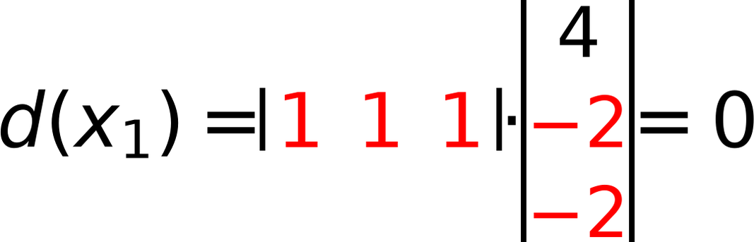
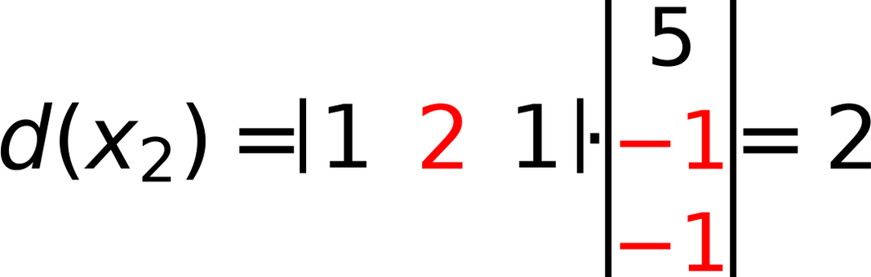
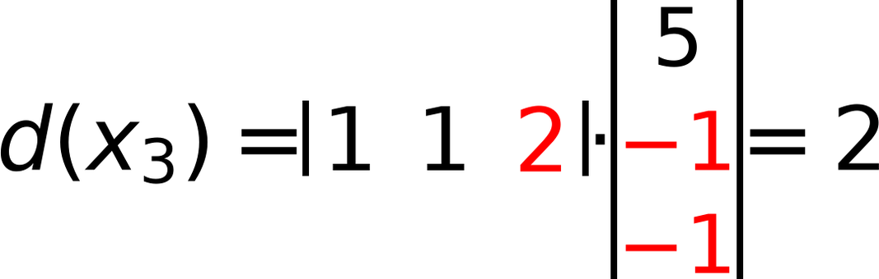
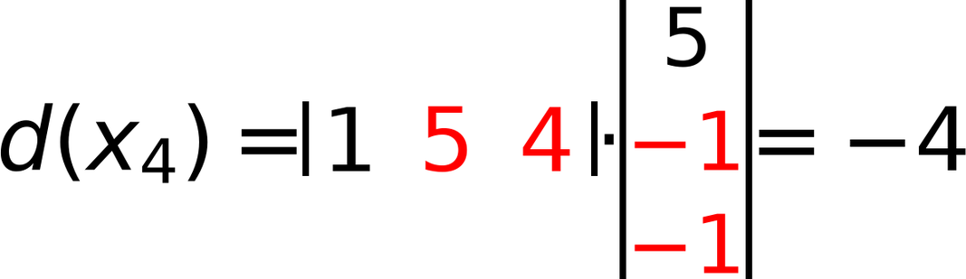
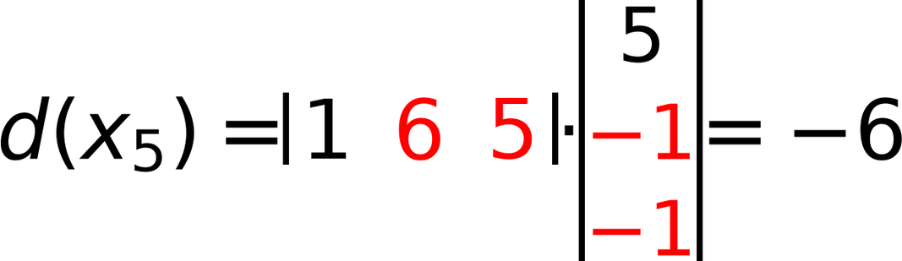
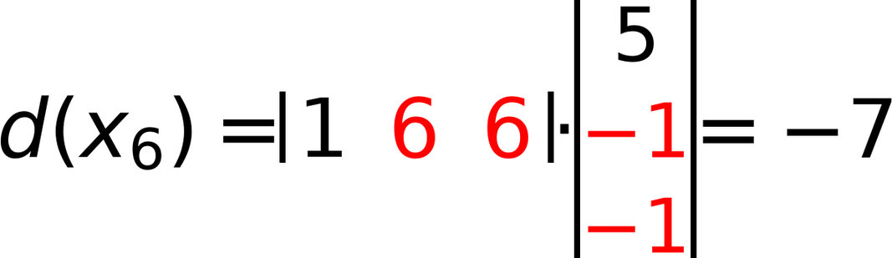
x₁
x₂
x₃
x₄
x₅
x₆
4
Initial W =
REPEAT using Step η = 1
48
(1)
(2)
(1)
(5)
(6)
(6)
-2
Z₁
Z₁
Z₁
-2
Check classes of
0
7
3
(1)
(1)
(2)
(4)
(5)
(6)
0
6
2
C1
C1
C1
C2
C2
C2
C₁ positive C₂ negative Zero is unaccepted
Ugmented Vectors (from Top)
$$d(x_{1})=\left(1 1 1\right)⋅\left(\begin{matrix}4 \\ -2 \\ -2\end{matrix}\right)=0$$
⇒
Update Weight
4
1
5
x₁
x₂
x₃
x₄
x₅
x₆
W =
-2
+
1
*
1
=
-1
⇐
(1)
(1)
(1)
(1)
(1)
(1)
-2
1
-1
(1)
(2)
(1)
(5)
(6)
(6)
⇒
Keep same Weight
(1)
(1)
(2)
(4)
(5)
(6)
$$d(x_{2})=\left(1 2 1\right)⋅\left(\begin{matrix}5 \\ -1 \\ -1\end{matrix}\right)=2$$
5
C₁
C₁
C₁
C₂
C₂
C₂
W =
-1
-1
Iteration 1
$$d(x_{3})=\left(1 1 2\right)⋅\left(\begin{matrix}5 \\ -1 \\ -1\end{matrix}\right)=2$$
⇒
Keep same Weight
5
W =
-1
-1
$$d(x_{4})=\left(1 5 4\right)⋅\left(\begin{matrix}5 \\ -1 \\ -1\end{matrix}\right)=-4$$
⇒
Keep same Weight
5
W =
-1
-1
$$d(x_{5})=\left(1 6 5\right)⋅\left(\begin{matrix}5 \\ -1 \\ -1\end{matrix}\right)=-6$$
⇒
Keep same Weight
5
W =
-1
-1
$$d(x_{6})=\left(1 6 6\right)⋅\left(\begin{matrix}5 \\ -1 \\ -1\end{matrix}\right)=-7$$
⇒
Keep same Weight
5
W =
-1
-1

