Slide 1



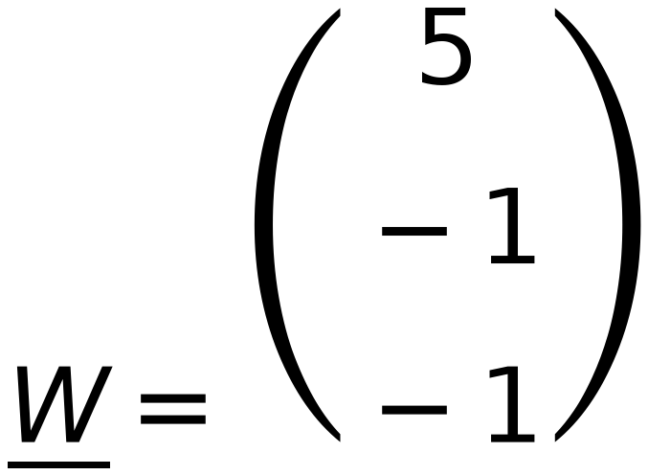
x₁
x₂
x₃
x₄
x₅
x₆
4
REPEAT
using Step η = 1
50
Initial W =
-2
Z₁
Z₂
Z₃
$$\underline{W}=\left(\begin{matrix}5 \\ \\ -1 \\ \\ -1\end{matrix}\right)$$
1
2
1
5
6
6
Check classes of
-2
$$\left(\begin{matrix}0 \\ 0\end{matrix}\right)$$
$$\left(\begin{matrix}7 \\ 6\end{matrix}\right)$$
$$\left(\begin{matrix}3 \\ 2\end{matrix}\right)$$
1
1
2
4
5
6
C₁ positive C₂ negative Zero is unaccepted
C₁
C₁
C₁
C₂
C₂
C₂
Augmented Vectors (from Top)
x₁
x₂
x₃
x₄
x₅
x₆
1
1
1
1
1
1
1
2
1
5
6
6
1
1
2
4
5
6
7
C₁
C₁
C₁
C₂
C₂
C₂
6
Iteration 2
5
4
+ve
3
No change in W
Stop Iterations
2
1
0
0
1
2
3
4
5
6
7
8

