Slide 1
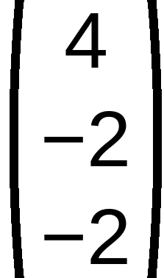

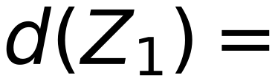

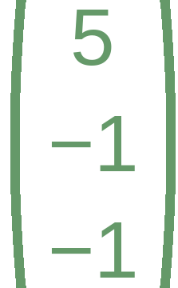
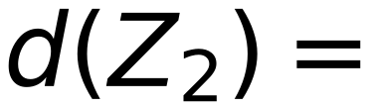

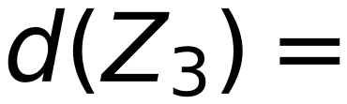

x₁
x₂
x₃
x₄
x₅
x₆
$$\begin{matrix}4 \\ -2 \\ -2\end{matrix}$$
$$Step η = 1$$
Z₁
Z₂
Z₃
51
1
2
1
5
6
6
Initial W =
Check classes of
0
7
3
1
1
2
4
5
6
0
6
2
C₁
C₁
C₁
C₂
C₂
C₂
C₁
positive
C₂
negative
Zero
is unaccepted
Ugmented Vectors ( from Top )
$$(1 0 0)$$
$$\begin{matrix}5 \\ -1 \\ -1\end{matrix}$$
x₁
x₂
x₃
x₄
x₅
x₆
$$d(Z_{1}) =$$
=
5
Positive > 0
Class I
1
1
1
1
1
1
1
2
1
5
6
6
1
1
2
4
5
6
$$(1 7 6)$$
$$\begin{matrix}5 \\ -1 \\ -1\end{matrix}$$
C₁
C₁
C₁
C₂
C₂
C₂
$$d(Z_{2}) =$$
=
−8
Negative < 0
Class II
Check Classes
$$(1 3 2)$$
$$\begin{matrix}5 \\ -1 \\ -1\end{matrix}$$
$$d(Z_{3}) =$$
=
0
Not > 0 , Not < 0
Undefined Class

