Slide 1

Neural Network
1
Back Propagation Training Algorithm
CSAI 253 - Spring 2024
Prepared By
Dr. Khaled Mostafa ElSayed
kmelsayed@zewailcity.edu.eg
Instructors:
Dr. Khaled Mostafa ElSayed
kmelsayed@zewailcity.edu.eg
Dr. Mohamed Maher Ata
momaher@zewailcity.edu.eg

Slide 2
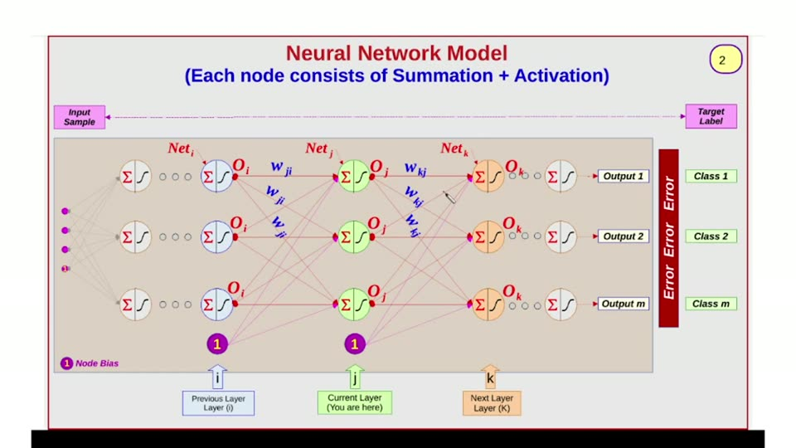

Slide 3
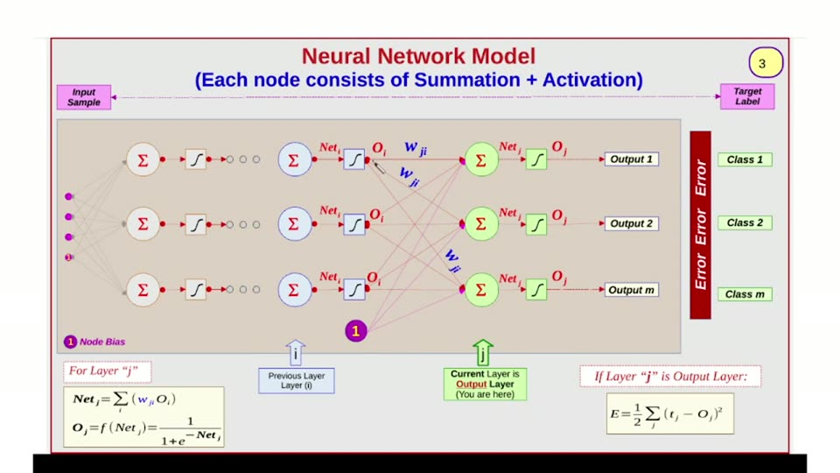

Slide 4
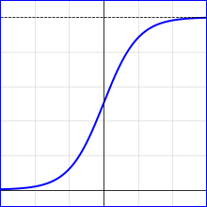
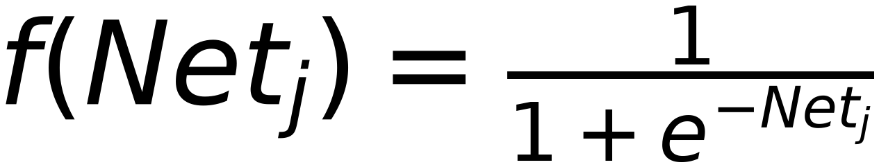
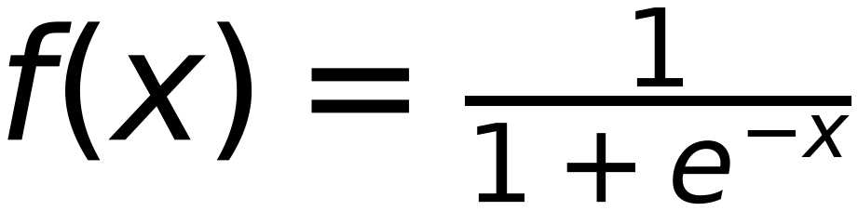
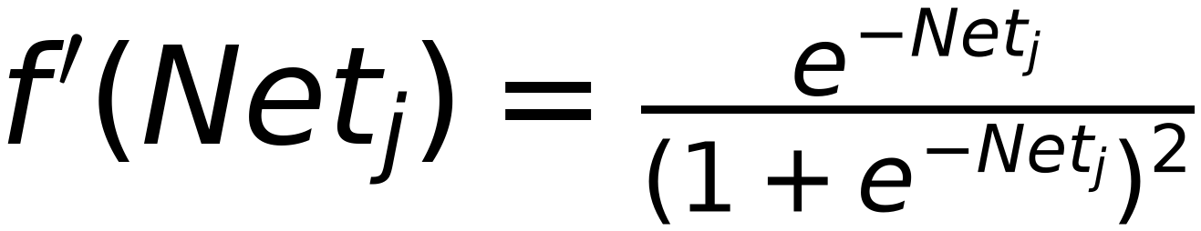
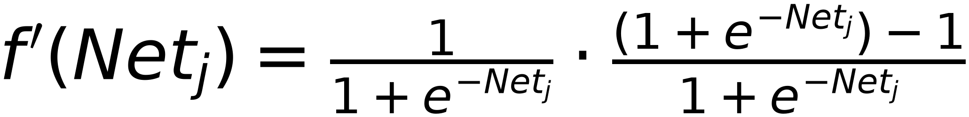
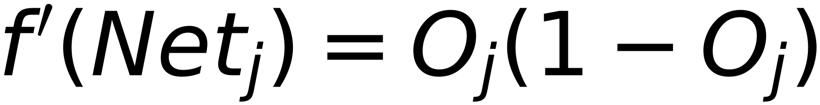
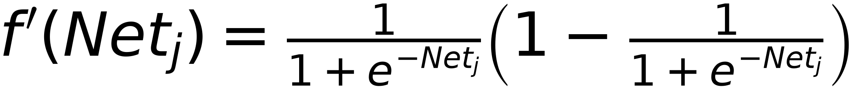
Remember:
Derivative of Sigmoid Function
4
O_j:
Σ
Net_j
f
Net_j

Slide 5
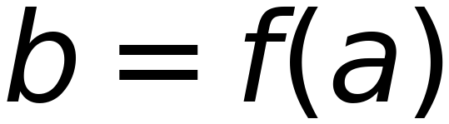
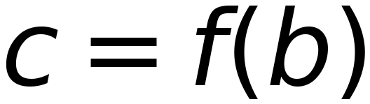

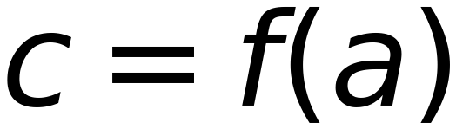
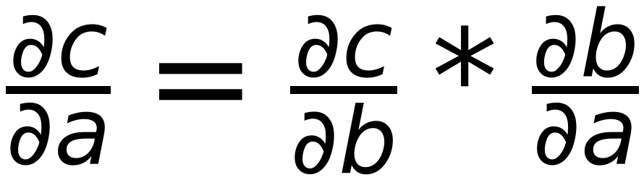
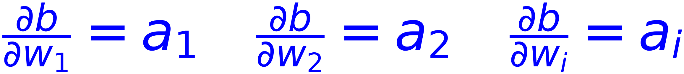


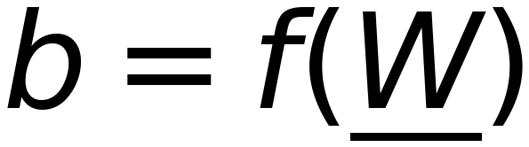
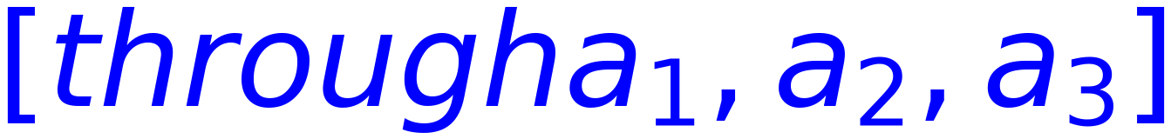
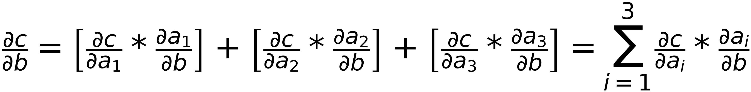
Revision
5
if a is changed , c will be chnaged accordingly)
Chain Rule
Conclusion:
=
then
One Term ONLY
and

Slide 6
Update Weights of
6
Output Layer
( Weights from previous layer to output layer)

Slide 7




Neural Network Model
7
(Weights of Output Layer AFFECTS Calculated Error)
For Layer "j"
↑
↑
If Layer "j" is Output Layer:
Previous Layer Layer (0)
Current Layer is Output Layer (You are here)

Slide 8

8
w_j
w_j
w_j
Σ
Net
Net
Class 1
O
Σ
Σ
Output 1
E
w
O
r
?
w
r
Σ
o
Class 2
Net
Σ
Σ
Net
r
O
Output 2
w
O
Σ
w
Class m
Net
Σ
Σ
Net
Multi Bias
O
1
Output m
w
O
w

Slide 9




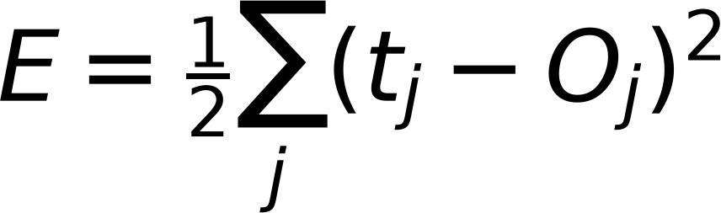
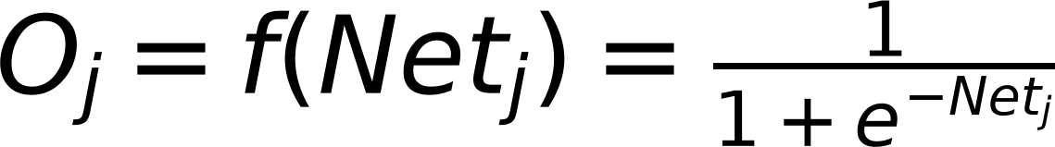
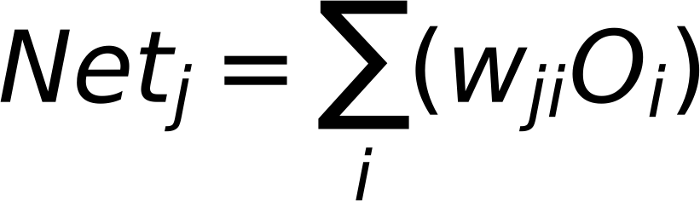
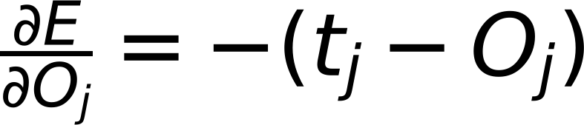
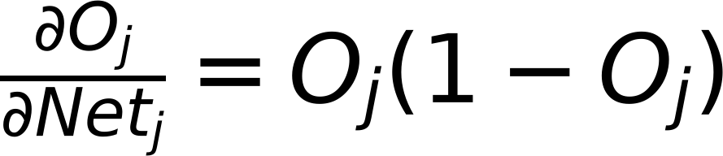
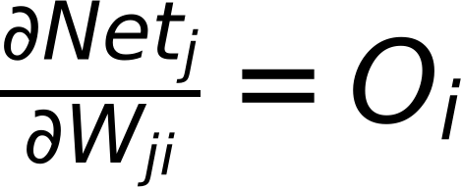

Gradient Descent
9
Error Class 1
$$W_{ji}^{Updated}=W_{ji}^{old}-η\frac{∂E}{∂W_{ji}}$$
E
r
r
Error Class 2
$$W_{ji}^{Updated}=W_{ji}^{old}+Δ_{ji}$$
o
r
Where
$$Δ_{ji}=-η\frac{∂E}{∂W_{ji}}$$
Error Class m
$$E=\frac{1}{2}\sum_{j}{(t_{j}-O_{j})^{2}}$$
For Sigmoid Activation
$$O_{j}=f(Net_{j})=\frac{1}{1+e^{-Net_{j}}}$$
$$Net_{j}=\sum_{i}{(w_{ji}O_{i})}$$
$$\frac{∂E}{∂O_{j}}=-(t_{j}-O_{j})$$
$$\frac{∂O_{j}}{∂Net_{j}}=O_{j}(1-O_{j})$$
$$\frac{∂Net_{j}}{∂W_{ji}}=O_{i}$$
$$\frac{∂E}{∂W_{ji}}=\frac{∂E}{∂O_{j}}*\frac{∂O_{j}}{∂Net_{j}}*\frac{∂Net_{j}}{∂W_{ji}}$$
$$\frac{∂E}{∂O_{j}}=-(t_{j}-O_{j})$$
$$=-(t_{j}-O_{j})*O_{j}(1-O_{j})*O_{i}$$
$$\frac{∂O_{j}}{∂Net_{j}}=O_{j}(1-O_{j})$$
$$\frac{∂Net_{j}}{∂W_{ji}}=O_{i}$$

Slide 10












Gradient Descent
10
Class 1
$$W_{ji}^{updated}=W_{ji}^{old}-η\frac{∂E}{∂W_{ji}}$$
E
r
r
Class 2
$$W_{ji}^{updated}=W_{ji}^{old}+Δ_{ji}$$
o
r
Where
$$Δ_{ji}=-η\frac{∂E}{∂W_{ji}}$$
Class m
$$E=\frac{1}{2}\sum_{j}{(t_{j}-O_{j})^{2}}$$
For Sigmoid Activation
$$O_{j}=f(Net_{j})=\frac{1}{1+e^{-Net_{j}}}$$
$$Net_{j}=\sum_{i}{(w_{ji}O_{i})}$$
$$\frac{∂E}{∂O_{j}}=-(t_{j}-O_{j})$$
$$\frac{∂O_{j}}{∂Net_{j}}=O_{j}(1-O_{j})$$
$$\frac{∂Net_{j}}{∂W_{ji}}=O_{i}$$
$$\frac{∂E}{∂W_{ji}}=\frac{∂E}{∂O_{j}}⋅\frac{∂O_{j}}{∂Net_{j}}⋅\frac{∂Net_{j}}{∂W_{ji}}=\frac{∂E}{∂Net_{j}}⋅\frac{∂Net_{j}}{∂W_{ji}}$$
$$\frac{∂E}{∂O_{j}}=-(t_{j}-O_{j})$$
$$=-(t_{j}-O_{j})⋅O_{j}(1-O_{j})⋅O_{i}=-δ_{j}⋅O_{i}$$
$$\frac{∂O_{j}}{∂Net_{j}}=O_{j}(1-O_{j})$$
Where
$$δ_{j}=-\frac{∂E}{∂Net_{j}}=(t_{j}-O_{j})⋅O_{j}(1-O_{j}) (δ_{j} depends on j ONLY)$$
$$\frac{∂Net_{j}}{∂W_{ji}}=O_{i}$$
$$Δ_{ji}=-η\frac{∂E}{∂W_{ji}}=ηδ_{j}⋅O_{i}$$
Where
$$δ_{j}=(t_{j}-O_{j})⋅O_{j}(1-O_{j}) for output Layer$$

Slide 11
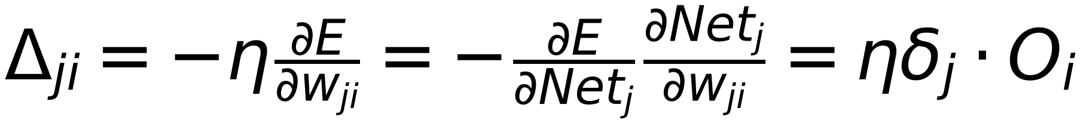
Updated Weights of Output Layer
11
( Calculated Error is affected by Netj,)
Input Sample
Target Label
∂E/∂wji
wji
wjj
Error
Error
Class 1
Σ
f()
Oi
Σ
Netj
Oj
Σ
Netj
Oj
Output 1
1
Class 2
Σ
f()
Oi
Σ
Netj
Oj
Σ
Netj
Oj
Output 2
Class m
Σ
f()
Oi
Σ
1
Netj
Oj
Σ
Netj
Oj
Output m
Node Bias
1
∂E/∂Netj = -δj
1
Where δj = -∂E/∂Netj (one δ for each Node j)

Slide 12






At Output Layer
12
O_i
δ_j
w_ji
O_j
t_j
w_ji
w_ji
O_i
δ_j
w_ji
w_ji
w_ji
O_j
Error
t_j
w_ji
w_ji
O_i
δ_j
w_ji
O_j
t_j
↑
Where:

Slide 13
Update Weights of
Hidden Layer
13
(Weights from previous layer to Hidden layer)

Slide 14


Neural Network Model
14
(Current Layer is Hidden Layer)
Input Sample
Target Label
O_j w_ji
Σ
Σ
Net_j
O_j w_kj
Σ
Net_j
O_k w_kl
Σ
Net_k
Error
Error
f
O_j
f
f
f
Output 1
Class 1
w_ji
w_kj
O_j
w_kl
O_k
O_j w_ji
Σ
f
Σ
Net_j
O_j w_kj
Σ
Net_j
O_k w_kl
Σ
Net_k
Class 2
O_j
f
f
f
Output 2
w_ji
w_kj
O_j
w_kl
O_k
O_j w_ji
Σ
f
Σ
Net_j
O_j w_kj
Σ
Net_j
O_k w_kl
Σ
Net_k
Class m
O_j
f
f
f
Output m
w_ji
w_kj
O_j
w_kl
O_k
1
1
⋮
⋮
⋮
⋮
⋮
For Layer "j"
Previous Layer
(l)
Current Layer
(You are here)
Next Layer
(K)
Note: Layer "j" is NOT Output Layer
X X X

Slide 15
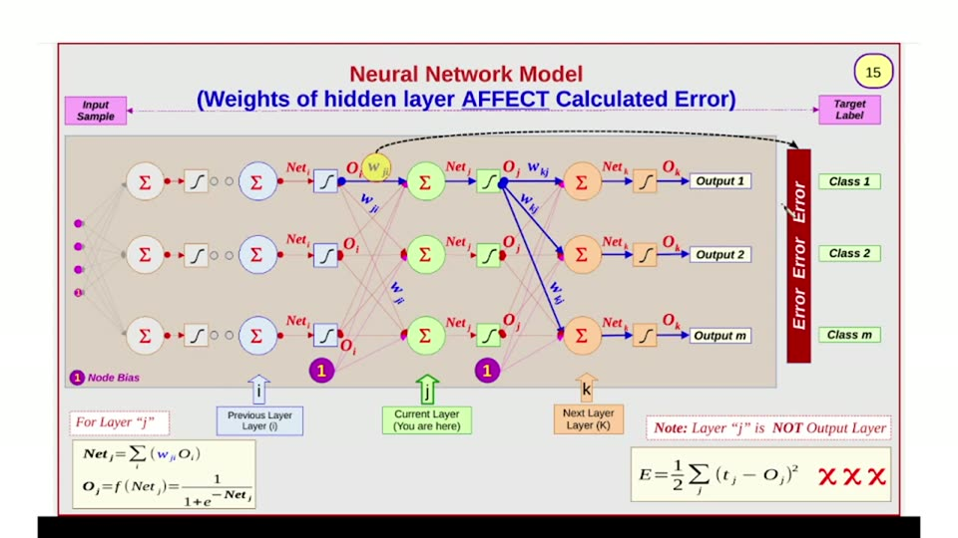

Slide 16




Neural Network Model
16
(How Weights of hidden layer affect Calculated Error)
Input Sample
Target Label
Error Error
Class 1
Class 2
Class m
↑ i
↑ j
↑ k
For Layer "j"
Previous Layer (l)
Current Layer (You are here)
Next Layer (K)
Note: Layer "j" is NOT Output Layer
X X X

Slide 17




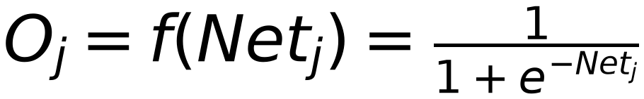
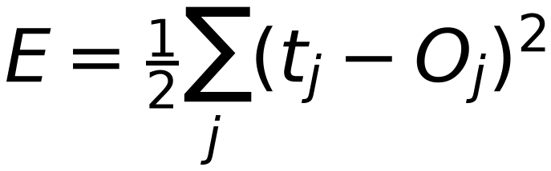
Neural Network Model
17
(Effect of Net_k on Calculated Error is known from O/P Layer)
Input
Sample
Target
Label
Net_i
O_i
W_ij
O_j
W_jk
O_k
Σ
Σ
W_ij
Σ
Net
W_jk
Σ
Net
Output 1
Error Error Error
Class 1
Net_i
O_i
O_j
O_k
Σ
Σ
W_ij
Σ
Net
W_jk
Σ
Net
Output 2
Class 2
Net_i
O_i
O_j
O_k
Σ
Σ
W_ij
Σ
Net
W_jk
Σ
Net
Output m
Class m
1
Node Bias
1
1
k
For Layer "j"
Previous Layer
Layer (i)
Current Layer
(You are here)
Next Layer
Layer (K)
Note: Layer "j" is NOT Output Layer
X X X

Slide 18
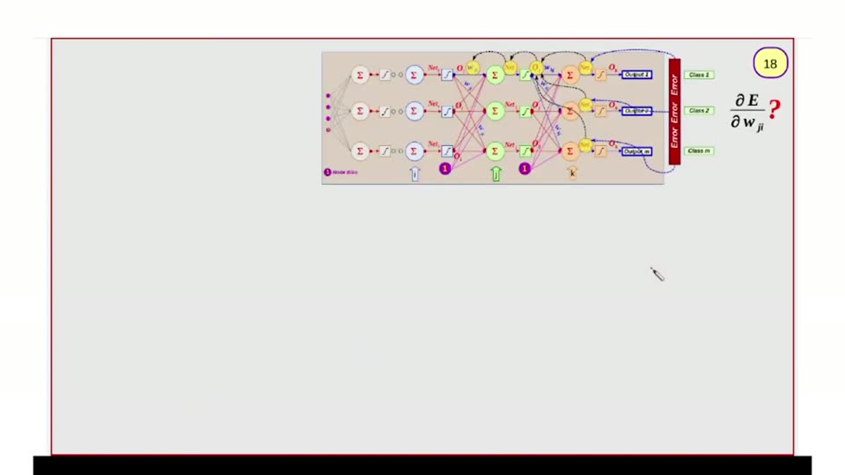

Slide 19
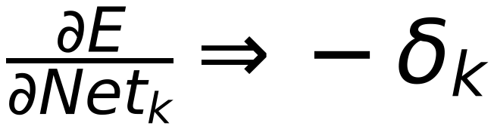
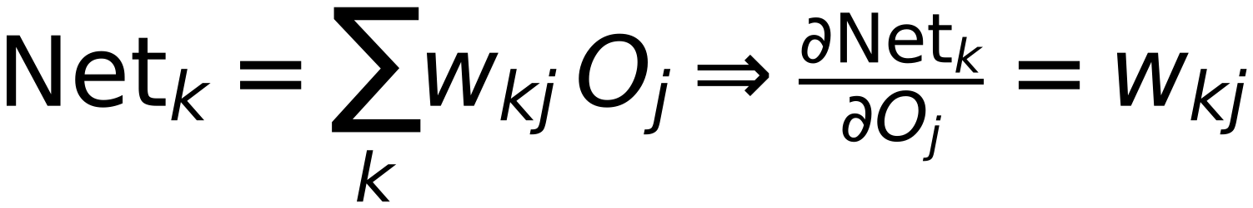
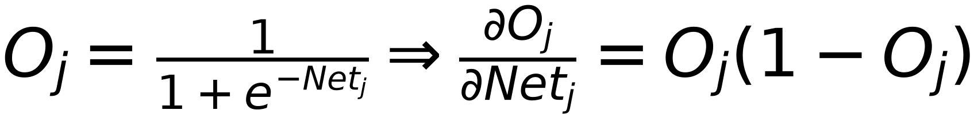
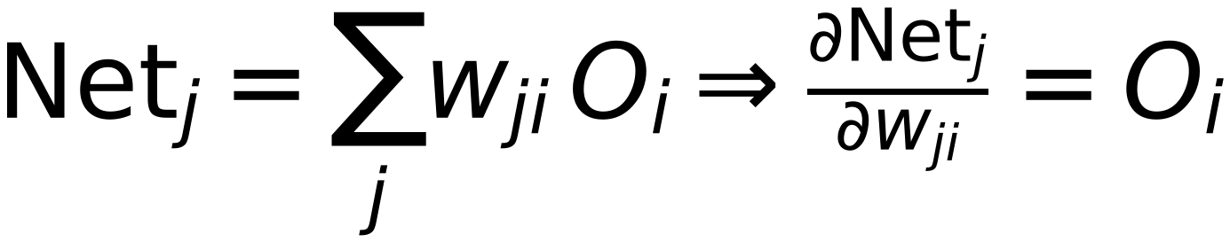
19
W_{ji} Affects Net_{j} ⇒
Net_{j} Affects O_{j} ⇒
Σ
w
σ
σ
Σ
σ
w
Σ
Net_k=1
Error
Error
Error
Class 1
O_{j} Affects (Net_{k=1}, Net_{k=2}, ..., Net_{k=m}) ⇒
Σ
w
σ
σ
Σ
σ
w
Σ
Net_k=2
Class 2
(Net_{k=1}, Net_{k=2}, ..., Net_{k=m}) Affect Error
Σ
w
σ
σ
Σ
σ
w
Σ
Net_k=3
Class m
Sample Data
1
1
X

Slide 20
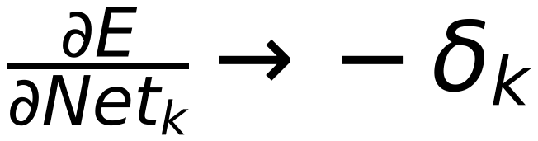
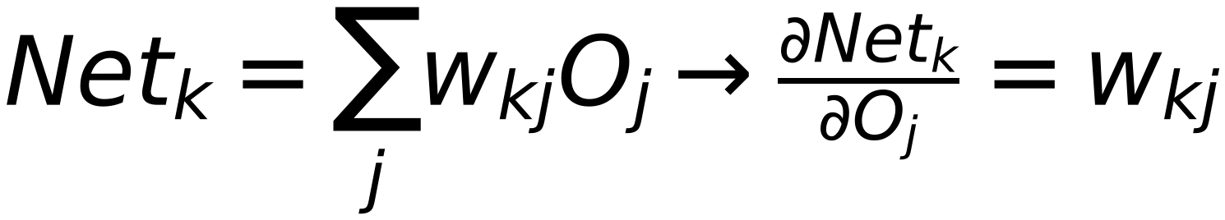

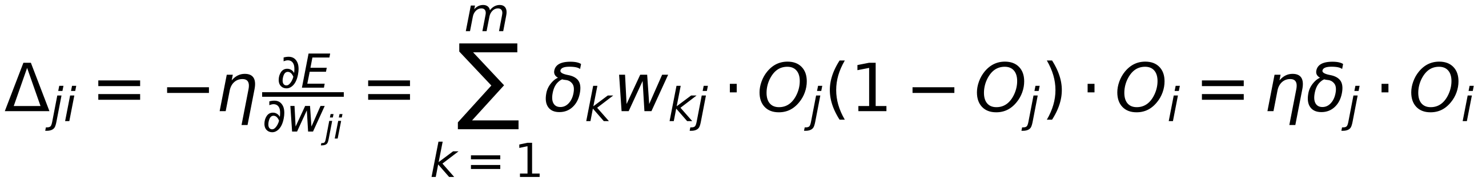
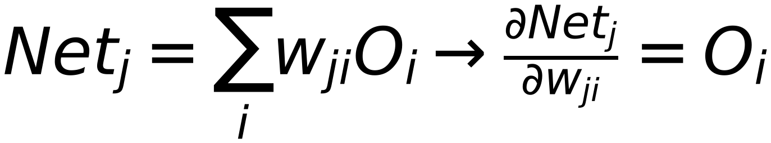
20
Net
Error
W_{ji} Affects Net_{j} ⇒
Σ
1
Output
Class 1
Net_{j} Affects O_{j} ⇒
Net
Σ
2
Output
Class 2
O_{j} Affects (Net_{k=1}, Net_{k=2}, ..., Net_{k=m}) ⇒
Net
Σ
3
Output
Class m
(Net_{k=1}, Net_{k=2}, ..., Net_{k=m}) Affect Error
Node Mode

Slide 21
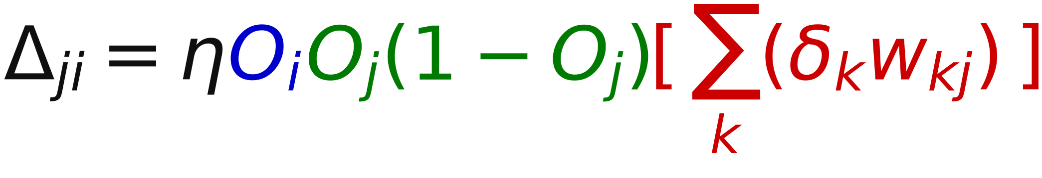

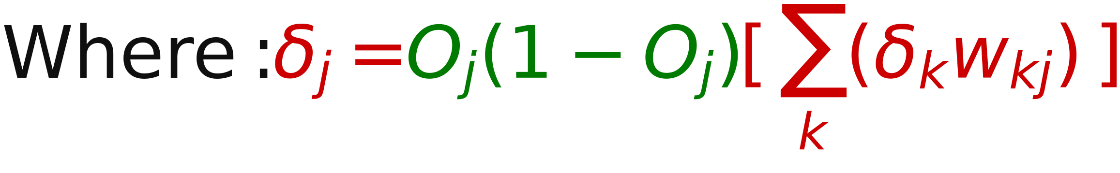
At Hidden Layer
21
Oᵢ
δₖ
wⱼᵢ
wₖⱼ
Oᵢ
δₖ
wⱼᵢ
Oⱼ
wₖⱼ
wⱼᵢ
δⱼ
wₖⱼ
Oᵢ
δₖ
j

Slide 22
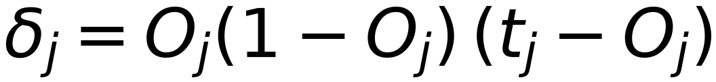
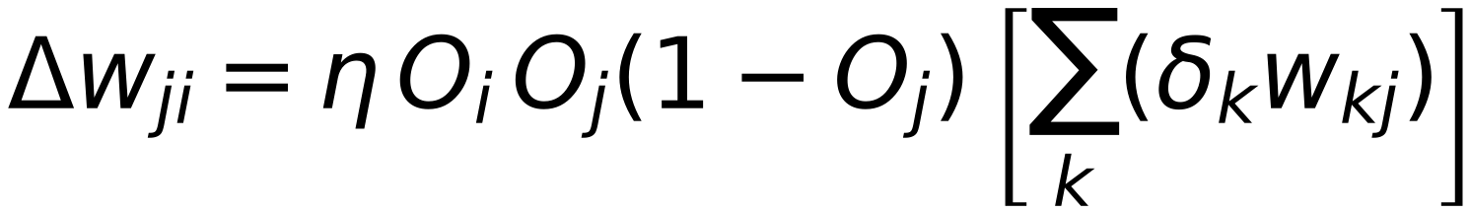
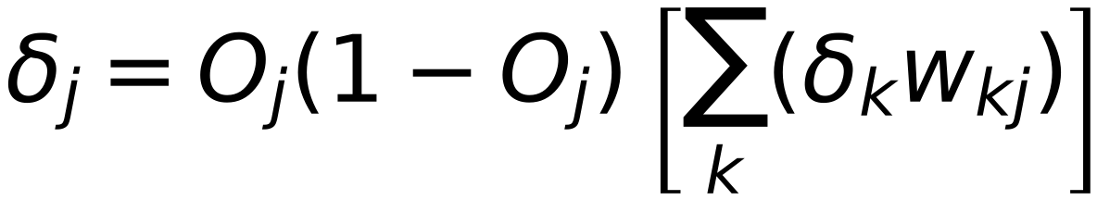
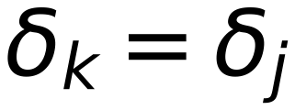
Back Propagation Training Algorithm
22
Neural Net
Netⱼ
Oⱼ
Σ
Σ
Output 1
Target 1
w₁ⱼ
Error 1
Error 2
Error m
w₂ⱼ
Σ
wₖᵢ
Σ
Output 2
Target 2
wₙⱼ
Σ
Σ
Output m
Target m
Input Layer
Hidden Layer
Output Layer
[1] Initialize all Weights with random values
[2] Provide one training sample at a time (and its corresponding target label)
[3] Go Forward : Start from Input Layer, Calculate Netⱼ, Oⱼ for each layer till reach output layer
[4] Go Backward : Start from Output Layer, Calculate Δwⱼᵢ, Wⱼᵢ for each weights of Output layer
Store:
(for each node at output Layer)
[5] Go Backward : go to previous Layer, Calculate Δwⱼᵢ, Wⱼᵢ for each weights of Hidden layer
Store:
(for each node at hidden Layer)
[6] Repeat [5] till reach first hidden layer
Remember:
of next layer ( which is already calculated in previous step )

Slide 23
23
Initialization (Random Weights)
Pick Training Sample, and Corresponding Label
Go Forward, Calculate Output
Go Backward, Update weights
Last Sample ?
NO
Yes
Stop criteria is reached
NO
Yes
Max Iteration Is reached
Stop
NO
Yes
Pick First Sample again
Stop with FAIL

Slide 24
Stopping Criteria
24
[1] Total Error = zero (Theoretical)
[2] Total Error < certain value (Threshold)
[3] Percentage Change of Weights is less than certain value (Threshold)
[4] Reach Maximum number of iterations (Epochs) without satisfying [2] or [3]
Stopping is due to reaching Maximum number of iterations = Training is FAILED
Expected Reasons:
[1] The defined Maximum Number of Epochs is small. Try to increase the limit
[2] Under-fitting (Training samples are not adequate). Try to provide more training samples
[3] Model Design is not suitable to training data. Try to add more nodes in hidden layer or add more hidden Layers
[4] Data is NOT separable by Neural Network. Try Another Models (e.g. SVM with Kernels)

Slide 25
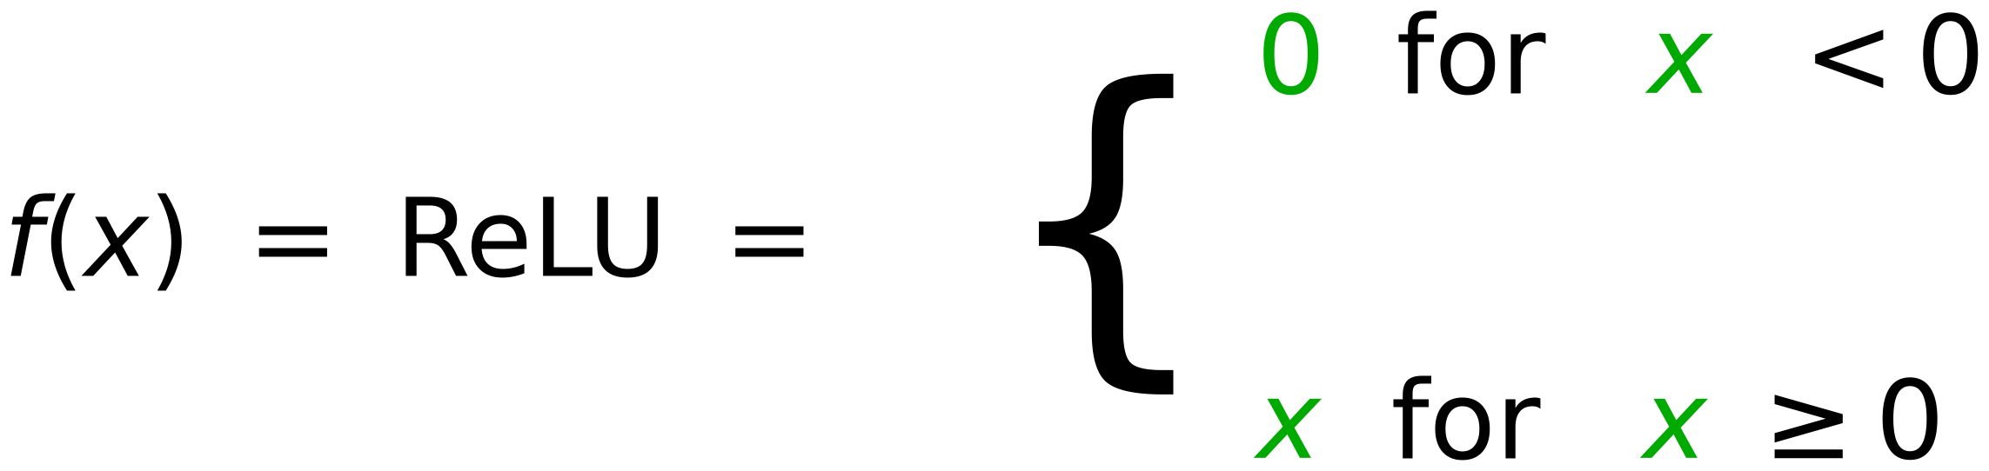
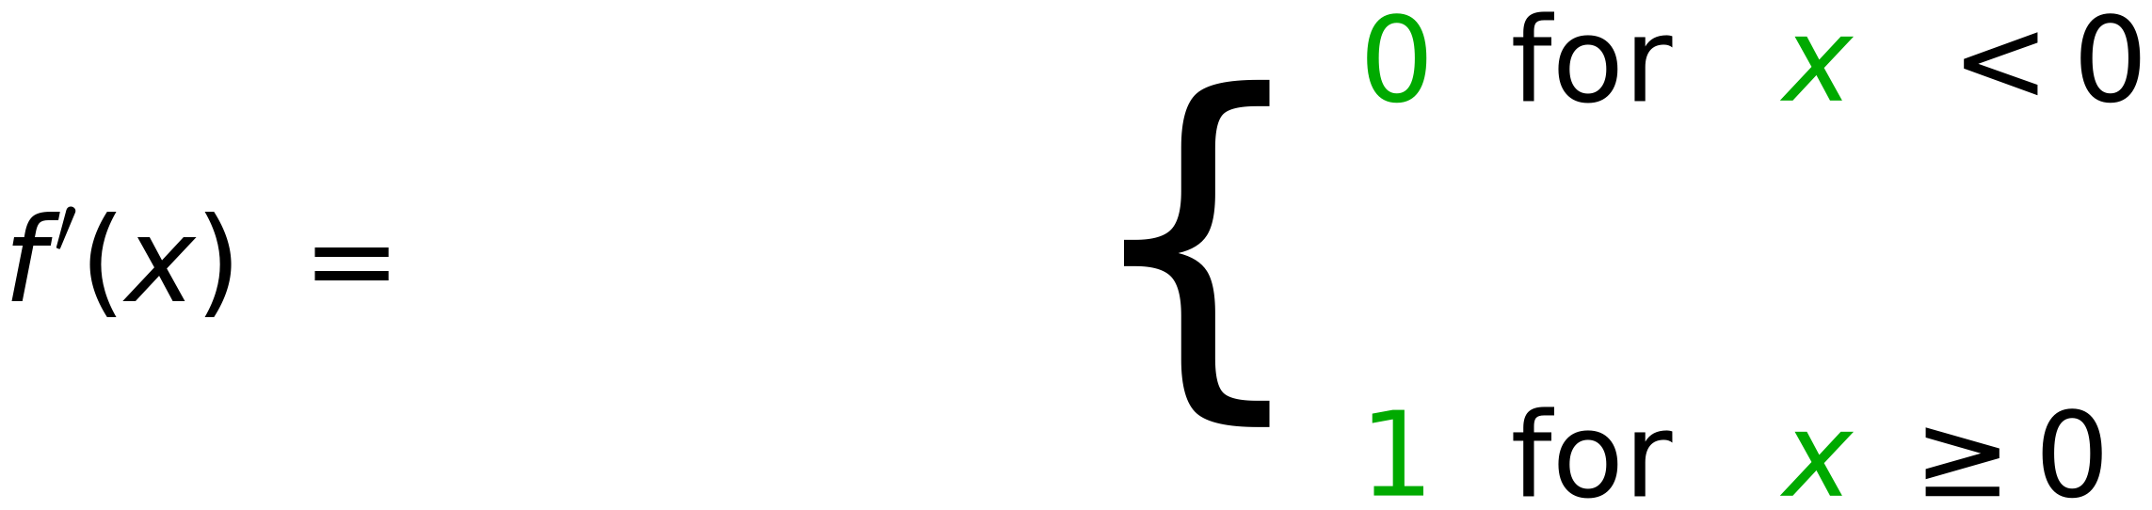
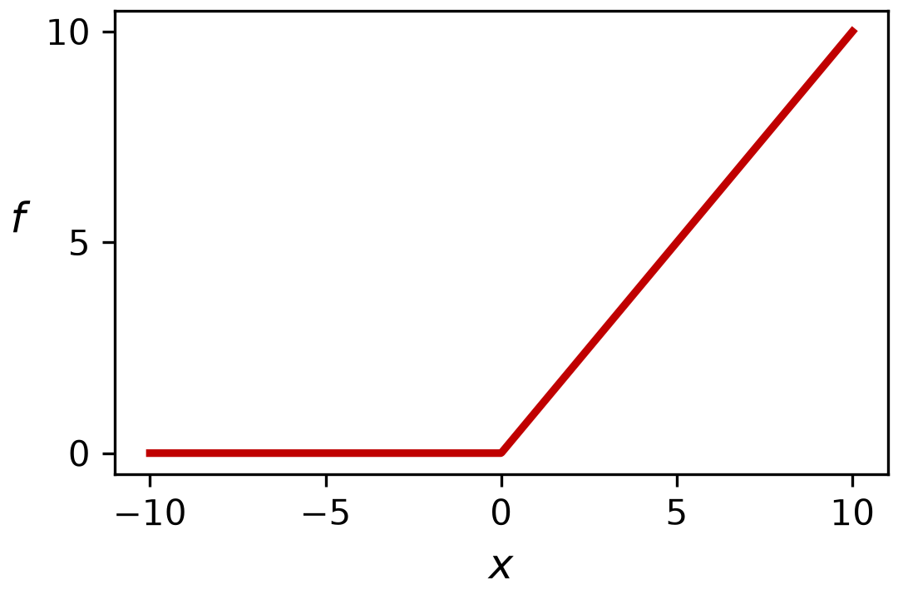
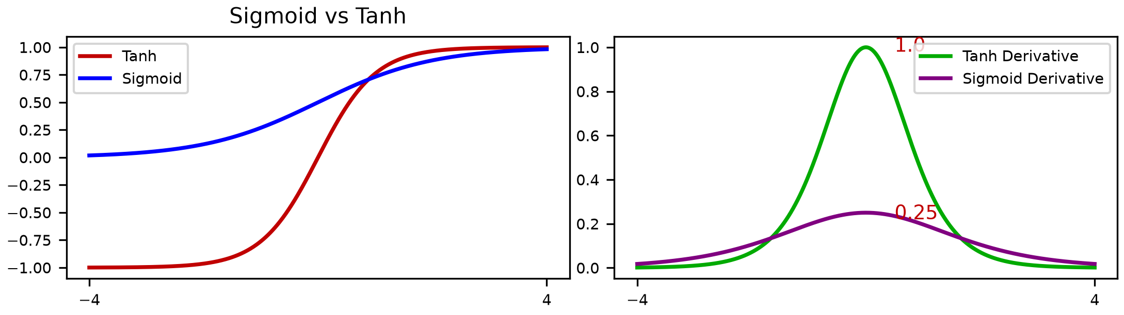
Vanishing and Exploding Gradients
25
Long Chain of Derivatives
1
Error
Error
Error
Σ
Σ
Output 1
Class 1
w
w
Σ
Σ
Output 2
Class 2
w
w
Σ
1
Σ
Output m
Class m
w
w
Node Bias
1.0
Exploding Gradients
Vanishing Gradients

Slide 26
26
Solved Example
[ Update Weights of Output Layer and Hidden Layer ]
Using one training sample

Slide 27
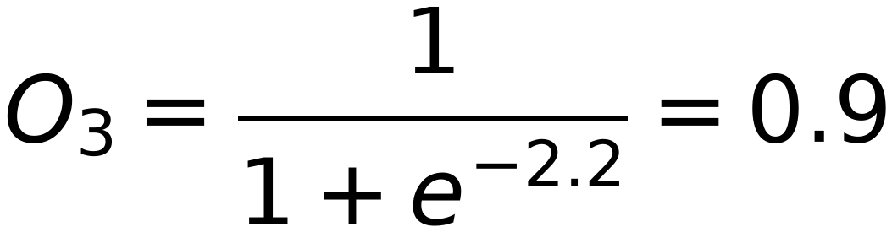
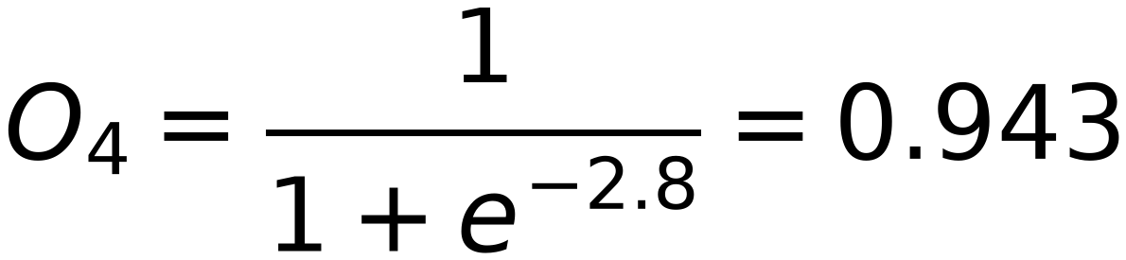
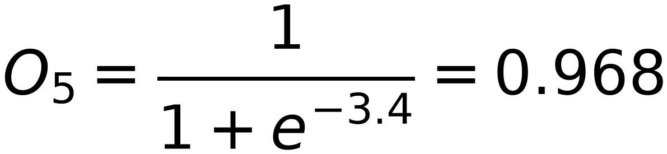
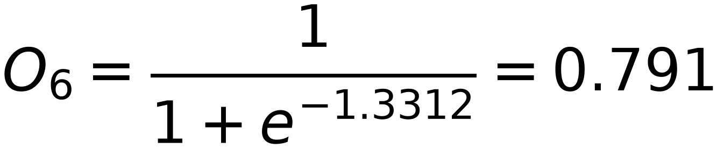

Example
27
Input
3
Output
Target
O₃
0.3
x₁
0.1
(1)
0.2
6
O₆
t₆=(0)
0.3
0.4
O₄
4
0.4
x₂
0.6
t₇=(1)
(5)
0.5
0.5
7
O₇
0.4
5
O₅
0.5
0.2
0.1
0.2
1
0.1
η=5
Bias
0.1
Forward
Net₃ = 1*0.1+5*0.4+1*0.1 = 2.2
Net₄ = 1*0.2+5*0.5+1*0.1 = 2.8
Net₅ = 1*0.3+5*0.6+1*0.1 = 3.4
Net₆ = 0.9*0.3+0.943*0.4+0.968*0.5+1*0.2 = 1.3312
Net₇ = 0.9*0.3+0.943*0.4+0.968*0.5+1*0.2 = 1.3312

Slide 28


Slide 29
After Updating O/p Layer weights
29
Input
O₃
-0.29
0.1
Target
x₁
0.4
3
Output
t₆
[
1
]
0.2
0.458
[
0
]
0.3
-0.218
6
O₆
0.5
O₄
0.565
t₇
5
x₂
4
0.6
-0.134
-0.445
1
0.1
0.1
O₅
0.669
7
O₇
1
0.1
5
-0.375
Bias
Bias
1
η= 5

Slide 30


Slide 31


Slide 32
32
Initialized weights
Output
Target
Input
O3
x1
3
[
1
]
0.1
0.3
O6
6
0.791
t6
0
x2
0.2
0.4
O4
0.4
5
0.3
0.1
0.3
4
0.5
0.5
0.4
O7
0.1
0.2
0.791
t7
1
0.6
O5
0.5
7
0.1
5
0.2
Bias
1
Bias
1
η = 5
Updated weights (after iteration # 1)
Output
Target
Input
O3
x1
3
[
1
]
0.125
-0.29
O6
6
0.352
t6
0
x2
0.215
0.525
O4
-0.218
5
-0.458
0.125
0.305
4
0.575
-0.134
-0.565
O7
0.115
-0.445
0.835
t7
1
0.625
O5
-0.669
7
0.105
5
-0.375
Bias
1
Bias
1
η = 5

Slide 33


Slide 34


