Slide 1


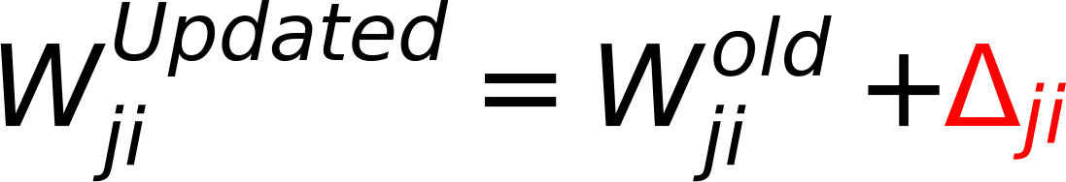

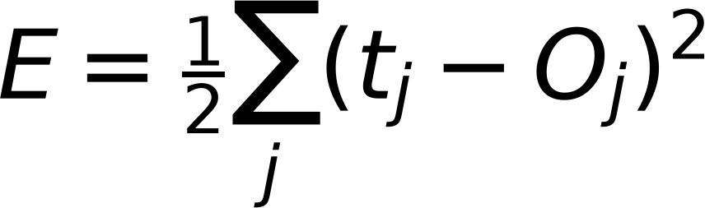
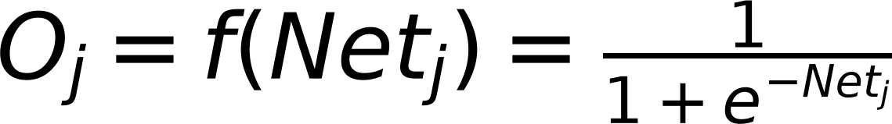
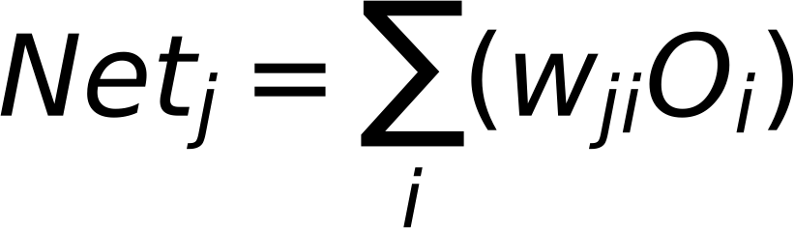
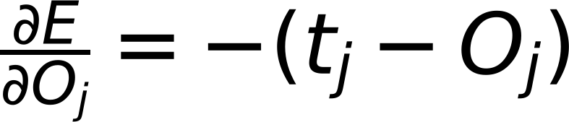
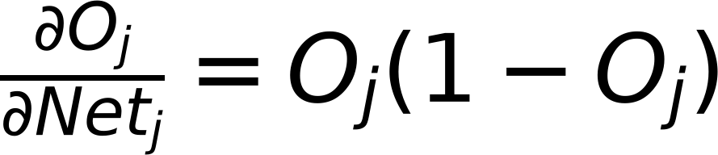
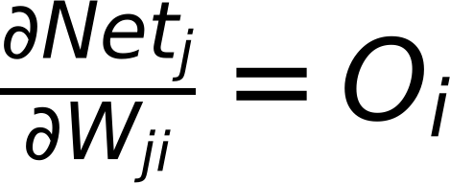

Gradient Descent
9
Error Class 1
$$W_{ji}^{Updated}=W_{ji}^{old}-η\frac{∂E}{∂W_{ji}}$$
E
r
r
Error Class 2
$$W_{ji}^{Updated}=W_{ji}^{old}+Δ_{ji}$$
o
r
Where
$$Δ_{ji}=-η\frac{∂E}{∂W_{ji}}$$
Error Class m
$$E=\frac{1}{2}\sum_{j}{(t_{j}-O_{j})^{2}}$$
For Sigmoid Activation
$$O_{j}=f(Net_{j})=\frac{1}{1+e^{-Net_{j}}}$$
$$Net_{j}=\sum_{i}{(w_{ji}O_{i})}$$
$$\frac{∂E}{∂O_{j}}=-(t_{j}-O_{j})$$
$$\frac{∂O_{j}}{∂Net_{j}}=O_{j}(1-O_{j})$$
$$\frac{∂Net_{j}}{∂W_{ji}}=O_{i}$$
$$\frac{∂E}{∂W_{ji}}=\frac{∂E}{∂O_{j}}*\frac{∂O_{j}}{∂Net_{j}}*\frac{∂Net_{j}}{∂W_{ji}}$$
$$\frac{∂E}{∂O_{j}}=-(t_{j}-O_{j})$$
$$=-(t_{j}-O_{j})*O_{j}(1-O_{j})*O_{i}$$
$$\frac{∂O_{j}}{∂Net_{j}}=O_{j}(1-O_{j})$$
$$\frac{∂Net_{j}}{∂W_{ji}}=O_{i}$$

