Slide 1











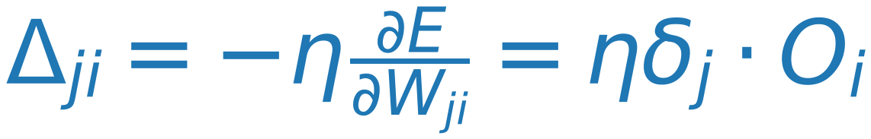
Gradient Descent
10
Class 1
$$W_{ji}^{updated}=W_{ji}^{old}-η\frac{∂E}{∂W_{ji}}$$
E
r
r
Class 2
$$W_{ji}^{updated}=W_{ji}^{old}+Δ_{ji}$$
o
r
Where
$$Δ_{ji}=-η\frac{∂E}{∂W_{ji}}$$
Class m
$$E=\frac{1}{2}\sum_{j}{(t_{j}-O_{j})^{2}}$$
For Sigmoid Activation
$$O_{j}=f(Net_{j})=\frac{1}{1+e^{-Net_{j}}}$$
$$Net_{j}=\sum_{i}{(w_{ji}O_{i})}$$
$$\frac{∂E}{∂O_{j}}=-(t_{j}-O_{j})$$
$$\frac{∂O_{j}}{∂Net_{j}}=O_{j}(1-O_{j})$$
$$\frac{∂Net_{j}}{∂W_{ji}}=O_{i}$$
$$\frac{∂E}{∂W_{ji}}=\frac{∂E}{∂O_{j}}⋅\frac{∂O_{j}}{∂Net_{j}}⋅\frac{∂Net_{j}}{∂W_{ji}}=\frac{∂E}{∂Net_{j}}⋅\frac{∂Net_{j}}{∂W_{ji}}$$
$$\frac{∂E}{∂O_{j}}=-(t_{j}-O_{j})$$
$$=-(t_{j}-O_{j})⋅O_{j}(1-O_{j})⋅O_{i}=-δ_{j}⋅O_{i}$$
$$\frac{∂O_{j}}{∂Net_{j}}=O_{j}(1-O_{j})$$
Where
$$δ_{j}=-\frac{∂E}{∂Net_{j}}=(t_{j}-O_{j})⋅O_{j}(1-O_{j}) (δ_{j} depends on j ONLY)$$
$$\frac{∂Net_{j}}{∂W_{ji}}=O_{i}$$
$$Δ_{ji}=-η\frac{∂E}{∂W_{ji}}=ηδ_{j}⋅O_{i}$$
Where
$$δ_{j}=(t_{j}-O_{j})⋅O_{j}(1-O_{j}) for output Layer$$

