Slide 1


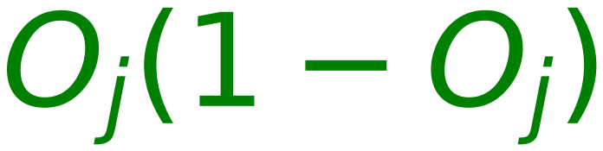

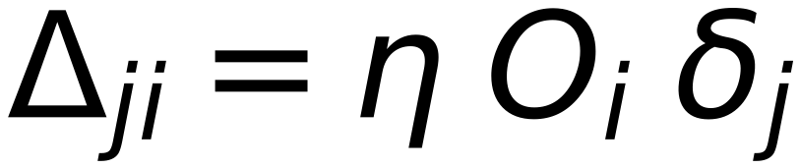

At Output Layer
12
O_i
δ_j
w_ji
O_j
t_j
w_ji
w_ji
O_i
δ_j
w_ji
w_ji
w_ji
O_j
Error
t_j
w_ji
w_ji
O_i
δ_j
w_ji
O_j
t_j
↑
Where:

