Slide 1
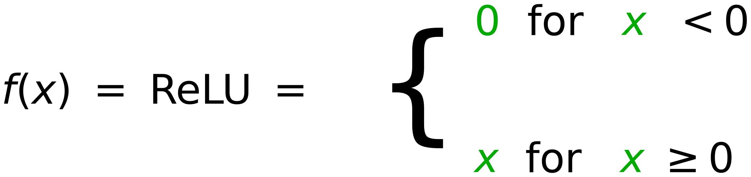
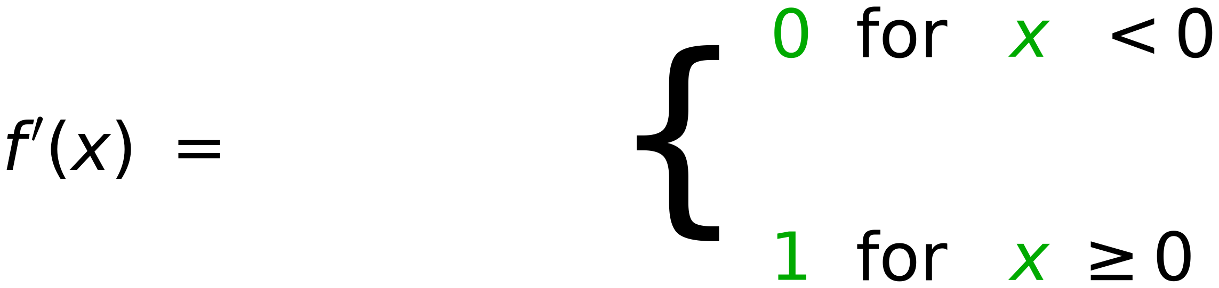
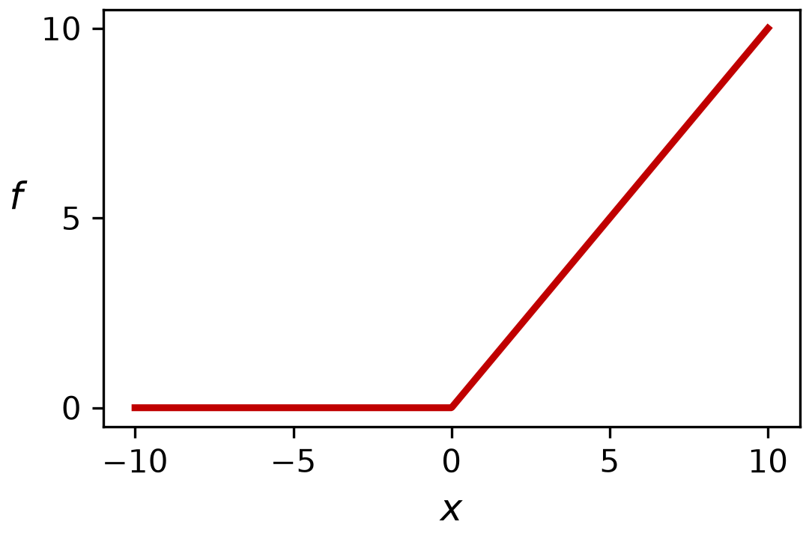
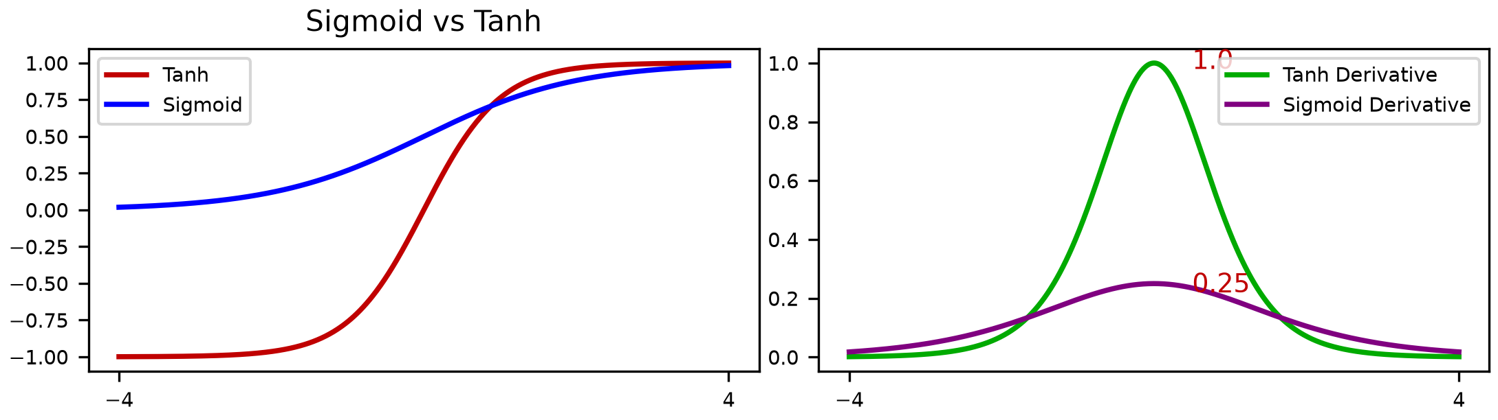
Vanishing and Exploding Gradients
25
Long Chain of Derivatives
1
Error
Error
Error
Σ
Σ
Output 1
Class 1
w
w
Σ
Σ
Output 2
Class 2
w
w
Σ
1
Σ
Output m
Class m
w
w
Node Bias
1.0
Exploding Gradients
Vanishing Gradients

