Slide 1
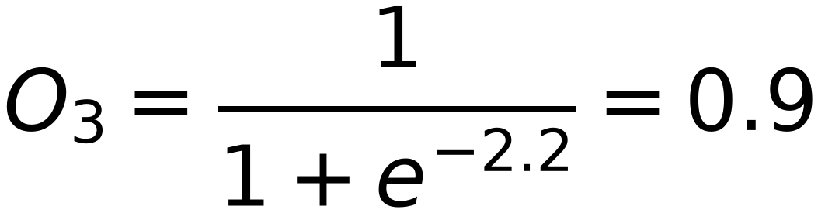
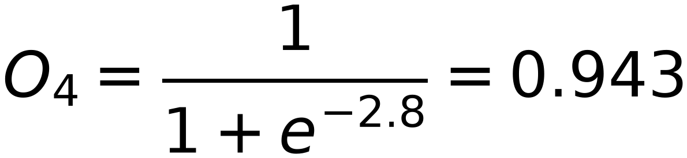
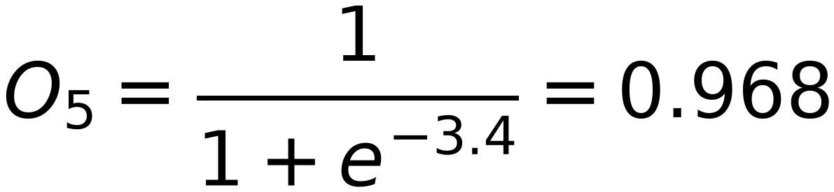
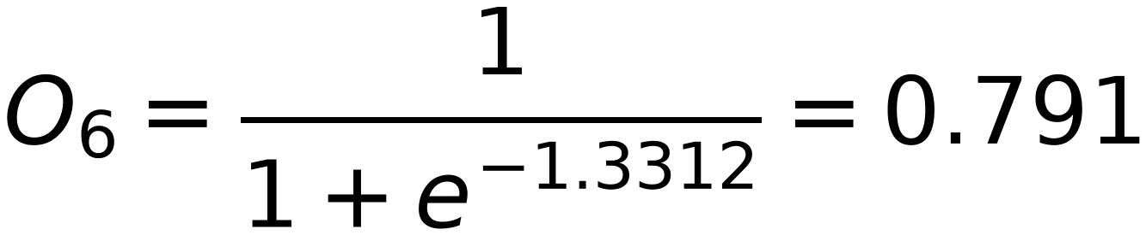
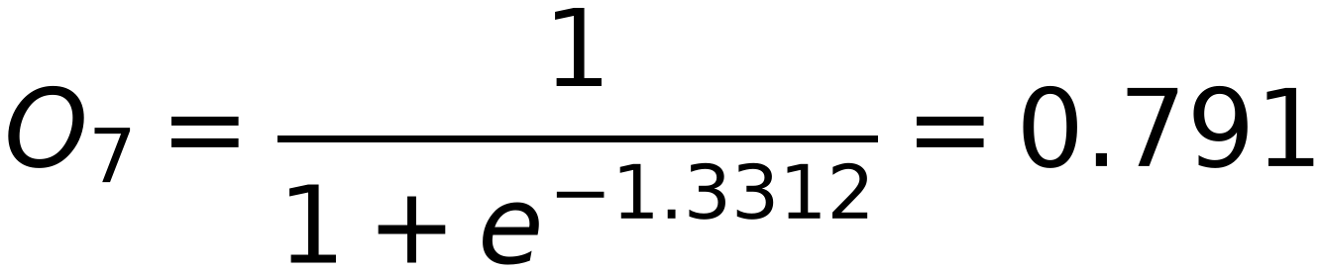
Example
27
Input
3
Output
Target
O₃
0.3
x₁
0.1
(1)
0.2
6
O₆
t₆=(0)
0.3
0.4
O₄
4
0.4
x₂
0.6
t₇=(1)
(5)
0.5
0.5
7
O₇
0.4
5
O₅
0.5
0.2
0.1
0.2
1
0.1
η=5
Bias
0.1
Forward
Net₃ = 1*0.1+5*0.4+1*0.1 = 2.2
Net₄ = 1*0.2+5*0.5+1*0.1 = 2.8
Net₅ = 1*0.3+5*0.6+1*0.1 = 3.4
Net₆ = 0.9*0.3+0.943*0.4+0.968*0.5+1*0.2 = 1.3312
Net₇ = 0.9*0.3+0.943*0.4+0.968*0.5+1*0.2 = 1.3312

