Slide 1
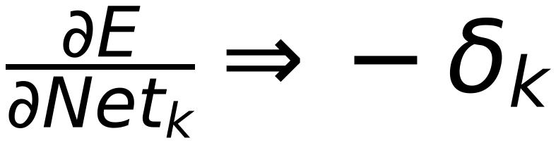
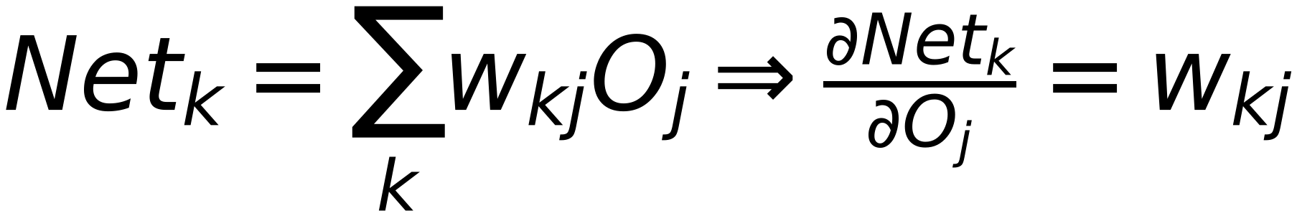
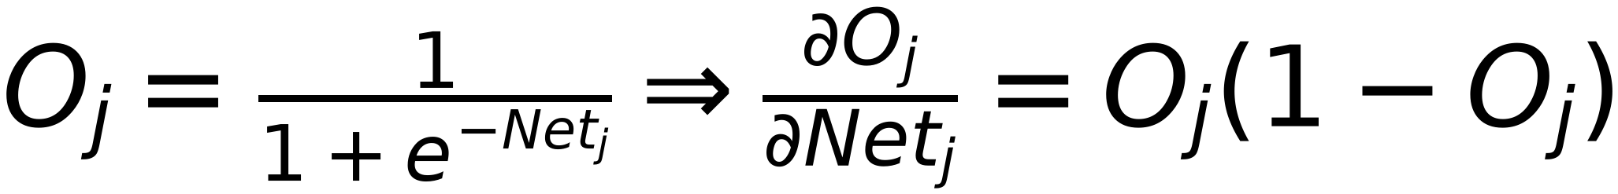
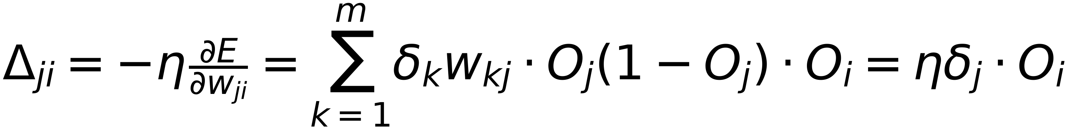
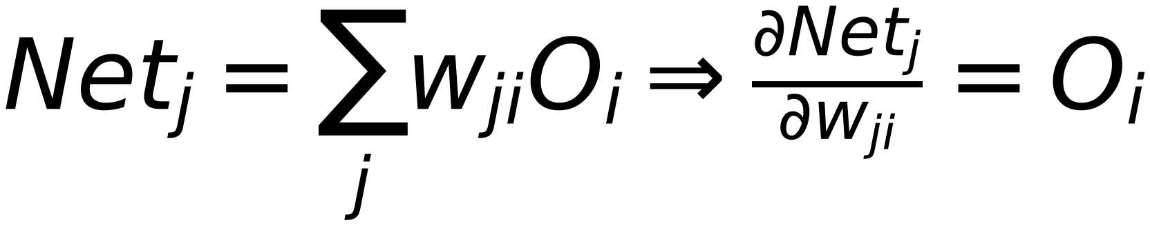
20
Net
Error
W_{ji} Affects Net_{j} ⇒
Σ
1
Output
Class 1
Net_{j} Affects O_{j} ⇒
Net
Σ
2
Output
Class 2
O_{j} Affects (Net_{k=1}, Net_{k=2}, ..., Net_{k=m}) ⇒
Net
Σ
3
Output
Class m
(Net_{k=1}, Net_{k=2}, ..., Net_{k=m}) Affect Error
Node Mode

