Slide 1

1
Ridge Regression,
Gradient Descent,
And Perceptron
CSAI 253 - Spring 2024
Prepared By
Dr. Khaled Mostafa ElSayed
kmelsayed@zewailcity.edu.eg
Instructors:
Dr. Khaled Mostafa ElSayed
kmelsayed@zewailcity.edu.eg
Dr. Mohamed Maher Ata
momaher@zewailcity.edu.eg

Slide 2
2
Revision of Standard Linear
Regression Model

Slide 3
Matrix Notation for Linear Regression and Classification (N- Samples)
3
X₁
X₂
...
X_{n}
x₁₁
x₂₁
...
x_{n1}
Remember
N Training Samples
x₁₂
x₂₂
...
x_{n2}
y = W^{T}X = X^{T}W
...
...
...
...
x_{1d}
x_{2d}
...
x_{nd}
y₁
y₂
...
y_{n}
In General: N >>> d
b
Y = X W
y₁
1
x₁₁
x₁₂
...
x_{1d}
y₂
=
1
x₂₁
x₂₂
...
x_{2d}
w₁
Where: X_{N×d+1} is a matrix
w₂
...
1
...
...
...
...
y_{n}
1
x_{n1}
x_{n2}
...
x_{nd}
...
Y_{N×1} is labels vector
N × 1
N × d+1
w_{d}
d+1 × 1

Slide 4
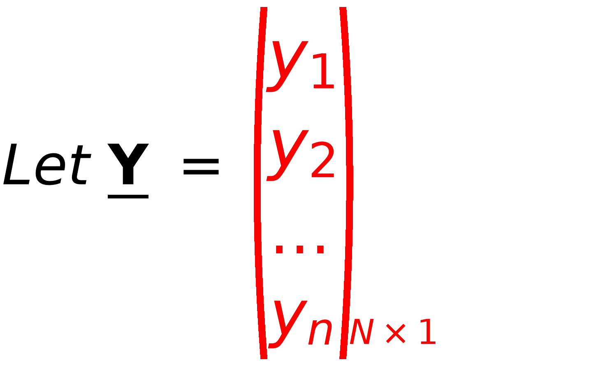
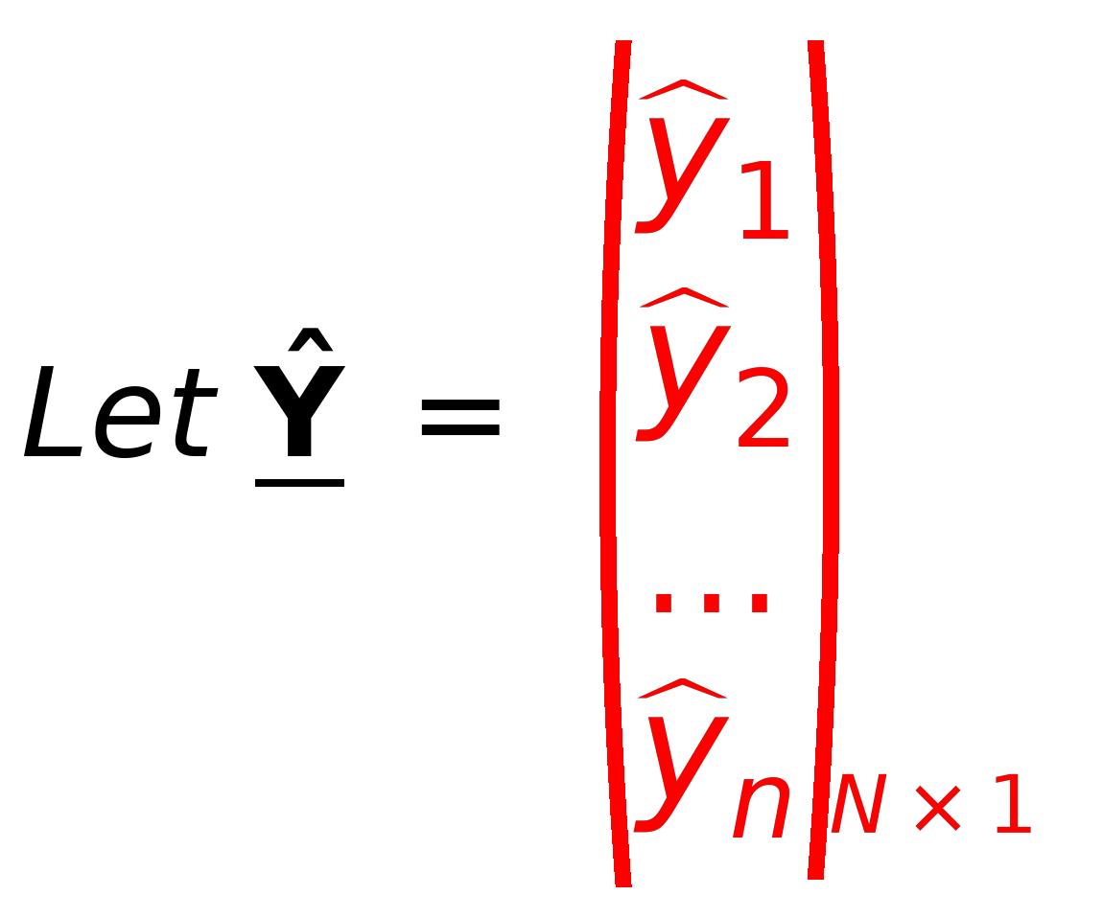
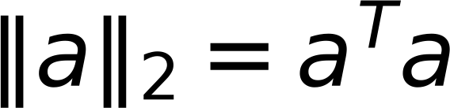
4
Concept of LOSS Function
Remember
Original Labels
Predicted Labels
from Training Samples
from Model Ŷ=XW
Objective is Ŷ=Y
Ŷ = X W
Predicted
Where : X_{N x d+1} is a matrix
⇒
Given
If Ŷ≠Y ⇒ There is an Error (Loss)
Y_{N x 1} is labels vector
Given
⇒
W is Model Parameter
Required
⇒
Define Loss function as squared distance between Ŷ and Y

Slide 5
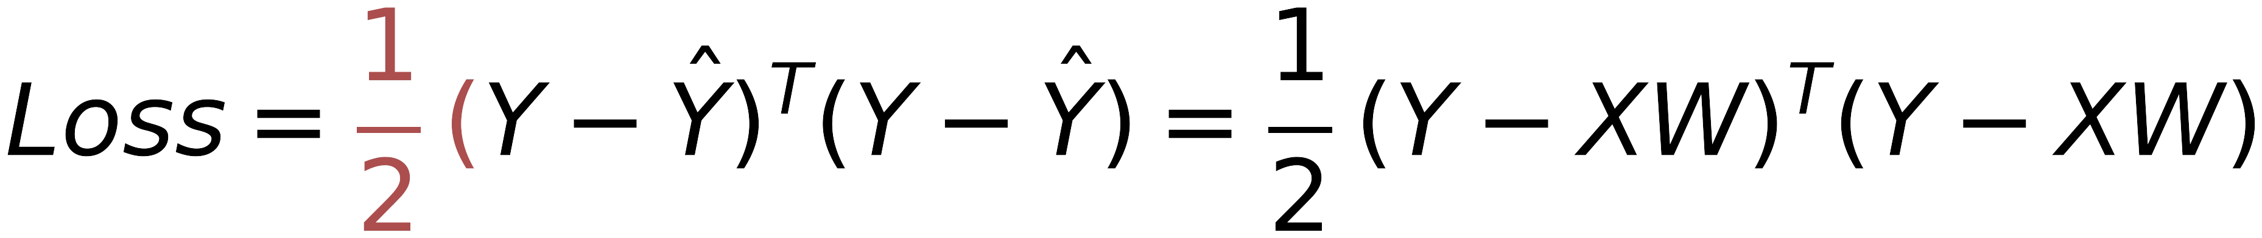
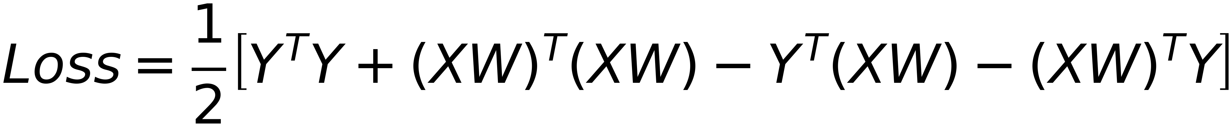

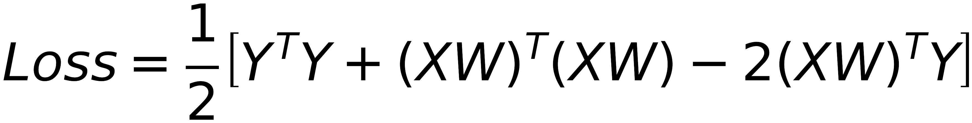
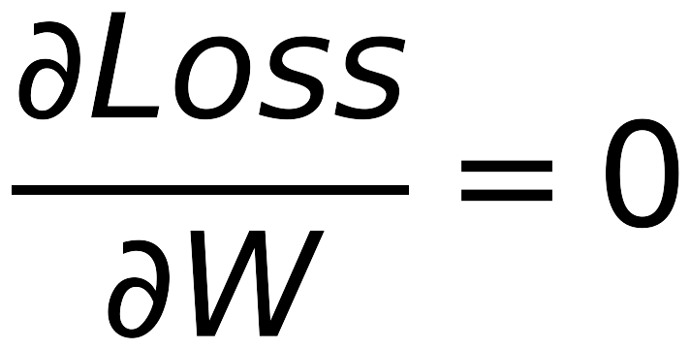
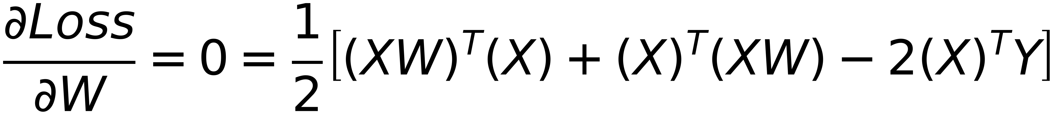
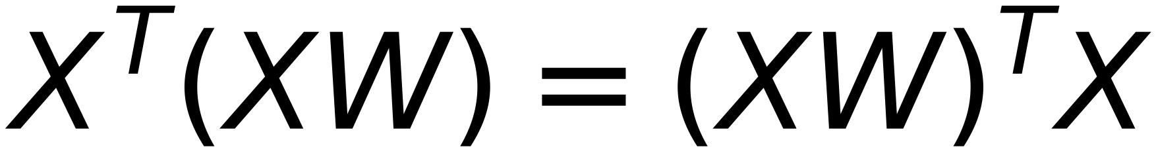
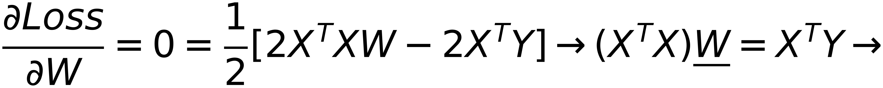

5
Minimization of Loss function to obtain BEST model parameters
Remember
X is a matrix, W is a vector,
XW is a vector
Get Best W that minimizes the loss
Remember

Slide 6
6
Problems of Linear Regression
(With Linearly Separable Data)

Slide 7
7
Problems of Linear Regression
Assume the Dataset is linearly separable (suitable to apply Linear regression model)
Linear regression model has FOUR problems:
➢Overfitting Problem
➢Matrix Inversion Problem [1] (Singular Matrix)
➢Matrix Inversion Problem [2] (Large Matrix dimension)
➢Different Hyperplanes can solve the problems (Selection of Best Hyperplane)

Slide 8
8
[1] Ridge Regularizer to Minimize Overfitting
(Also Known as L2 regularizer)

Slide 9
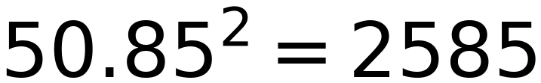
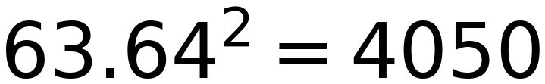
9
$$50.85^{2}=2585$$
$$63.64^{2}=4050$$
50.85 mm
63.64 mm
Overfit (try to minimize the residuals ONLY)
Generalized (Residuals are not minimized)
Fails to detect the Pattern
Successes to detect the Pattern

Slide 10
10
Overfit (try to minimize the residuals ONLY)
Generalized (Residuals are not minimized)
Fails to detect the Pattern
Successes to detect the Pattern

Slide 11
11
Example of Overfitting due to outlier in data
(and how to minimize overfitting )

Slide 12
12
Effect of Overfitting on model parameter “W”
Training Data
Test Data
 | X1 | X2 | X3 | X4 | X5 | X6 | X7 | X8
X1 | 1 | 2 | 3 | 4 | 8 | 9 | 10 | 11
X2 | 1 | 3 | 5 | 6 | 16 | 7 | 5 | 3
y | 2 | 4 | 6 | 8 | 16 | 18 | 20 | 22
 | Test1 | Test2 | Test3
X1 | 30 | 40 | 50
X2 | 15 | 20 | 25
y | 60 | 80 | 100
Perfect Data
Y follows x1
 | X1 | X2 | X3 | X4 | X5 | X6 | X7 | X8
X1 | 1 | 2 | 3 | 4 | 8 | 9 | 10 | 30
X2 | 1 | 3 | 5 | 6 | 16 | 7 | 5 | 3
y | 2 | 4 | 6 | 8 | 16 | 18 | 20 | 22
Again
Y follows x1
X5 is Outlier
What will be the effect of X8 Outlier values on the trained model ???
 | X1 | X2 | X3 | X4 | X5 | X6 | X7 | X8
X1 | 1 | 2 | 3 | 4 | 8 | 9 | 10 | 60
X2 | 1 | 3 | 5 | 6 | 16 | 7 | 5 | 3
y | 2 | 4 | 6 | 8 | 16 | 18 | 20 | 22
X5 is Outlier

Slide 13
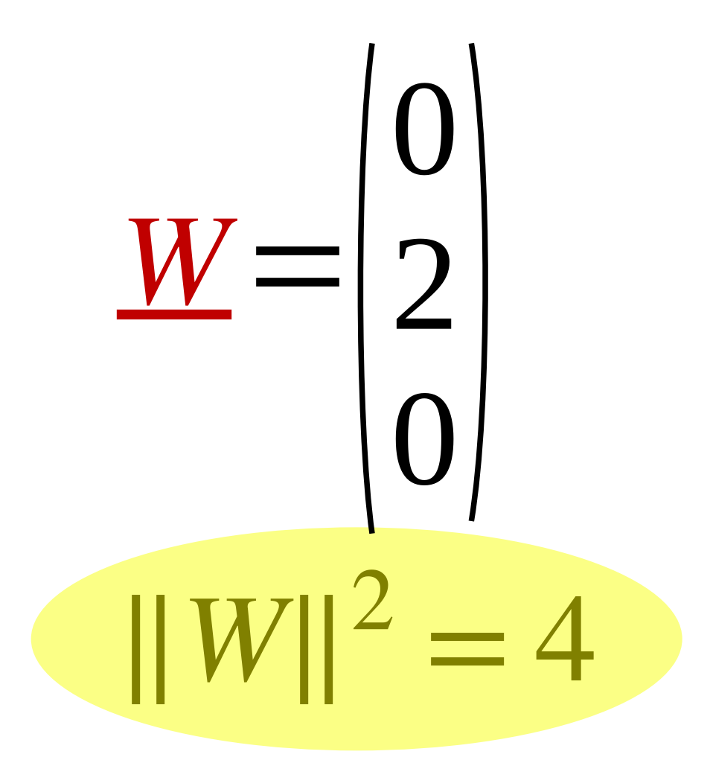
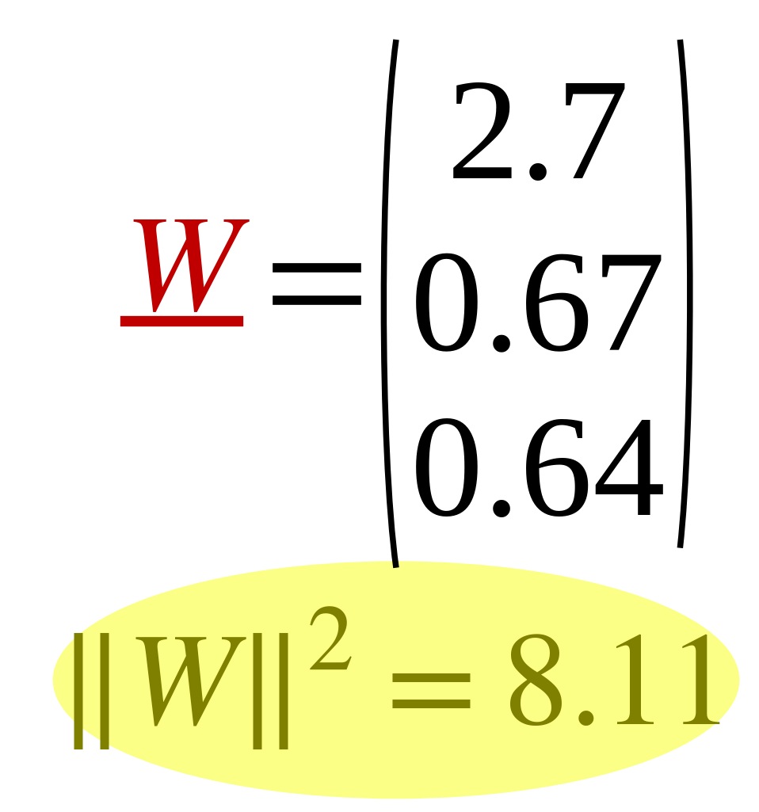
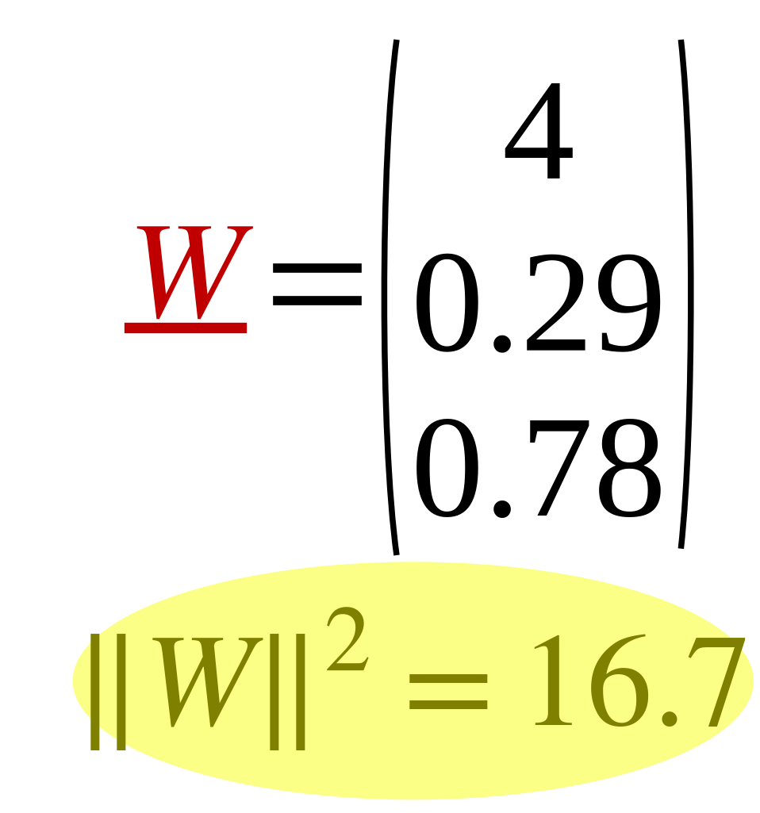
Effect of Overfitting on model parameter “W”
13
Train
Test
 | X1 | X2 | X3 | X4 | X5 | X6 | X7 | X8
X1 | 1 | 2 | 3 | 4 | 8 | 9 | 10 | 11
X2 | 1 | 3 | 5 | 6 | 16 | 7 | 5 | 3
y | 2 | 4 | 6 | 8 | 16 | 18 | 20 | 22
Test1 | Test2 | Test3
30 | 40 | 50
15 | 20 | 25
60 | 80 | 100
 | X1 | X2 | X3 | X4 | X5 | X6 | X7 | X8
X1 | 1 | 2 | 3 | 4 | 8 | 9 | 10 | 30
X2 | 1 | 3 | 5 | 6 | 16 | 7 | 5 | 3
y | 2 | 4 | 6 | 8 | 16 | 18 | 20 | 22
Test1 | Test2 | Test3
30 | 40 | 50
15 | 20 | 25
32.4 | 42.3 | 52.3
 | X1 | X2 | X3 | X4 | X5 | X6 | X7 | X8
X1 | 1 | 2 | 3 | 4 | 8 | 9 | 10 | 60
X2 | 1 | 3 | 5 | 6 | 16 | 7 | 5 | 3
y | 2 | 4 | 6 | 8 | 16 | 18 | 20 | 22
Test1 | Test2 | Test3
30 | 40 | 50
15 | 20 | 25
24.4 | 31.2 | 38

Slide 14
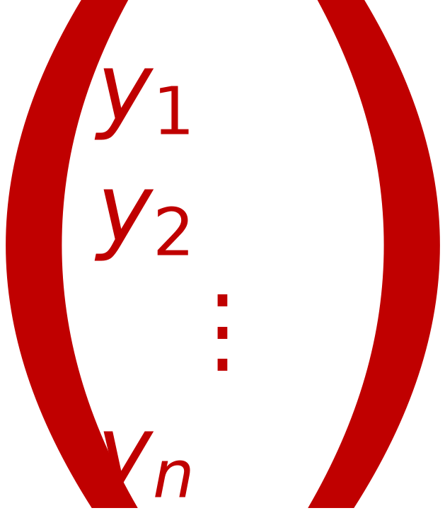
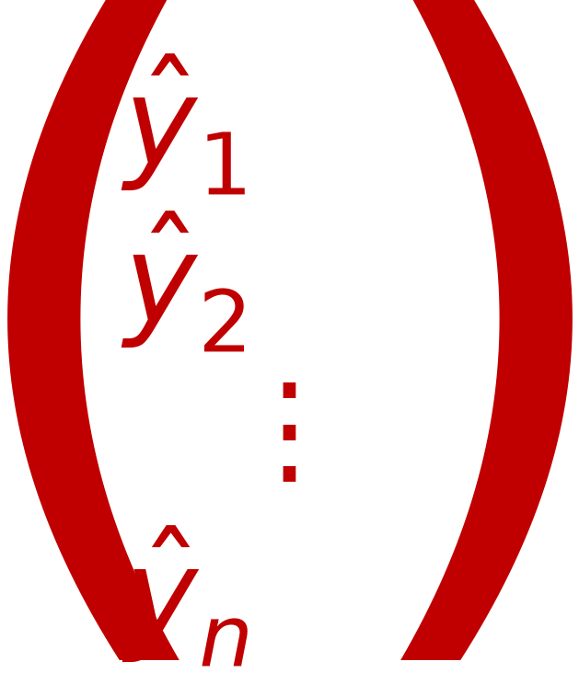

14
LOSS Function that MINIMIZES Overfitting
Let Y =
Let Ŷ =
N_{×1}
Original Labels
N_{×1}
Predicted Labels
from Training Samples
from Model Ŷ = X W
Objective is Ŷ=Y and ||W|| is minimum This is called Ridge Regularization
Objective function J(W)=Loss(X,Y,W)+λR(W) (λ is a weighting factor)
Define Loss function as squared distance between Ŷ and Y
Loss Term = ||Y-Ŷ||² = (Y-Ŷ)^{T}(Y-Ŷ)
Regularization Term R = ||W||² = W^{T}W
Objective function J(W) =

Slide 15
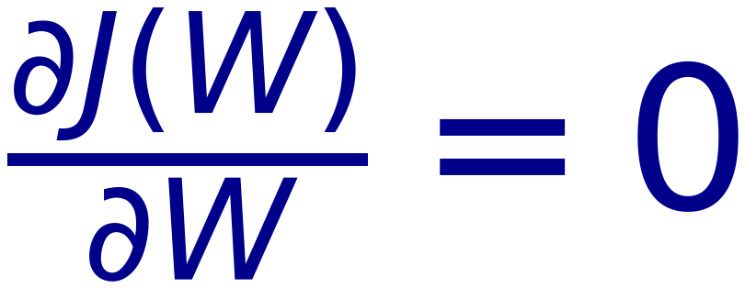
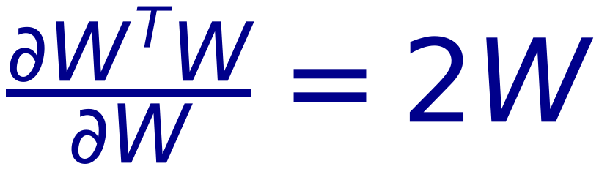


Minimization of Objective function to obtain BEST model parameters
15
Remember
Get Best W that minimizes the Objective Function J(W)

Slide 16
L₁ and L₂ Regularization
16
Regularizers are based on:
Penalize large values of W (model parameters)
• This have the effect of better generalization of the model
• Since there is a contradiction between model training (using training dataset) and model
generalization, the generalization term is added to the objective loss function with a
customized weigh factor (do regularization to what extent)
• Penalization may be applied on the Squared Norm of the Weight Vector
This is called L₂ regularization (also know as Ridge Regularization )
• Penalization may also be applied on the sum of Absolute values of the Weight Vector
This is called L₁ regularization
• Regularization is particularly important for Small number of samples (N) and Large vector
Length (d)

Slide 17
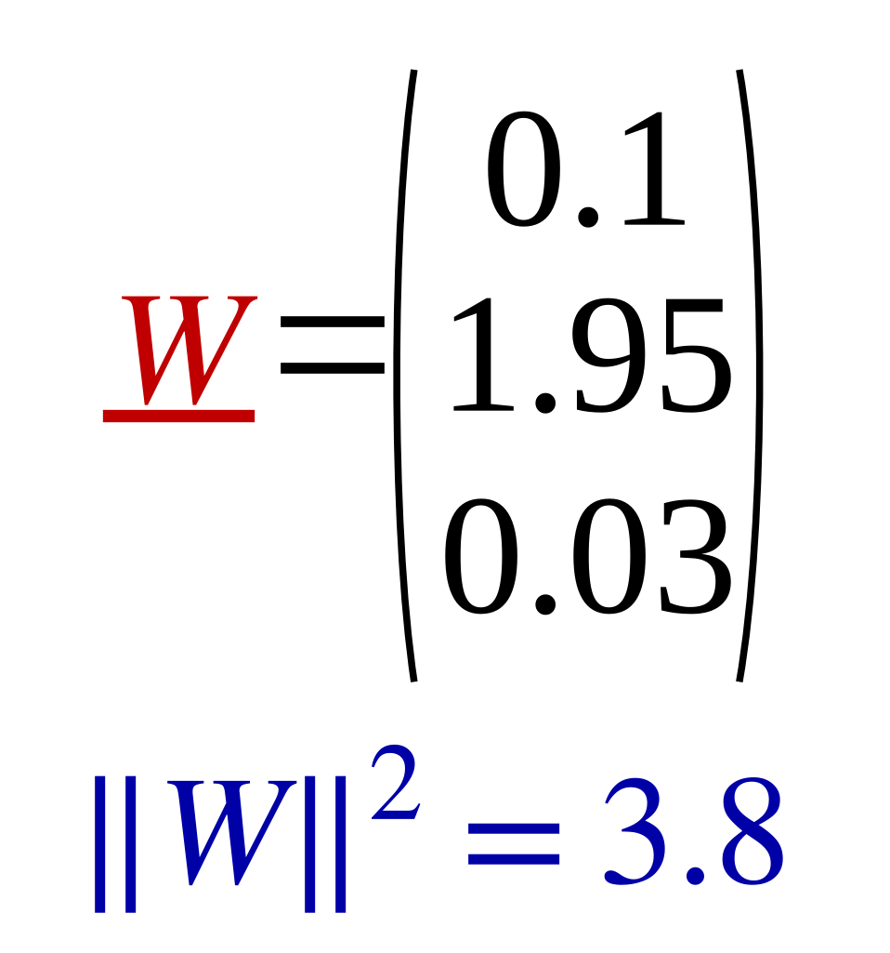
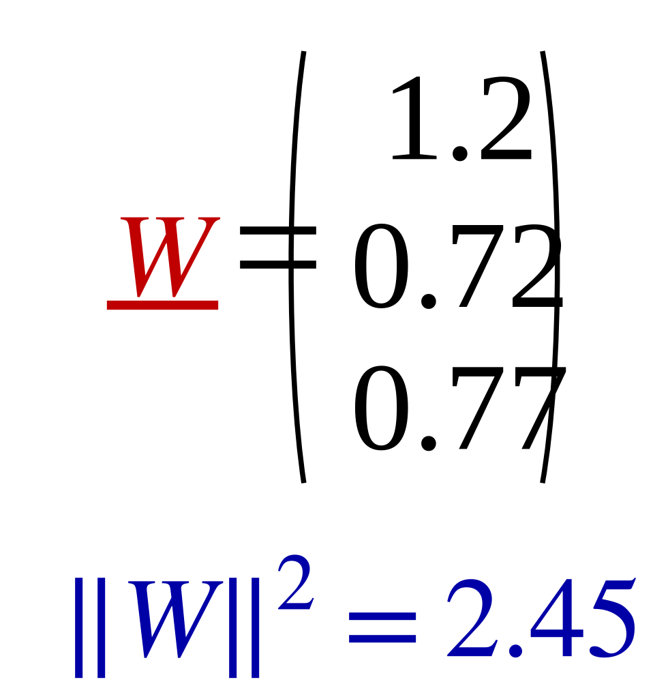
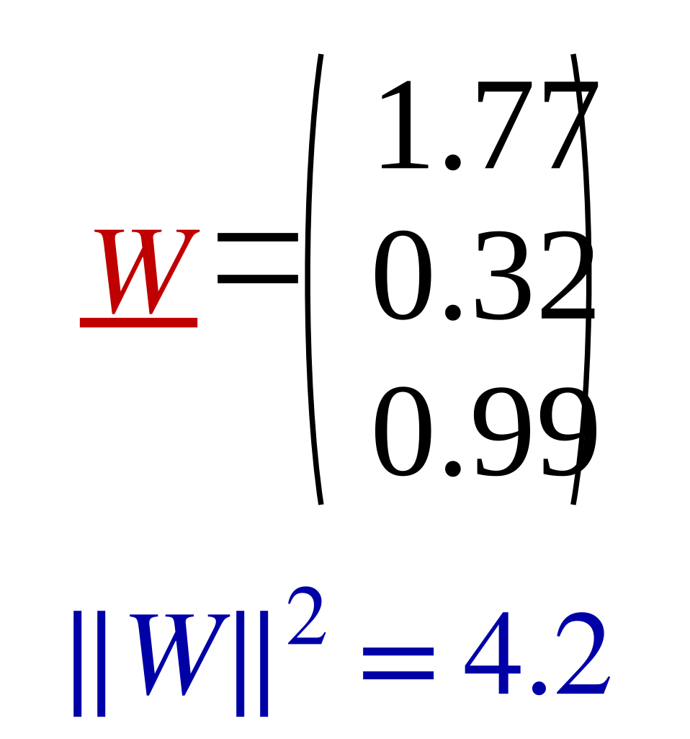
Adding Ridge Regularizer to the model λ=3
17
Train
Test
 | X1 | X2 | X3 | X4 | X5 | X6 | X7 | X8
X1 | 1 | 2 | 3 | 4 | 8 | 9 | 10 | 11
X2 | 1 | 3 | 5 | 6 | 16 | 7 | 5 | 3
y | 2 | 4 | 6 | 8 | 16 | 18 | 20 | 22
 | Test1 | Test2 | Test3
X1 | 30 | 40 | 50
X2 | 15 | 20 | 25
y | 59 | 78.7 | 98.4
 | X1 | X2 | X3 | X4 | X5 | X6 | X7 | X8
X1 | 1 | 2 | 3 | 4 | 8 | 9 | 10 | 30
X2 | 1 | 3 | 5 | 6 | 16 | 7 | 5 | 3
y | 2 | 4 | 6 | 8 | 16 | 18 | 20 | 22
 | Test1 | Test2 | Test3
X1 | 30 | 40 | 50
X2 | 15 | 20 | 25
y | 34.1 | 45.1 | 56.1
 | X1 | X2 | X3 | X4 | X5 | X6 | X7 | X8
X1 | 1 | 2 | 3 | 4 | 8 | 9 | 10 | 60
X2 | 1 | 3 | 5 | 6 | 16 | 7 | 5 | 3
y | 2 | 4 | 6 | 8 | 16 | 18 | 20 | 22
 | Test1 | Test2 | Test3
X1 | 30 | 40 | 50
X2 | 15 | 20 | 25
y | 26.2 | 34.4 | 42.5

Slide 18
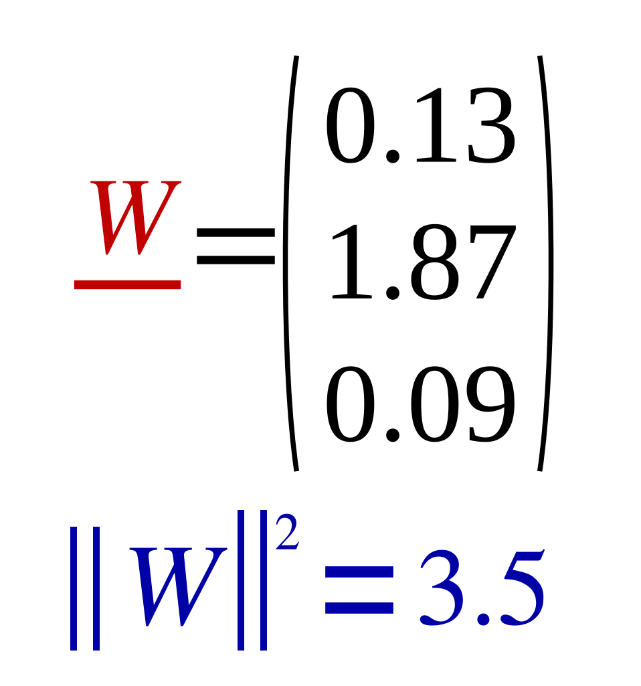
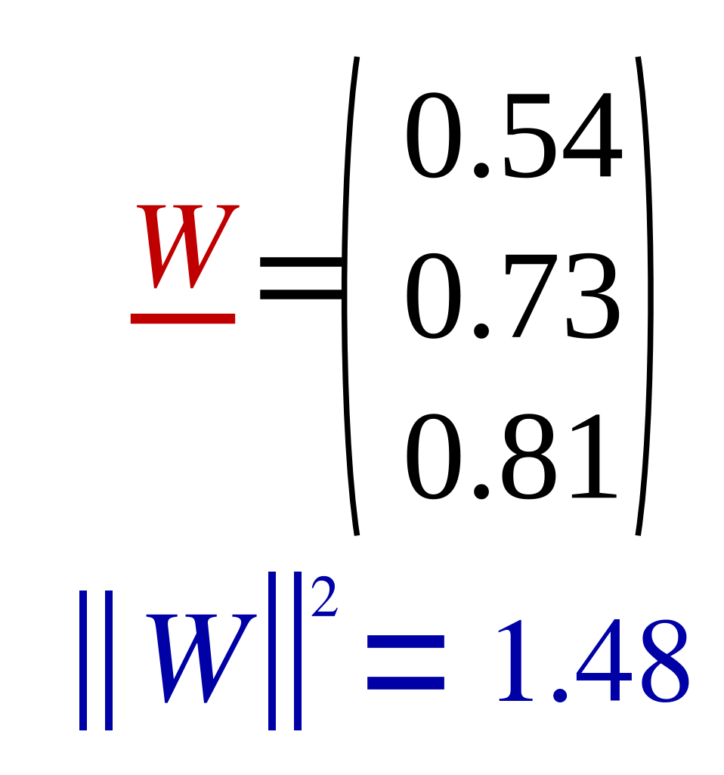
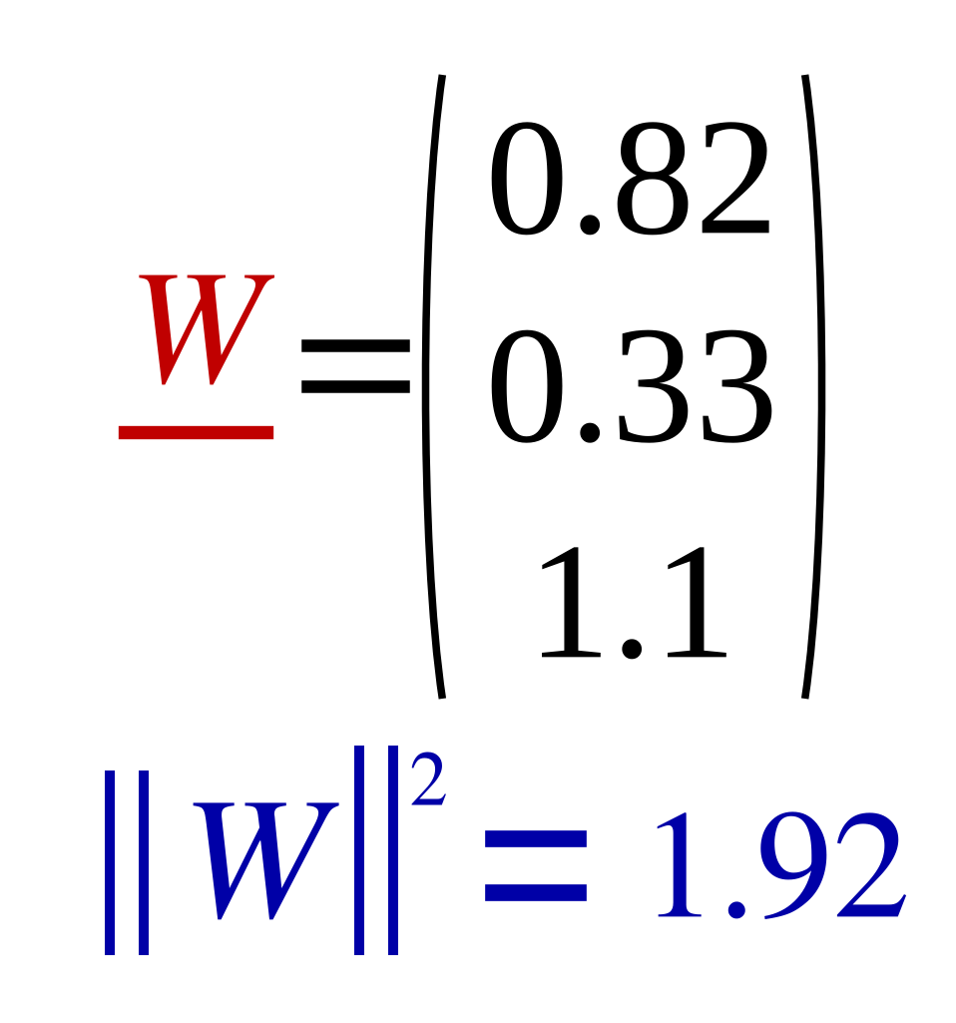
Adding Ridge Regularizer to the model λ=10
18
Train
Test
 | X1 | X2 | X3 | X4 | X5 | X6 | X7 | X8
X1 | 1 | 2 | 3 | 4 | 8 | 9 | 10 | 11
X2 | 1 | 3 | 5 | 6 | 16 | 7 | 5 | 3
y | 2 | 4 | 6 | 8 | 16 | 18 | 20 | 22
 | Test1 | Test2 | Test3
X1 | 30 | 40 | 50
X2 | 15 | 20 | 25
y | 57.4 | 76.5 | 95.6
 | X1 | X2 | X3 | X4 | X5 | X6 | X7 | X8
X1 | 1 | 2 | 3 | 4 | 8 | 9 | 10 | 30
X2 | 1 | 3 | 5 | 6 | 16 | 7 | 5 | 3
y | 2 | 4 | 30 | 8 | 16 | 18 | 20 | 22
 | Test1 | Test2 | Test3
X1 | 30 | 40 | 50
X2 | 15 | 20 | 25
y | 34.6 | 46.4 | 57.4
 | X1 | X2 | X3 | X4 | X5 | X6 | X7 | X8
X1 | 1 | 2 | 3 | 4 | 8 | 9 | 10 | 60
X2 | 1 | 3 | 5 | 6 | 16 | 7 | 5 | 3
y | 2 | 4 | 60 | 8 | 16 | 18 | 20 | 22
 | Test1 | Test2 | Test3
X1 | 30 | 40 | 50
X2 | 15 | 20 | 25
y | 26.8 | 35.4 | 44.1

Slide 19
19
pending recreation

Slide 20
20
[2] Ridge Regularization to overcome
Inverse Problem of Singular Matrix

Slide 21

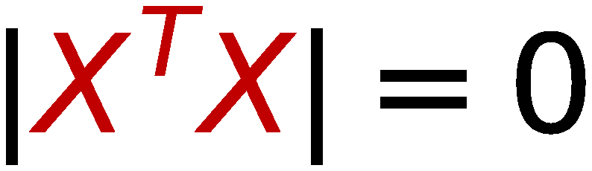
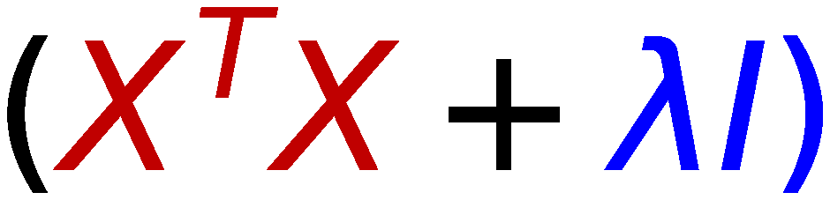


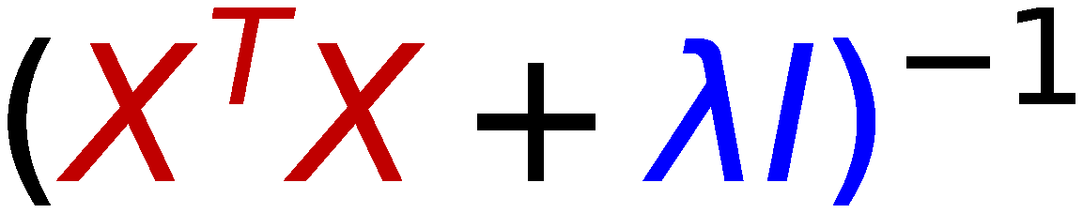
21
Inverse Problem of Singular Matrix
14 | 10 | 15
10 | 40 | 46
20 | 80 | 92
⇒
Singular Matrix
⇒
No Inverse
17 | 10 | 15
10 | 43 | 46
20 | 80 | 95
⇒
Non-Singular Matrix
⇒
Inverse Exists
0.07 | 0.04 | -0.03
-0.01 | 0.23 | -0.11
-0.01 | -0.2 | 0.11
⇒

Slide 22
22
[3] Inverse of High Dimension
(non-singular) Matrix

Slide 23

23
Inverse of High Dimension Matrix
Recall
⇒
T
(X
X
)
is of size
if Feature vectors are of dimension d
d+1
x
d+1
The standard matrix inversion algorithm has a time complexity of O(n
),
3
which means that the computation time increases rapidly with the size of
the matrix (increasing cubically with the number of components).
For Example: if Features vector is of size 1000 then Inverse calculation is
or order 1000,000,000 which is impractical
Solution:
Instead of using Least Squares with Matrix inversion,
use Gradient Descent iterative solution

Slide 24

24
Gradient Descent (GD)
and
How to apply to minimize Loss function

Slide 25
25
pending recreation

Slide 26
Gradient Descent Solution
26
Gradient Descent (GD) Algorithm:
[1] Start with initial Random Weights (W)
[2] Update the weights by moving along the direction of negative gradient of Loss function
(w.r.t. W) (moving step is a hyper parameter, AKA Learning Rate)
[3] Stop when the gradient is almost zero (this is at the minimum value of the function)
Notes:
Least Squares Linear regression objective function is a convex function (even with
regularizer). This means it has ONE Minimum (good news ).
GD will approximatly find this minimum value but at a variable number of steps depending on
the used Learning Rate

Slide 27
Follow Negative Direction of Gradient with
27
Selected Learning Rate
Cost
Learning step
Minimum
θ
Random
initial value
θ

Slide 28
Effect of small and large Learning Rate
28
Small Learning Rate
Large Learning Rate
Loss
Loss
Value of weight
Value of weight

Slide 29
29
Example: Obtain Minimum Value
of a function using
Gradient Descent (GD)

Slide 30
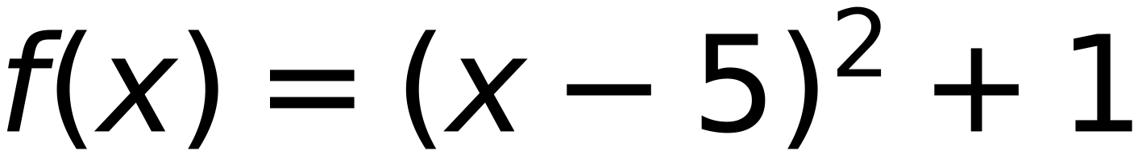

30
Convex Function, Learning Rate =0.2, Start at X=3
30
15
10
3
3
(2, 10)
(7, 7)
step | 0.2
initial X | 3
delta | 0.1
5
(5, 1)
f(x) Minimum value is 1.0
-5
0
5
10
15
Reach Minimum after 11 Steps
x | 3 | 3.2 | 3.4 | 3.6 | 3.8 | 4 | 4.2 | 4.4 | 4.6 | 4.8 | 5
f(x) | 5 | 4.24 | 3.56 | 2.96 | 2.44 | 2 | 1.64 | 1.36 | 1.16 | 1.04 | 1
x-delta | 2.9 | 3.1 | 3.3 | 3.5 | 3.7 | 3.9 | 4.1 | 4.3 | 4.5 | 4.7 | 4.9
f(x-delta) | 5.41 | 4.61 | 3.89 | 3.25 | 2.69 | 2.21 | 1.81 | 1.49 | 1.25 | 1.09 | 1.01
x+delta | 3.1 | 3.3 | 3.5 | 3.7 | 3.9 | 4.1 | 4.3 | 4.5 | 4.7 | 4.9 | 5.1
f(x+delta) | 4.61 | 3.89 | 3.25 | 2.69 | 2.21 | 1.81 | 1.49 | 1.25 | 1.09 | 1.01 | 1.01
slope | -8 | -7.2 | -6.4 | -5.6 | -4.8 | -4 | -3.2 | -2.4 | -1.6 | -0.8 | 0
next x | 3.2 | 3.4 | 3.6 | 3.8 | 4 | 4.2 | 4.4 | 4.6 | 4.8 | 5 | stop

Slide 31
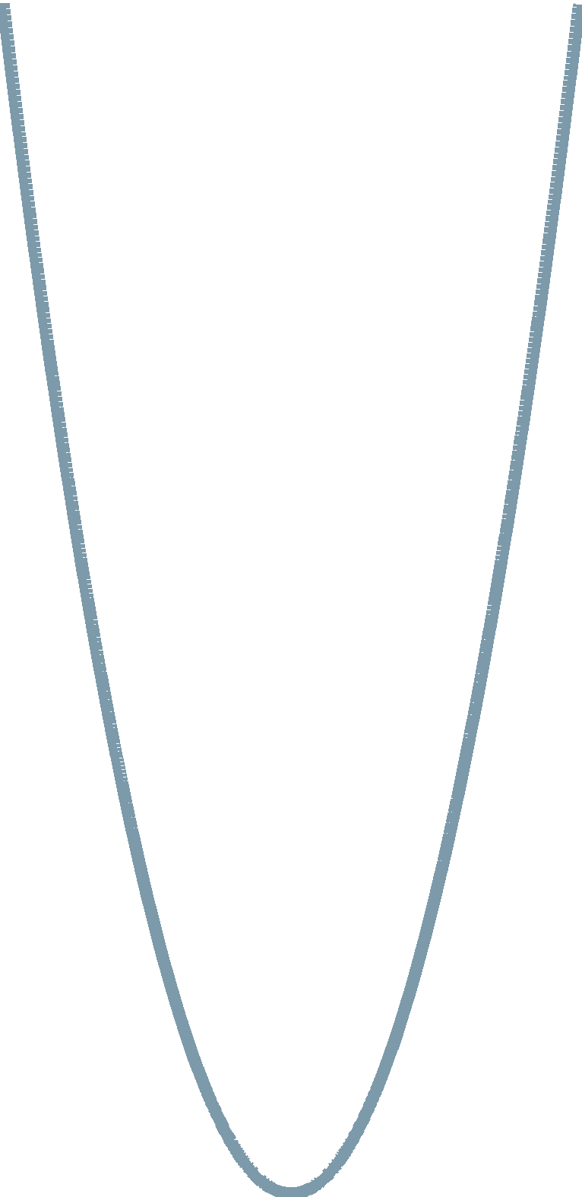


Convex Function,
Learning Rate =0.3,
Start at X=3
31
15
3
3
10
(2, 10)
(?, ?)
step
0.3
initial X
3
5
delta
0.1
X
is in between 4.8 and color red bold
5.1
(5, 1)
f(x)
is in between 1.04 and 1.01
-5
0
5
10
15
Bouncing
x
3
3.3
3.6
3.9
4.2
4.5
4.8
5.1
4.8
5.1
4.8
5.1
4.8
5.1
4.8
5.1
4.8
5.1
f(x)
5
3.89
2.96
2.21
1.64
1.25
1.04
1.01
1.04
1.01
1.04
1.01
1.04
1.01
1.04
1.01
1.04
1.01
x-delta
2.9
3.2
3.5
3.8
4.1
4.4
4.7
5
4.7
5
4.7
5
4.7
5
4.7
5
4.7
5
f(x-delta)
5.41
4.24
3.25
2.44
1.81
1.36
1.09
1
1.09
1
1.09
1
1.09
1
1.09
1
1.09
1
x+delta
3.1
3.4
3.7
4
4.3
4.6
4.9
5.2
4.9
5.2
4.9
5.2
4.9
5.2
4.9
5.2
4.9
5.2
f(x+delta)
4.61
3.56
2.69
2
1.49
1.16
1.01
1.04
1.01
1.04
1.01
1.04
1.01
1.04
1.01
1.04
1.01
1.04
slope
-8
-6.8
-5.6
-4.4
-3.2
-2
-0.8
0.4
-0.8
0.4
-0.8
0.4
-0.8
0.4
-0.8
0.4
-0.8
0.4
next x
3.3
3.6
3.9
4.2
4.5
4.8
5.1
4.8
5.1
4.8
5.1
4.8
5.1
4.8
5.1
4.8
5.1
4.8

Slide 32
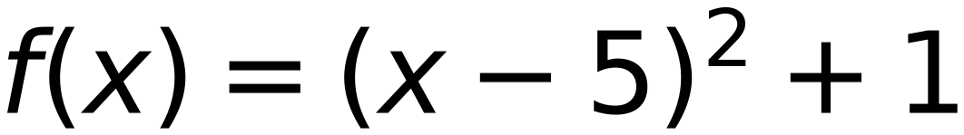
Convex Function, Learning Rate =0.4, Start at X=3
32
15
3
3
10
(2, 10)
(?, ?)
step
0.4
initial X
3
5
delta
0.1
X = 5
f(x) Minimum value is 1.0
(5, 1)
-5
0
5
10
15
Reach Minimum after 6 Steps
x
3
3.4
3.8
4.2
4.6
5
f(x)
5
3.56
2.44
1.64
1.16
1
x-delta
2.9
3.3
3.7
4.1
4.5
4.9
f(x-delta)
5.41
3.89
2.69
1.81
1.25
1.01
x+delta
3.1
3.5
3.9
4.3
4.7
5.1
f(x+delta)
4.61
3.25
2.21
1.49
1.09
1.01
slope
-8
-6.4
-4.8
-3.2
-1.6
0
next x
3.4
3.8
4.2
4.6
5
stop

Slide 33
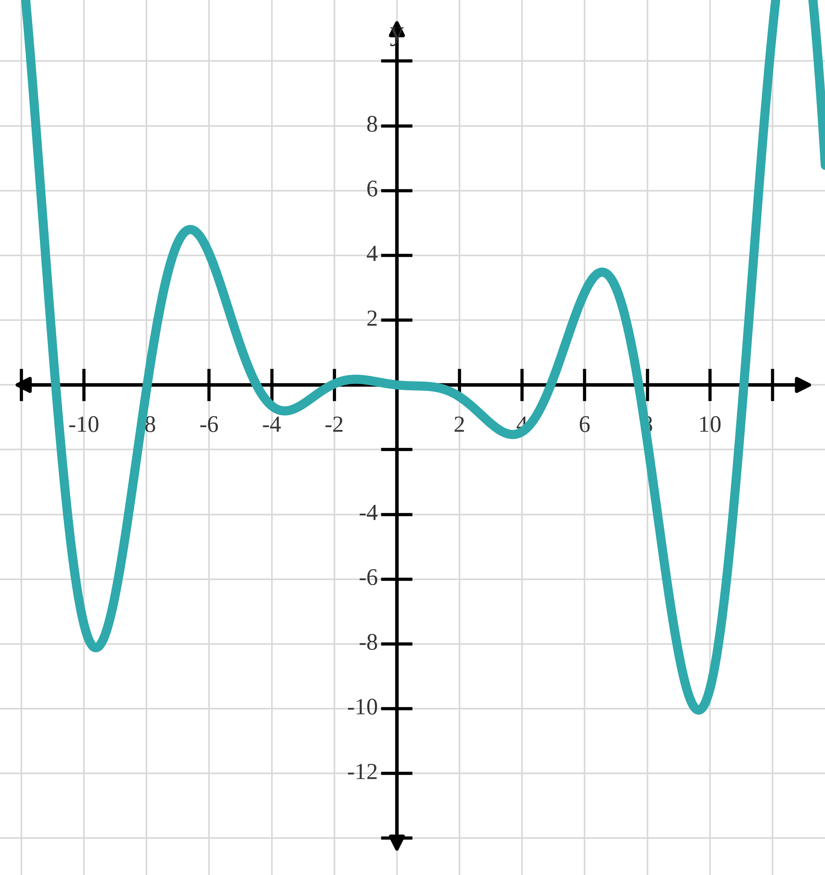
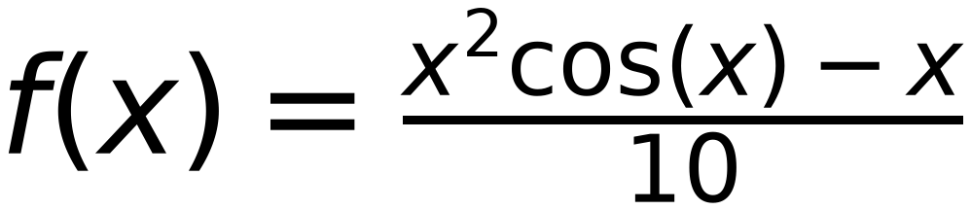
Non-Convex Function
33
May reach different minimum value based on:
initial point and learning rate
x
step
0.1
X
is in between -9.7 and color red bold -9.6
Reach
Local Minima
initial X
-11
f(x)
is in between -8.08 and -8.011
delta
0.1
x
-11
-10.9
-10.8
-10.7
-10.6
-10.5
-10.4
-10.3
-10.2
-10.1
-10
-9.9
-9.8
-9.7
-9.6
-9.7
-9.6
-9.7
f(x)
1.15
-0.04
-1.19
-2.26
-3.27
-4.19
-5.03
-5.77
-6.41
-6.95
-7.39
-7.72
-7.96
-8.08
-8.11
-8.08
-8.11
-8.08
x-delta
-11.1
-11
-10.9
-10.8
-10.7
-10.6
-10.5
-10.4
-10.3
-10.2
-10.1
-10
-9.9
-9.8
-9.7
-9.8
-9.7
-9.8
f(x-delta)
2.39
1.15
-0.04
-1.19
-2.26
-3.27
-4.19
-5.03
-5.77
-6.41
-6.95
-7.39
-7.72
-7.96
-8.08
-7.96
-8.08
-7.96
x+delta
-10.9
-10.8
-10.7
-10.6
-10.5
-10.4
-10.3
-10.2
-10.1
-10
-9.9
-9.8
-9.7
-9.6
-9.5
-9.6
-9.5
-9.6
f(x+delta)
-0.04
-1.19
-2.26
-3.27
-4.19
-5.03
-5.77
-6.41
-6.95
-7.39
-7.72
-7.96
-8.08
-8.11
-8.05
-8.11
-8.05
-8.11
slope
-24.3
-23.4
-22.2
-20.8
-19.3
-17.6
-15.8
-13.8
-11.8
-9.8
-7.7
-5.7
-3.6
-1.5
0.3
-1.5
0.3
-1.5
next x
-10.9
-10.8
-10.7
-10.6
-10.5
-10.4
-10.3
-10.2
-10.1
-10
-9.9
-9.8
-9.7
-9.6
-9.7
-9.6
-9.7
-9.6

Slide 34
34
pending recreation

Slide 35
35
Using Gradient Descent to train
Linear Regression Model
(Problem Formulation)

Slide 36
Problem Formulation
36
Define two classes: class I and Class II
let d(X) be a discriminant function = W^{T} X
if X ∈ class I then d(X) > 0
if X ∈ Class II then d(X) < 0
For misclassified X :
If X ∈ class I and misclassified as Class II then d(X) will be <0
If X ∈ Class II and misclassified as Class I then d(X) will be >0
Define Error function as:
$$Error=\sum_{allmisclassifiedvectors(i)}{W^{T}X_{i}⇒(W^{T}X_{i})takepositiveandnegativevalues}$$
X
Define δ_{i} as :
If X ∈ class I and misclassified as Class II then d(X) will be <0 ⇒ δ_{i} = -1 ⇒ d(X) δ_{i} >0
If X ∈ Class II and misclassified as Class I then d(X) will be >0 ⇒ δ_{i} = +1 ⇒ d(X) δ_{i} >0

Slide 37

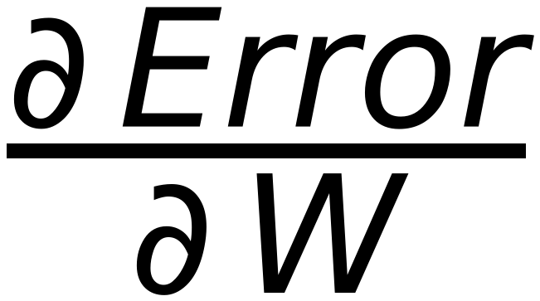
37
Problem Formulation
Define δ_{_i} as :
If X ∈ class I and misclassified as Class II then d(X) will be <0 ⇒ δ_{_i} = -1 ⇒ d(X)δ_{_i} > 0
If X ∈ class II and misclassified as Class I then d(X) will be >0 ⇒ δ_{_i} = +1 ⇒ d(X)δ_{_i} > 0
Redefine Error function as:
Error =
δ_{_i} W^{T} X_{_i}
⇒
(W^{T} X_{_i}) takes positive and negative values and δ_{_i} has the same sign
all misclassified vectors (i)
Summation is always positive
Minimize the Error using Gradient Descent with step η
W^{(updated)} = W^{old} - η
where
=
δ_{_i} X_{_i}
misclassified vectors
W^{(updated)} = W^{old} - η
δ_{_i} X_{_i}
misclassified vectors ONLY (i)

Slide 38
38
Gradient Descent (GD)
vs
Stochastic Gradient Descent (SGD)

Slide 39

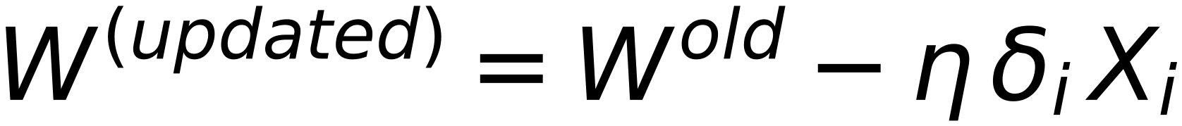
39
Gradient Descent (GD) – Stochastic Gradient Descent SGD)
and
Mini-Batch
Gradient Descent
Stochastic Gradient Descent (SGD) is a variant of GD which computes the gradient of the Error
function with respect to a single training example
In other words, it updates the weights using one training sample at a time
Remember: GD updated the weight vector after passing through ALL training samples.
$$W^{(updated)}=W^{old}-η δ_{i} X_{i}$$
Repeat for ALL misclassified Samples
Why using SGD
SGD is usually more efficient than GD
SGD converges faster than GD
Batch GD is a generalization of GD and SGD
where weights are updated after passing through
“Mini-Batch” of training samples with size n
If n=N (it is GD), and if n=1 (it is SGD)

Slide 40
40
Training of Linear Regression Model
usnig SGD
Solved Example

Slide 41
x₁
x₂
x₃
x₄
x₅
x₆
4
Step η = 2
Z₁
Z₁
Z₁
41
1
2
1
5
6
6
Initial W =
-2
Check classes of
0
7
3
1
1
2
4
5
6
-2
0
6
2
C₁
C₁
C₁
C₂
C₂
C₂
C₁
positive,
C₂
negative,
Zero
is unaccepted
7
6
5
4
3
2
1
0
0
1
2
3
4
5
6
7
8

Slide 42
x₁
x₂
x₃
x₄
x₅
x₆
4
Step η = 2
Z₁
Z₁
Z₁
42
1
2
1
5
6
6
Initial W =
-2
Check classes of
1
1
2
4
5
6
-2
0
7
3
0
6
2
C₁
C₂
positive
negative
Zero
C₁
C₁
C₁
C₂
C₂
C₂
is unaccepted
Ugmented Vectors ( from Top )
1
1
1
4
4
1
6
d(x₁) =
= 0
⇒
Update Weight
x₁
x₂
x₃
x₄
x₅
x₆
-2
W =
-2
+ 2 *
1
=
0
⇐
1
1
1
1
1
1
-2
-2
1
0
1
2
1
5
6
6
1
1
2
4
5
6
1
2
1
6
6
C₁
C₁
C₁
C₂
C₂
C₂
d(x₂) =
0
= 6
⇒
Keep same Weight
W =
0
0
0
Iteration 1
1
1
2
6
6
d(x₃) =
0
= 6
⇒
Keep same Weight
W =
0
0
0
1
5
4
6
6
1
4
d(x₄) =
= 6
⇒
Update Weight
0
W =
0
- 2 *
5
=
-10
⇐
0
0
4
-8
1
6
5
4
4
d(x₅) =
-10
= -96
⇒
Keep same Weight
W =
-10
-8
-8
1
6
6
4
4
d(x₆) =
-10
= -104
⇒
Keep same Weight
W =
-10
-8
-8

Slide 43
43
pending recreation

Slide 44
44
pending recreation

Slide 45
x₁
x₂
x₃
x₄
x₅
x₆
4
Step η = 2
Z₁
Z₁
Z₁
45
Initial W =
(1)
(2)
(1)
(5)
(6)
(6)
−2
Check classes of
(1)
(1)
(2)
(4)
(5)
(6)
−2
(0)
(7)
(3)
(1)
(1)
(1)
(4)
(5)
(6)
(0)
(6)
(2)
C₁
C₁
C₁
C₂
C₂
C₂
C₁ positive, C₂ negative, Zero is unaccepted
Ugmented Vectors ( from Top )
1
1
1
14
14
(1)
(1)
(1)
(1)
(1)
(1)
d(x₁) =
−4
= 10
⇒
Keep same Weight
W =
−4
(1)
(2)
(1)
(5)
(6)
(6)
0
0
(1)
(1)
(2)
(4)
(5)
(6)
(1)
(1)
(1)
(4)
(5)
(6)
1
2
1
14
14
C₁
C₁
C₁
C₂
C₂
C₂
d(x₂) =
−4
= 6
⇒
Keep same Weight
W =
−4
0
0
Iteration 4
1
1
2
14
14
d(x₃) =
−4
= 10
⇒
Keep same Weight
W =
−4
0
0
No change in W
1
5
4
14
14
d(x₄) =
−4
= −6
⇒
Keep same Weight
W =
−4
Stop Iterations
0
0
1
6
5
14
14
d(x₅) =
−4
= −10
⇒
Keep same Weight
W =
−4
0
0
1
6
6
14
14
d(x₆) =
−4
= −112
⇒
Keep same Weight
W =
−4
0
0

Slide 46
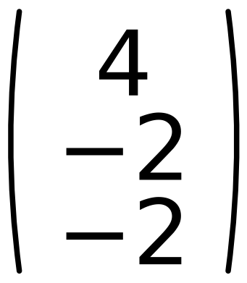
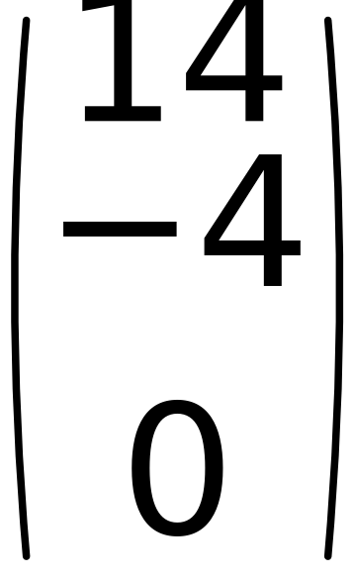
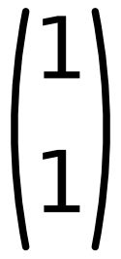
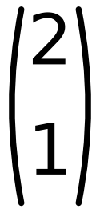
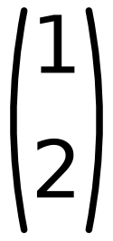
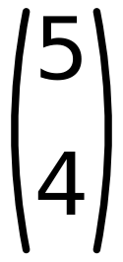
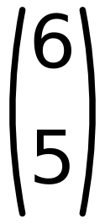
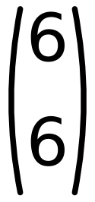
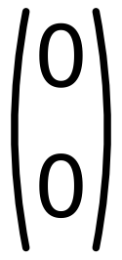
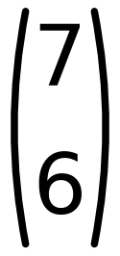
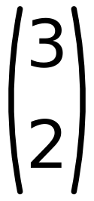


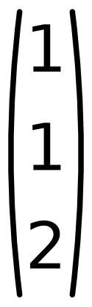
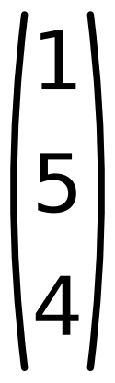

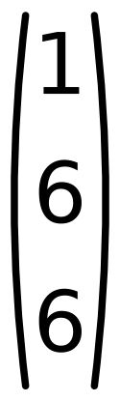
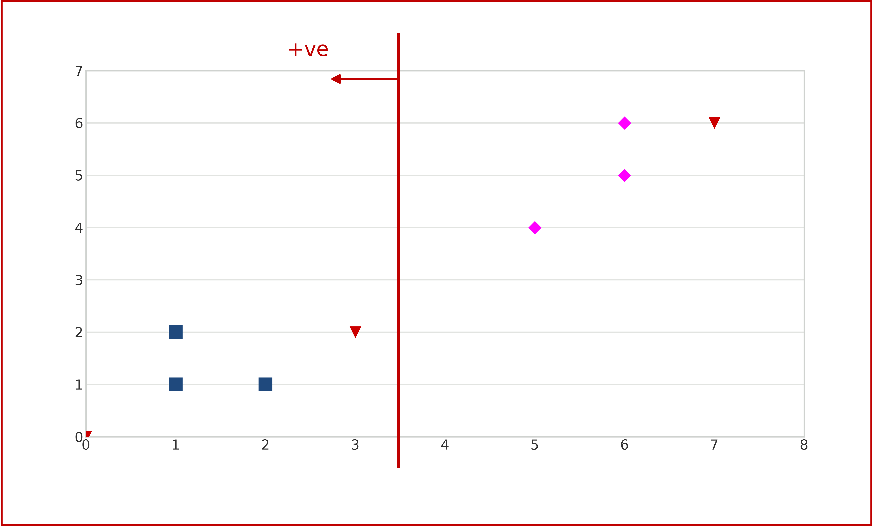
x₁
x₂
x₃
x₄
x₅
x₆
W =
Step η = 2
Z₁
Z₁
Z₁
46
Initial
Check classes of
W
=
C₁
C₁
C₁
C₂
C₂
C₂
C₁ positive C₂negative Zero is unaccepted
Ugmented Vectors ( from Top )
x₁
x₂
x₃
x₄
x₅
x₆
C₁
C₁
C₁
C₂
C₂
C₂
Iteration 4
No change in W
Stop Iterations

Slide 47
x₁
x₂
x₃
x₄
x₅
x₆
4
Step η = 2
Z₁
Z₁
Z₁
47
1
2
1
5
6
6
Initial W =
-2
Check classes of
0
7
3
1
1
2
4
5
6
-2
0
6
2
C₁
C₁
C₁
C₂
C₂
C₂
C₁ positive C₂negative Zero is unaccepted
Ugmented Vectors ( from Top )
1
0
0
14
x₁
x₂
x₃
x₄
x₅
x₆
d(Z₁) =
-4
= 14
⇒ Positive > 0
Class I
1
1
1
1
1
1
0
1
2
1
5
6
6
1
1
2
4
5
6
1
7
6
14
C₁
C₁
C₁
C₂
C₂
C₂
d(Z₂) =
-4
= -14
⇒ Negative < 0
Class II
0
Check Classes
1
3
2
14
d(Z₂) =
-4
= -2
⇒ Negative < 0
Class II
0

Slide 48
48
pending recreation

Slide 49
x₁
x₂
x₃
x₄
x₅
x₆
4
Initial W
REPEAT using Step η = 1
49
1
2
1
5
6
6
−2
Z₁
Z₂
Z₃
−2
Check classes of
0
7
3
1
1
2
4
5
6
0
6
2
C₁
C₁
C₁
C₂
C₂
C₂
C₁ positive C₂ negative Zero is unaccepted
Ugmented Vectors (from Top)
1
1
1
5
5
x₁
x₂
x₃
x₄
x₅
x₆
d(x₁) =
−1
=
3
⇒
Keep same Weight
W =
−1
1
1
1
1
1
1
−1
−1
1
2
1
5
6
6
1
1
2
4
5
6
1
2
1
5
5
C₁
C₁
C₁
C₂
C₂
C₂
d(x₂) =
−1
=
2
⇒
Keep same Weight
W =
−1
−1
−1
Iteration 2
1
1
2
5
5
d(x₃) =
−1
=
2
⇒
Keep same Weight
W =
−1
−1
−1
No change in
W
1
5
4
5
5
d(x₄) =
−1
=
−4
⇒
Keep same Weight
W =
−1
Stop
Iterations
−1
−1
1
6
5
5
5
d(x₅) =
−1
=
−6
⇒
Keep same Weight
W =
−1
−1
−1
1
6
6
5
5
d(x₆) =
−1
=
−7
⇒
Keep same Weight
W =
−1
−1
−1

Slide 50




x₁
x₂
x₃
x₄
x₅
x₆
4
REPEAT
using Step η = 1
50
1
2
1
5
6
6
Initial W =
-2
Z₁
Z₂
Z₃
-2
Check classes of
1
1
2
4
5
6
C₁ positive C₂ negative Zero is unaccepted
C₁
C₁
C₁
C₂
C₂
C₂
Augmented Vectors (from Top)
x₁
x₂
x₃
x₄
x₅
x₆
1
1
1
1
1
1
1
2
1
5
6
6
1
1
2
4
5
6
7
C₁
C₁
C₁
C₂
C₂
C₂
6
Iteration 2
5
4
+ve
3
No change in W
Stop Iterations
2
1
0
0
1
2
3
4
5
6
7
8

Slide 51








x₁
x₂
x₃
x₄
x₅
x₆
Z₁
Z₂
Z₃
51
1
2
1
5
6
6
Initial W =
Check classes of
0
7
3
1
1
2
4
5
6
0
6
2
C₁
C₁
C₁
C₂
C₂
C₂
C₁
positive
C₂
negative
Zero
is unaccepted
Ugmented Vectors ( from Top )
x₁
x₂
x₃
x₄
x₅
x₆
=
5
Positive > 0
Class I
1
1
1
1
1
1
1
2
1
5
6
6
1
1
2
4
5
6
C₁
C₁
C₁
C₂
C₂
C₂
=
−8
Negative < 0
Class II
Check Classes
=
0
Not > 0 , Not < 0
Undefined Class

