Slide 1
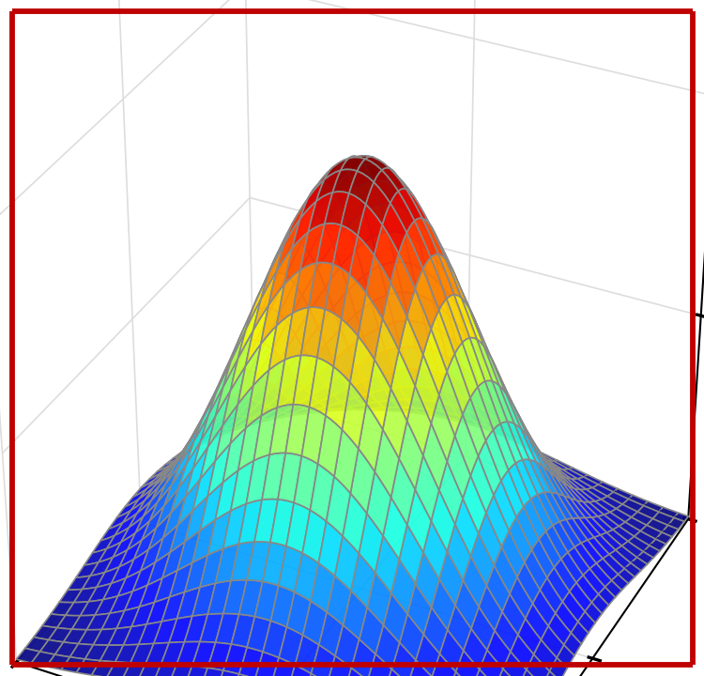
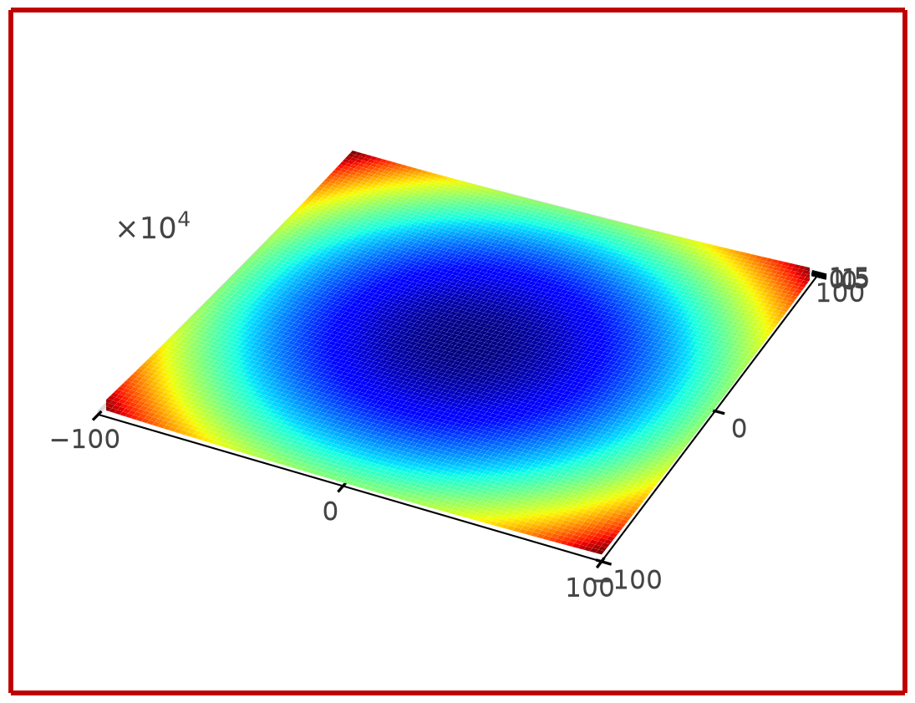
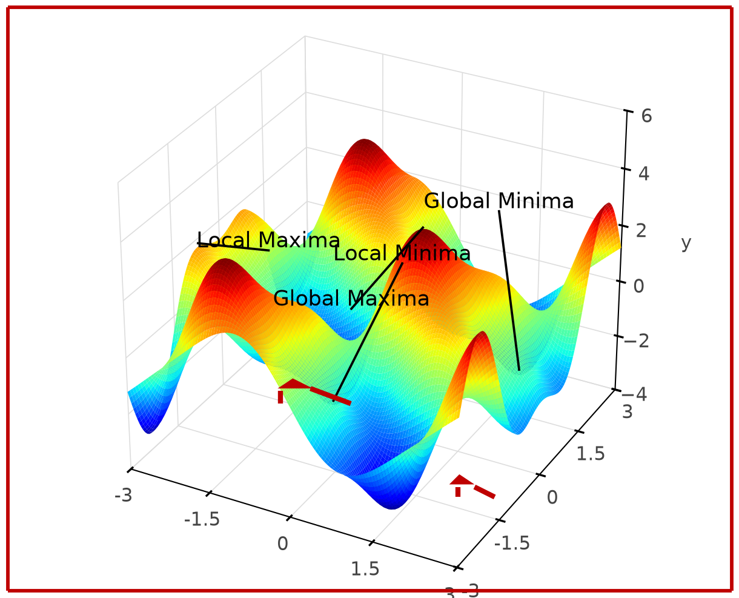
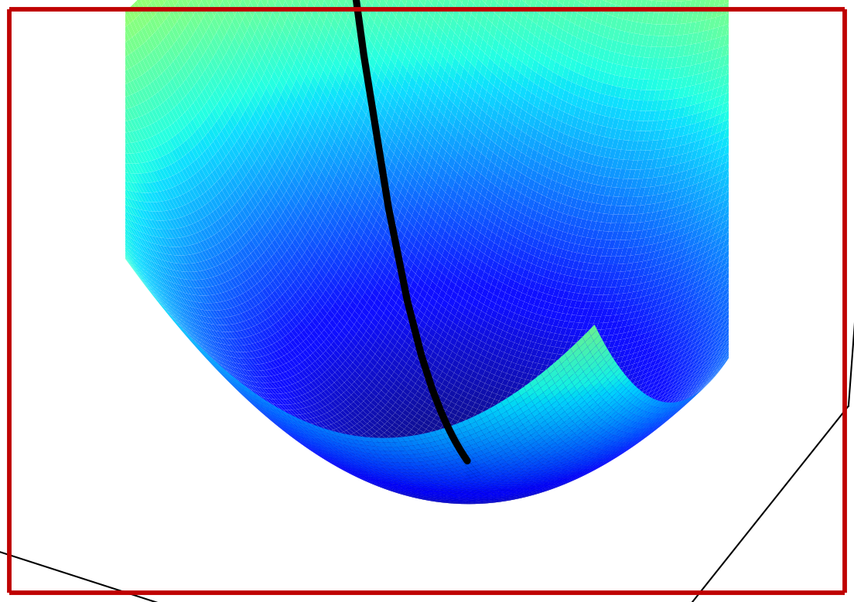
Types of Loss function shapes
25
Concave Function
One Maxima
Convex Function
One Minima
Gradient Descent
Path to reach Minima
Non-Convex
Multiple Minima

