Slide 1
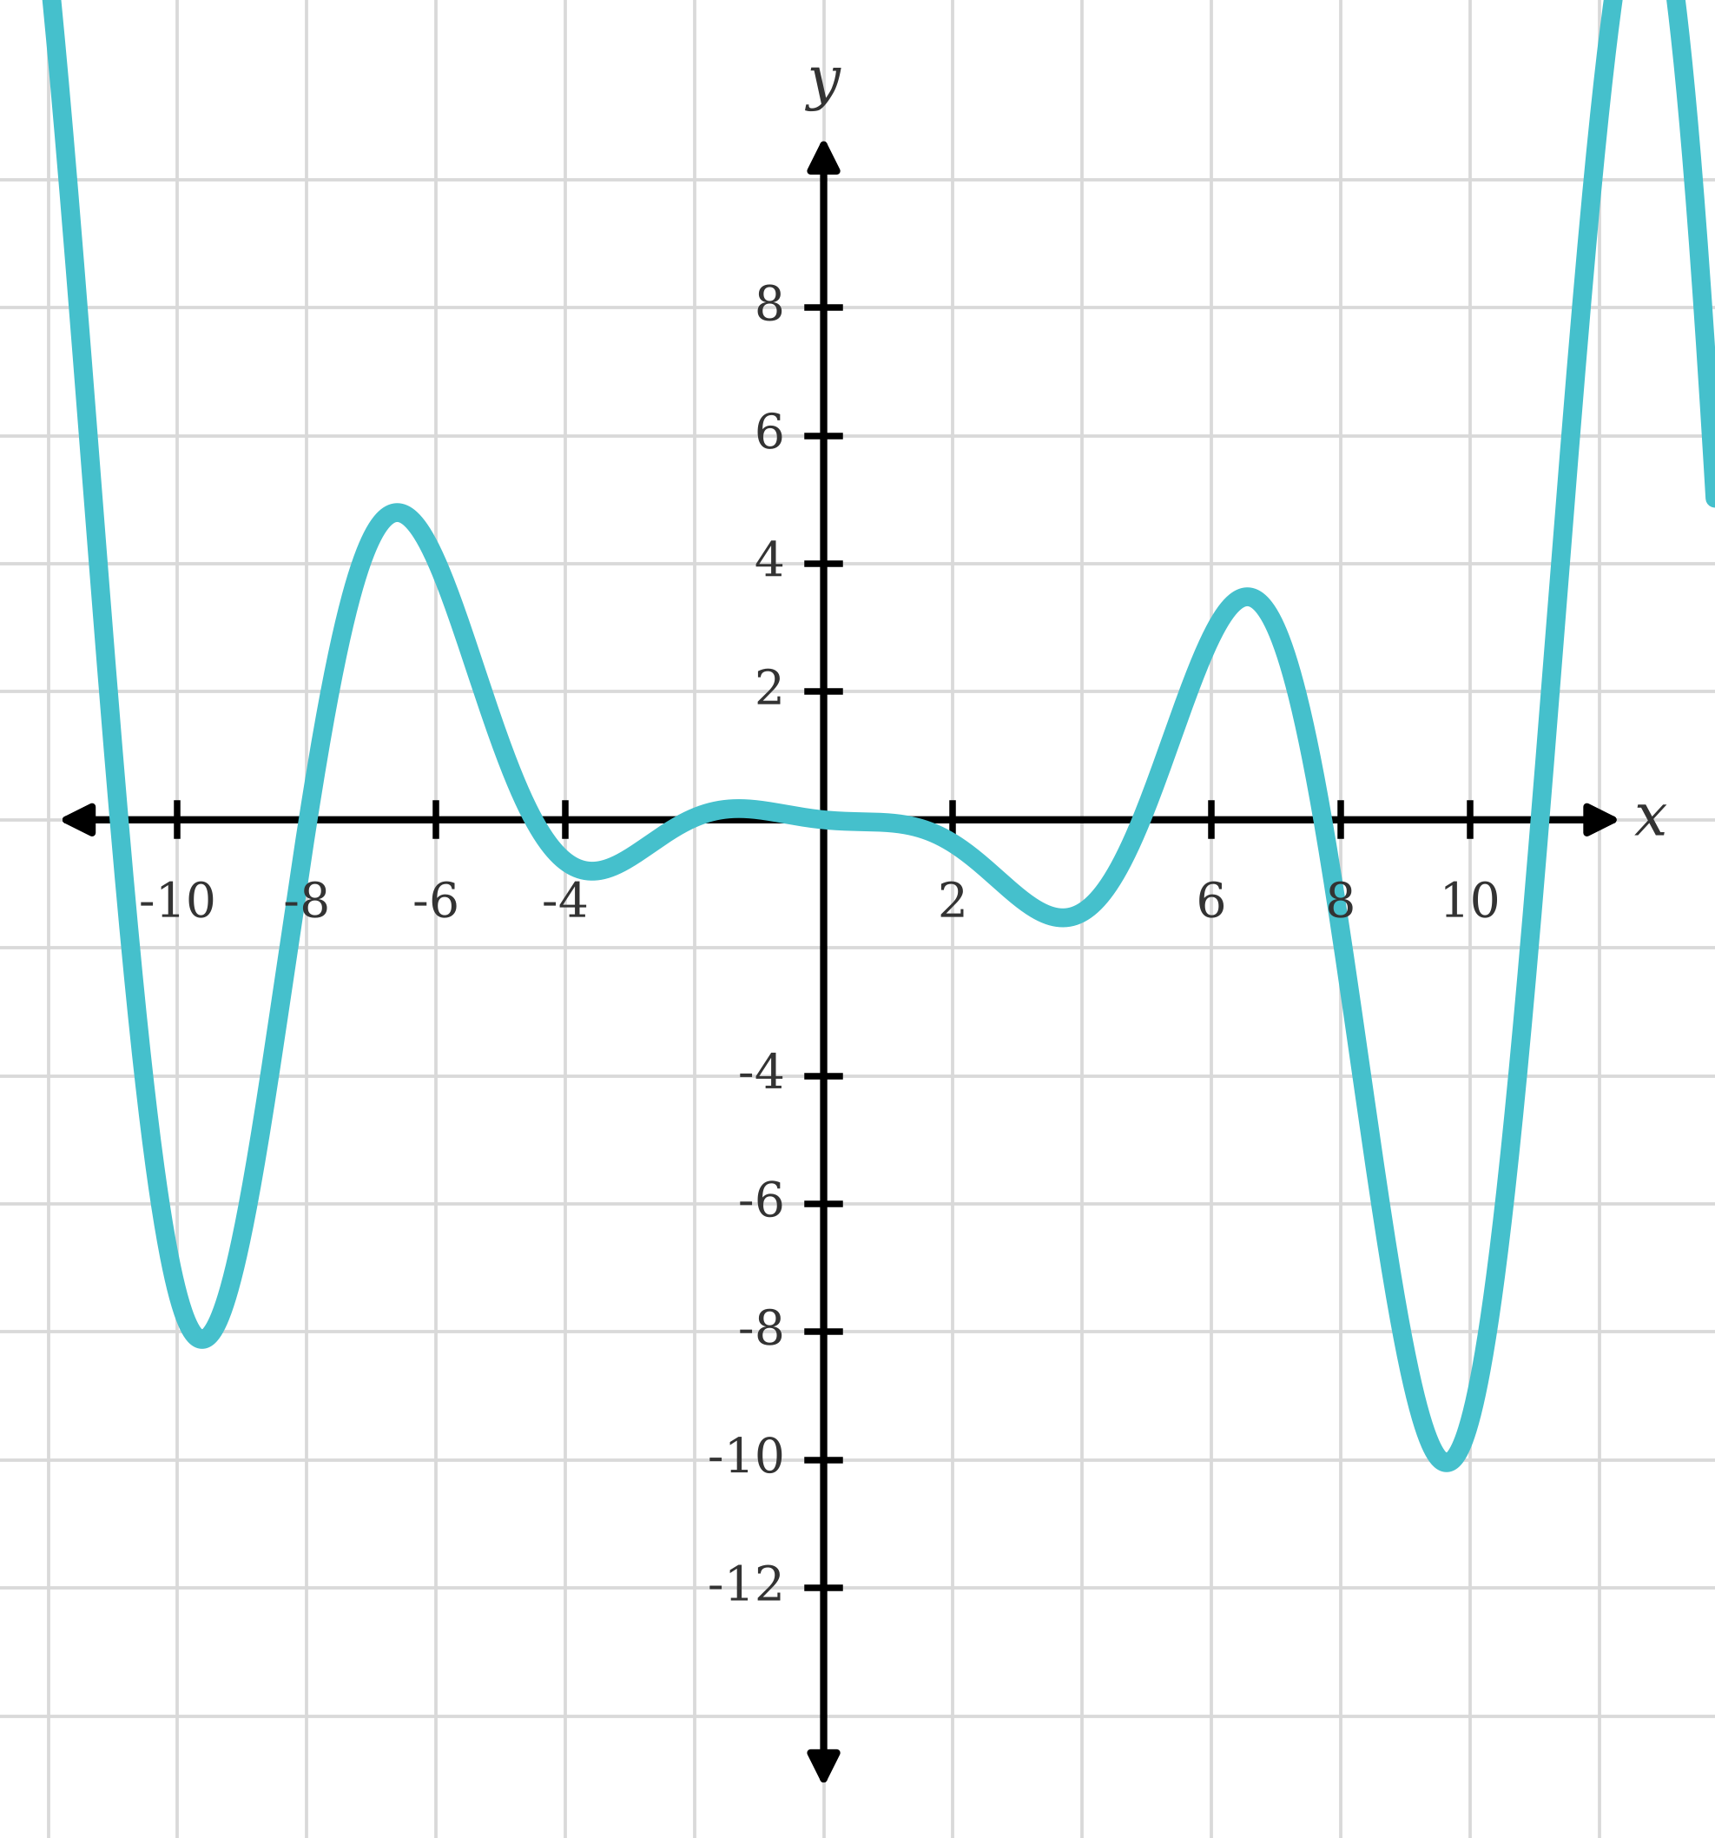
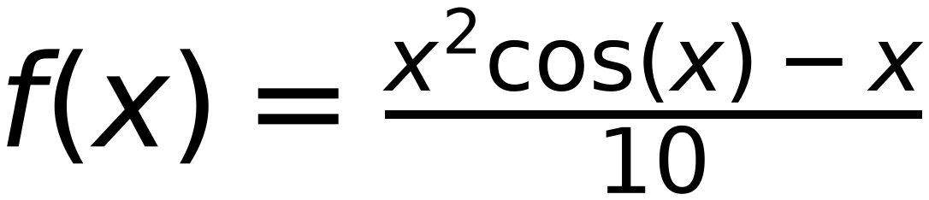
Non-Convex Function
34
May reach different minimum value based on:
initial point and learning rate
step
0.2
X
is in between 9.6 and color red bold 9.8
initial X
7
f(x)
is in between -10.03 and -9.92
Reach
global Minima
delta
0.1
x
7
7.2
7.4
7.6
7.8
8
8.2
8.4
8.6
8.8
9
9.2
9.4
9.6
9.8
9.6
9.8
9.6
f(x)
2.99
2.43
1.66
0.69
-0.45
-1.73
-3.1
-4.5
-5.88
-7.16
-8.28
-9.17
-9.77
-10.03
-9.92
-10.03
-9.92
-10.03
x-delta
6.9
7.1
7.3
7.5
7.7
7.9
8.1
8.3
8.5
8.7
8.9
9.1
9.3
9.5
9.7
9.5
9.7
9.5
f(x-delta)
3.19
2.74
2.07
1.2
0.14
-1.08
-2.41
-3.8
-5.2
-6.54
-7.75
-8.76
-9.51
-9.95
-10.02
-9.95
-10.02
-9.95
x+delta
7.1
7.3
7.5
7.7
7.9
8.1
8.3
8.5
8.7
8.9
9.1
9.3
9.5
9.7
9.9
9.7
9.9
9.7
f(x+delta)
2.74
2.07
1.2
0.14
-1.08
-2.41
-3.8
-5.2
-6.54
-7.75
-8.76
-9.51
-9.95
-10.02
-9.7
-10.02
-9.7
-10.02
slope
-4.5
-6.7
-8.7
-10.6
-12.2
-13.3
-13.9
-14
-13.4
-12.1
-10.1
-7.5
-4.4
-0.7
3.2
-0.7
3.2
-0.7
next x
7.2
7.4
7.6
7.8
8
8.2
8.4
8.6
8.8
9
9.2
9.4
9.6
9.8
9.6
9.8
9.6
9.8

