Slide 1

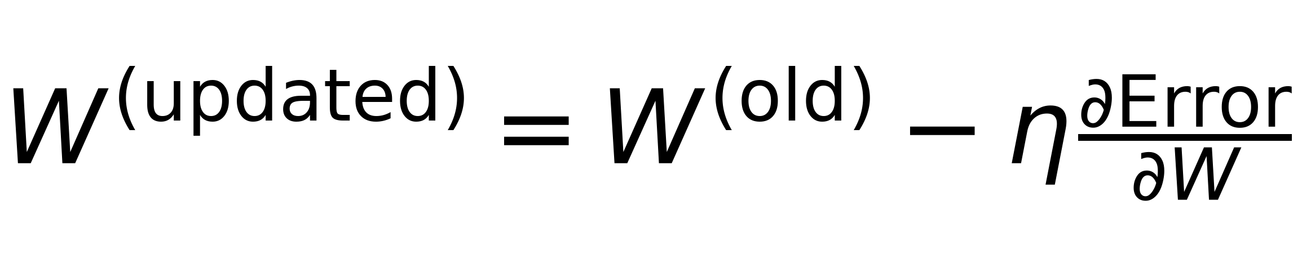
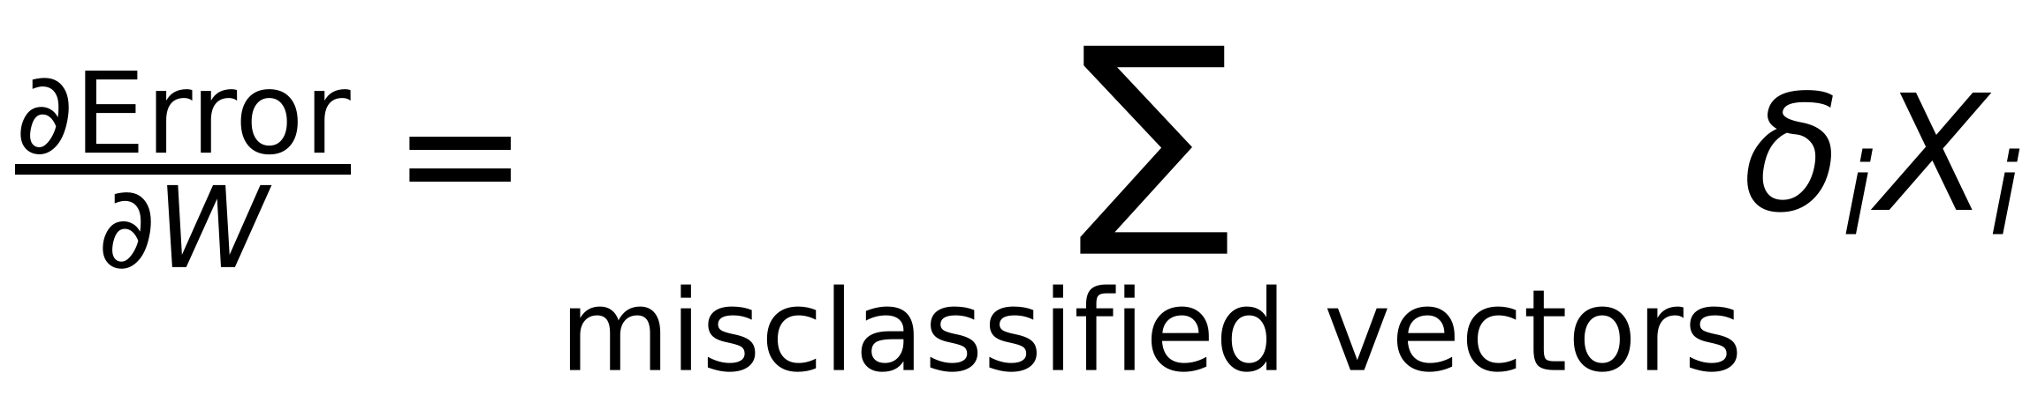
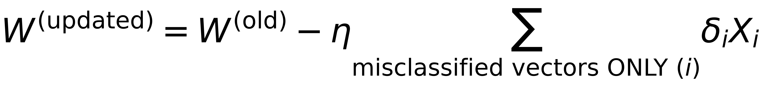

Problem Formulation
4
Define δ_{i} as:
If X ∈ class I and misclassified as Class II then d(X) will be <0 ⇒ δ_{i} = -1 ⇒ d(X)δ_{i} >0
If X ∈ class II and misclassified as Class I then d(X) will be >0 ⇒ δ_{i} = +1 ⇒ d(X)δ_{i} >0
Redefine Error function as:
$$\$Error=\sum_{all misclassified vectors (i)}{δ_{i}W^{T}X_{i}\$}$$
⇒ (WᵀXᵢ) takes positive and negative values and δᵢ has the same sign
Summation is always positive
Minimize the Error using Gradient Descent with step η
$$\$W^{(updated)}=W^{(old)}-η\frac{∂Error}{∂W}\$$$
where
$$\$\frac{∂Error}{∂W}=\sum_{misclassified vectors}{δ_{i}X_{i}\$}$$
$$\$W^{(updated)}=W^{(old)}-η\sum_{misclassified vectors ONLY (i)}{δ_{i}X_{i}\$}$$
Update after each sample
$$\$W^{(updated)}=W^{(old)}-ηδ_{i}X_{i}\$$$

