Slide 1
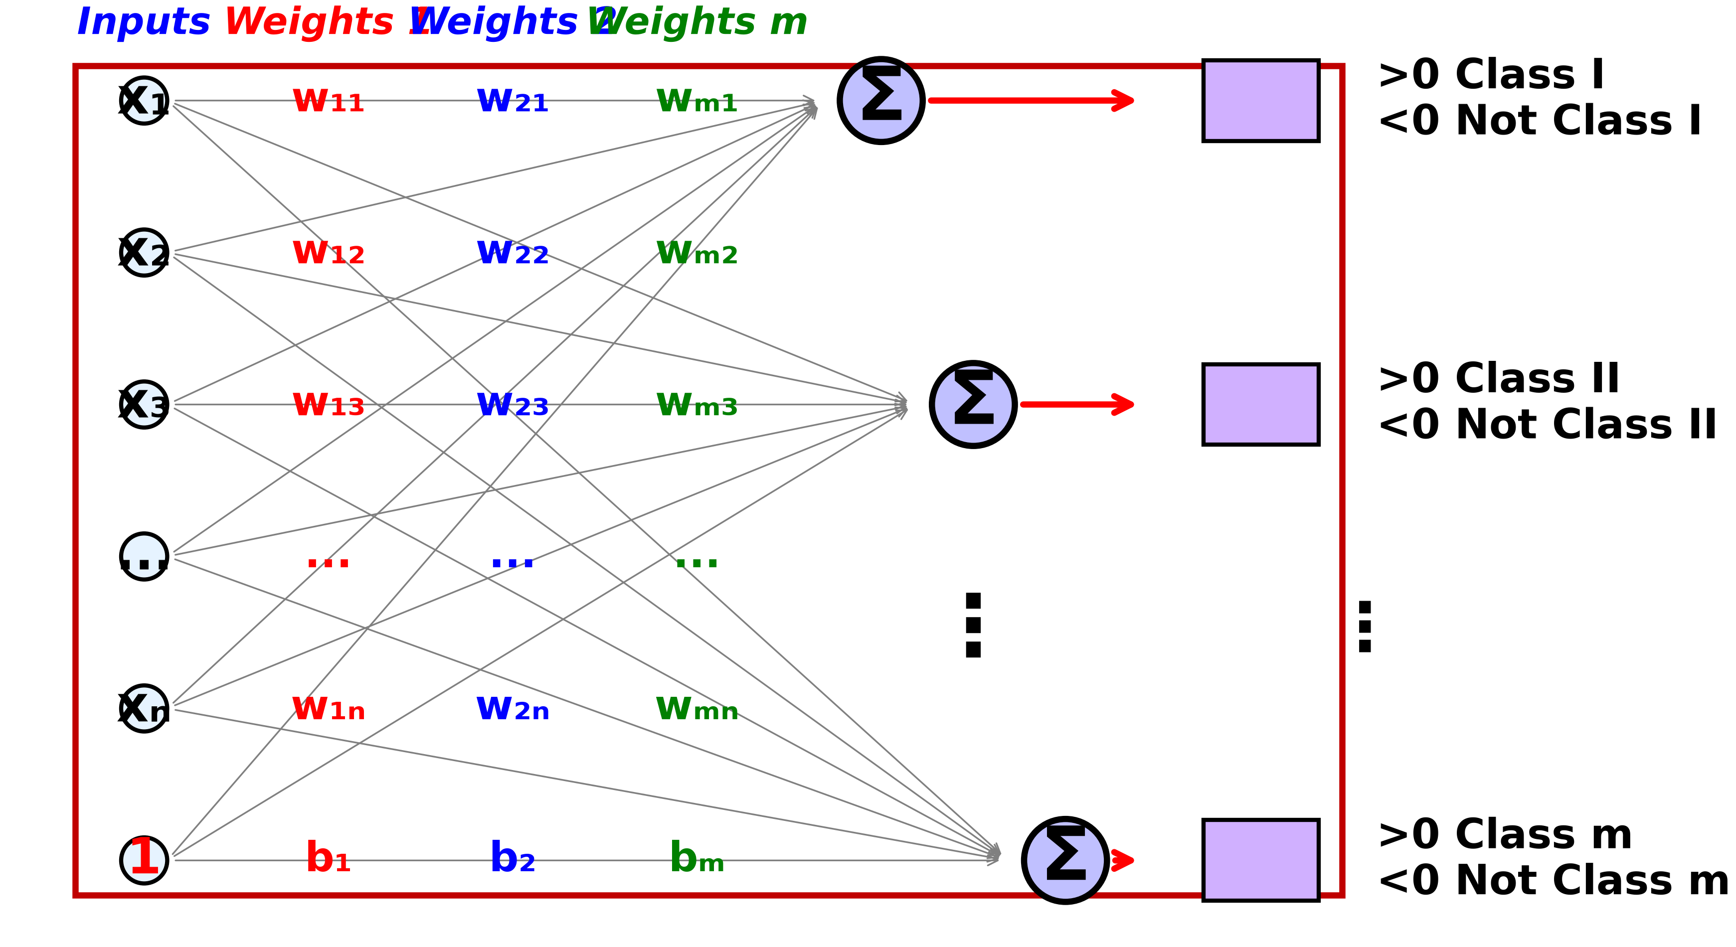
Visualization of Single Layer Perceptron
6
Multi-Class Classification

