Slide 1
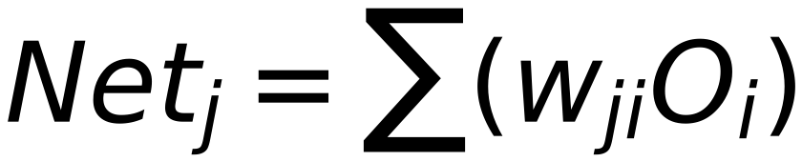
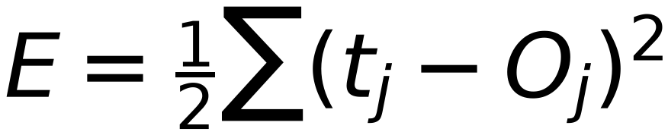

Neural Network Model
7
(Weights of Output Layer AFFECTS Calculated Error)
Input Sample
w_ji
Target Label
Σ
w_ji
Σ
Net_j
Σ
f
O_j
f
w_ji
f
O_j
Output 1
Class 1
Error
w_ji
w_ji
w_ji
w_ji
Σ
Σ
Net_j
w_ji
Σ
w_ji
f
...
O_j
f
w_ji
f
O_j
Output 2
Class 2
Error
w_ji
w_ji
w_ji
w_ji
Σ
Σ
Net_j
w_ji
Σ
f
O_j
f
f
O_j
Output m
Class m
1
1
Error
i
j
Node Bias
For Layer "j"
If Layer "j" is Output Layer:
Previous Layer Layer (0)
Current Layer is Output Layer (You are here)

