Slide 1
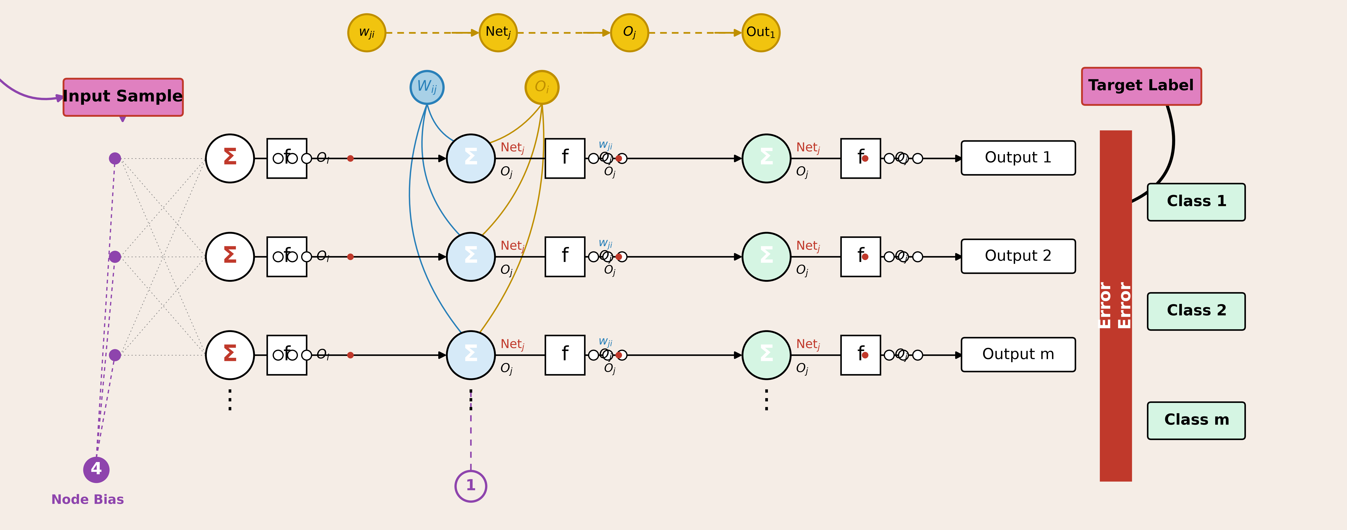
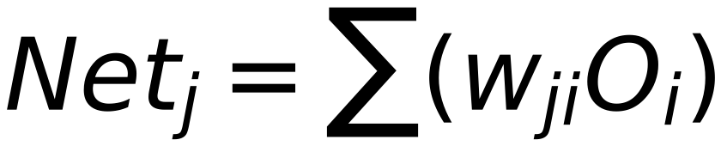

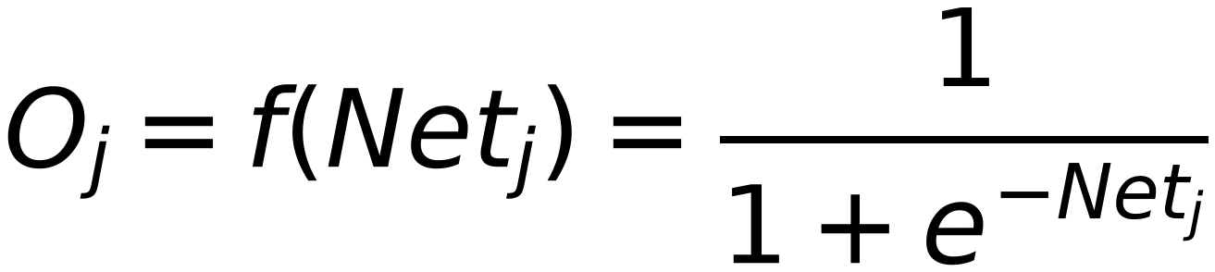
Neural Network Model
7
(Weights of Output Layer AFFECTS Calculated Error)
For Layer "j"
i
j
If Layer "j" is Output Layer:
Previous Layer Layer (0)
Current Layer is Output Layer (You are here)

