Slide 1
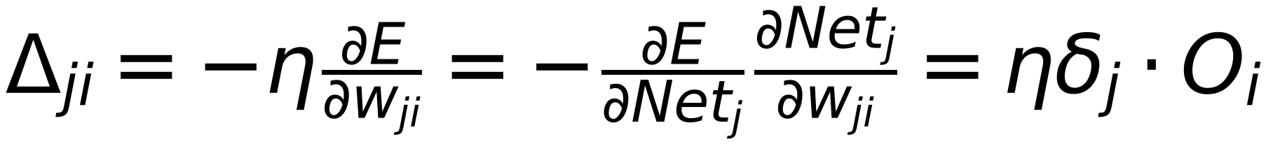
Updated Weights of Output Layer
11
( Calculated Error is affected by Netj,)
Input Sample
Target Label
∂E/∂wji
wji
wjj
Error
Error
Class 1
Σ
f()
Oi
Σ
Netj
Oj
Σ
Netj
Oj
Output 1
1
Class 2
Σ
f()
Oi
Σ
Netj
Oj
Σ
Netj
Oj
Output 2
Class m
Σ
f()
Oi
Σ
1
Netj
Oj
Σ
Netj
Oj
Output m
Node Bias
1
∂E/∂Netj = -δj
1
Where δj = -∂E/∂Netj (one δ for each Node j)

