Slide 1
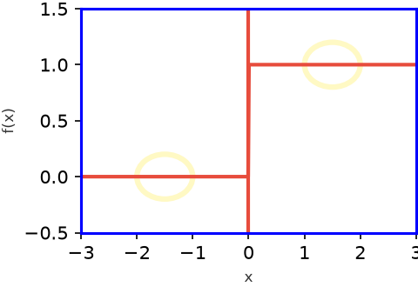
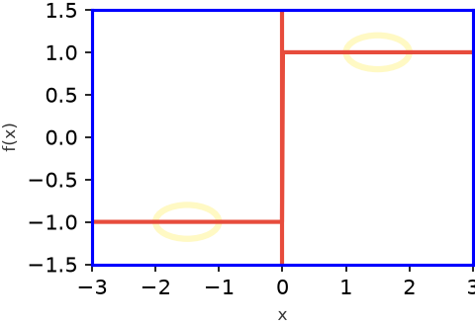
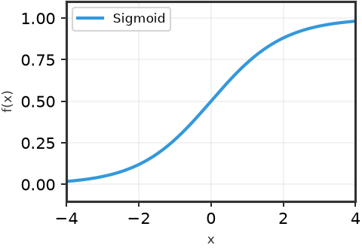
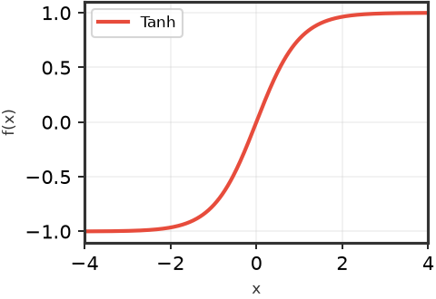
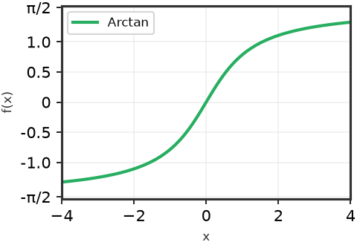
Saturation Problem in Activation Functions
18
F(x) = Uni-polar Unit Step
F(x) = Bi-polar Unit Step
F(x) = { 0 for x < 0
F(x) = { -1 for x < 0
{ 1 for x ≥ 0
{ 1 for x ≥ 0
Saturation Problem
Same Output value
for Different
input values
f(x) = Sigmoid(x)
f(x) = tanh(x)
Inverse Tangent Graph

