Slide 1
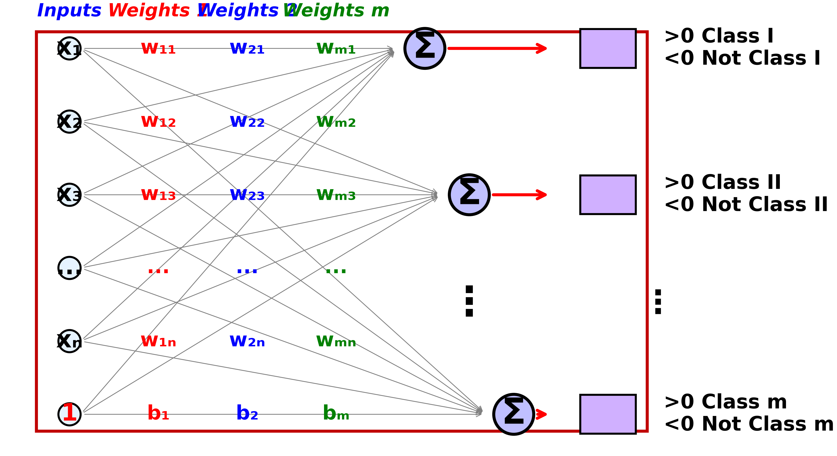
Visualization of Single Layer Perceptron
6
$$d_{1}(X)=W_{1}^{T}X=w_{11}x_{1}+w_{12}x_{2}+...+w_{1n}x_{n}+b_{1}⋅1$$
$$d_{2}(X)=W_{2}^{T}X=w_{21}x_{1}+w_{22}x_{2}+...+w_{2n}x_{n}+b_{2}⋅1$$
$$d_{m}(X)=W_{m}^{T}X=w_{m1}x_{1}+w_{m2}x_{2}+...+w_{mn}x_{n}+b_{m}⋅1$$
Multi-Class Classification

