Slide 1
Test Single Perceptron with
9
[AND – OR – XOR] Logic
(Binary Classification)

Slide 2
Revision of
2
Perceptron Algorithm

Slide 3
Test Single Perceptron with
9
[AND – OR – XOR] Logic
(Binary Classification)

Slide 4
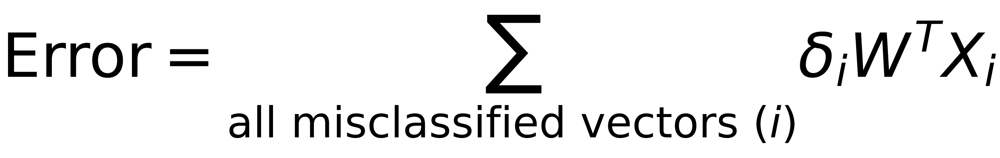
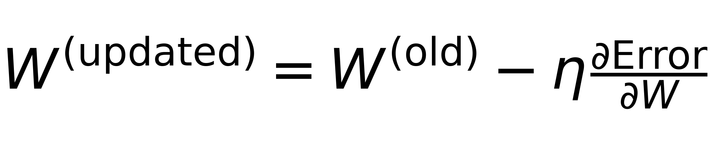
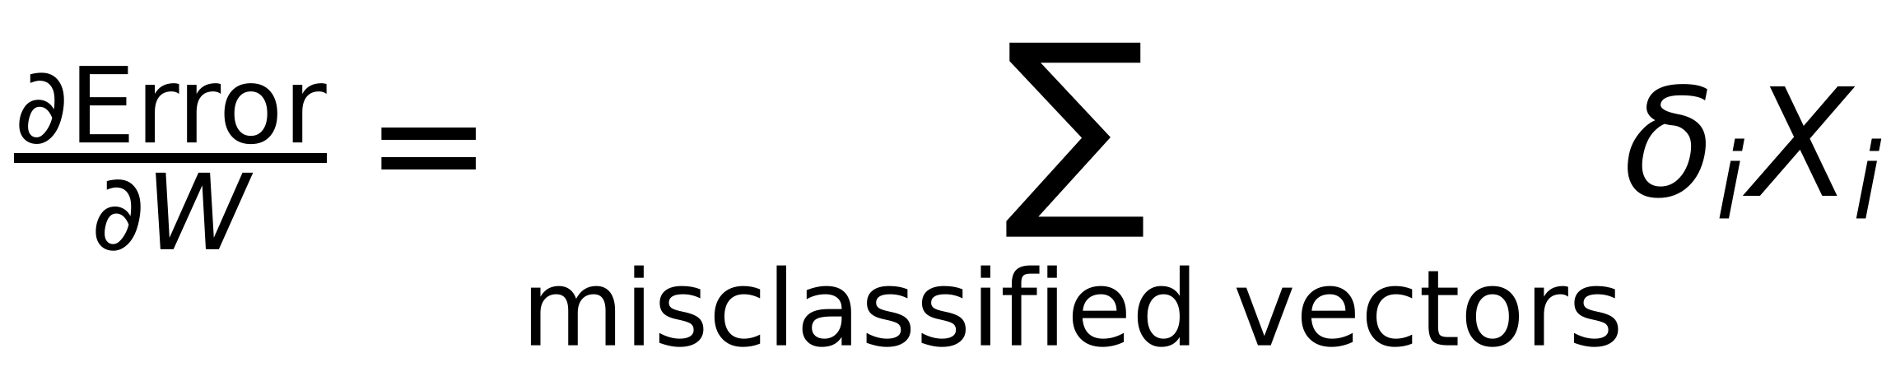
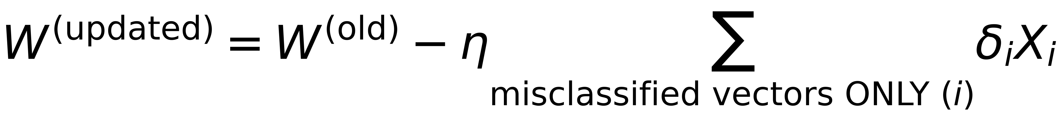
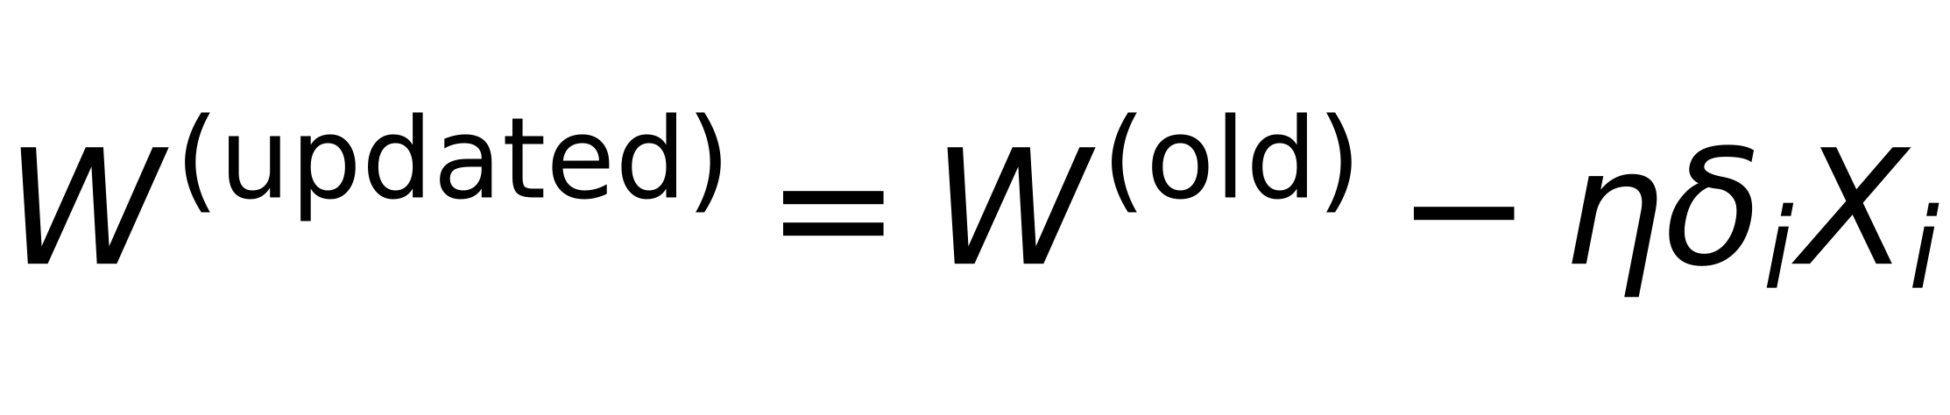
Problem Formulation
4
Define δ_{i} as:
If X ∈ class I and misclassified as Class II then d(X) will be <0 ⇒ δ_{i} = -1 ⇒ d(X)δ_{i} >0
If X ∈ class II and misclassified as Class I then d(X) will be >0 ⇒ δ_{i} = +1 ⇒ d(X)δ_{i} >0
Redefine Error function as:
$$\$Error=\sum_{all misclassified vectors (i)}{δ_{i}W^{T}X_{i}\$}$$
⇒ (WᵀXᵢ) takes positive and negative values and δᵢ has the same sign
Summation is always positive
Minimize the Error using Gradient Descent with step η
$$\$W^{(updated)}=W^{(old)}-η\frac{∂Error}{∂W}\$$$
where
$$\$\frac{∂Error}{∂W}=\sum_{misclassified vectors}{δ_{i}X_{i}\$}$$
$$\$W^{(updated)}=W^{(old)}-η\sum_{misclassified vectors ONLY (i)}{δ_{i}X_{i}\$}$$
Update after each sample
$$\$W^{(updated)}=W^{(old)}-ηδ_{i}X_{i}\$$$

Slide 5
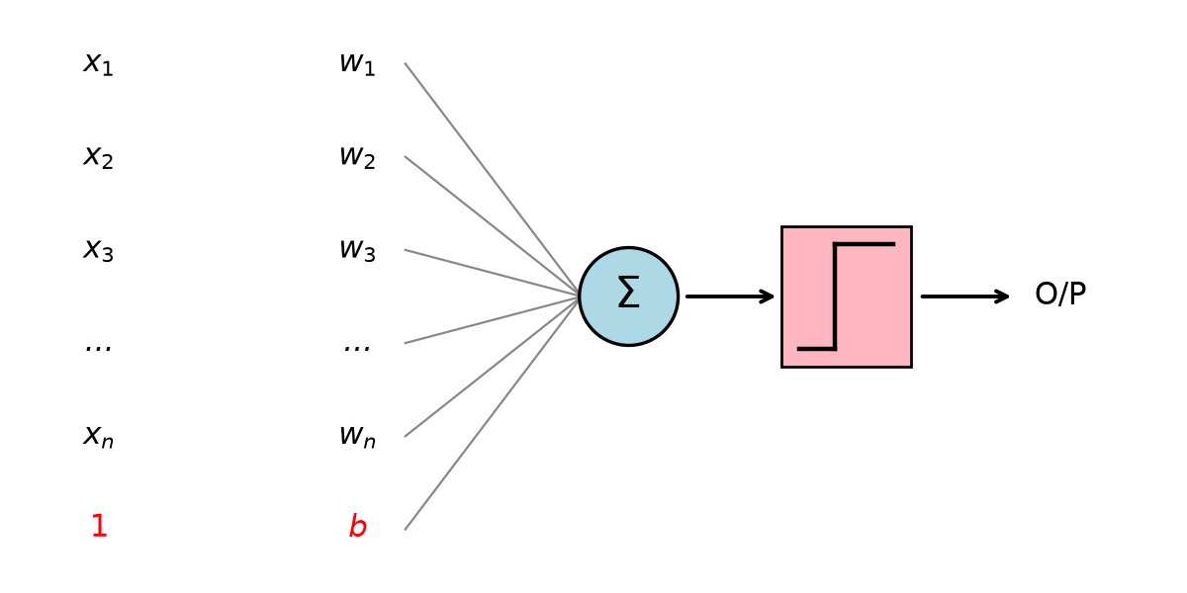
Visualization of Single Perceptron
5
X = [
]
X = [
]
W = [
]
x₁;
x₂;
...
xₙ
1;
x₁;
x₂;
...
xₙ
b;
w₁;
w₂;
...
wₙ
→
Model Weights
Augmented Vector
d(X) = Wᵀ X = w₁x₁ + w₂x₂ + ...... + wₙxₙ + b*1
}
>0 ⇒ Class I
<0 ⇒ Class II
=0 ⇒ Undefined Class
Binary Classification (2 Classes)

Slide 6
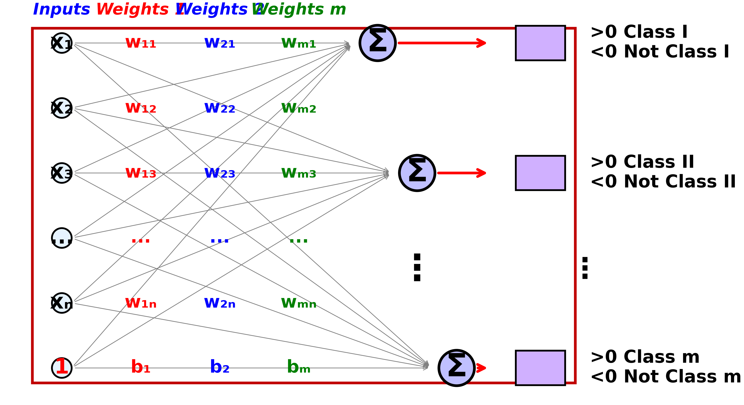
Visualization of Single Layer Perceptron
6
$$d_{1}(X)=W_{1}^{T}X=w_{11}x_{1}+w_{12}x_{2}+...+w_{1n}x_{n}+b_{1}⋅1$$
$$d_{2}(X)=W_{2}^{T}X=w_{21}x_{1}+w_{22}x_{2}+...+w_{2n}x_{n}+b_{2}⋅1$$
$$d_{m}(X)=W_{m}^{T}X=w_{m1}x_{1}+w_{m2}x_{2}+...+w_{mn}x_{n}+b_{m}⋅1$$
Multi-Class Classification

Slide 7
Test Single Perceptron with
9
[AND – OR – XOR] Logic
(Binary Classification)

Slide 8
Test Single Perceptron with
9
[AND – OR – XOR] Logic
(Binary Classification)

Slide 9
Test Single Perceptron with
9
[AND – OR – XOR] Logic
(Binary Classification)

Slide 10
Test Single Perceptron with
9
[AND – OR – XOR] Logic
(Binary Classification)

Slide 11
Test Single Perceptron with
9
[AND – OR – XOR] Logic
(Binary Classification)

Slide 12
Test Single Perceptron with
9
[AND – OR – XOR] Logic
(Binary Classification)

Slide 13
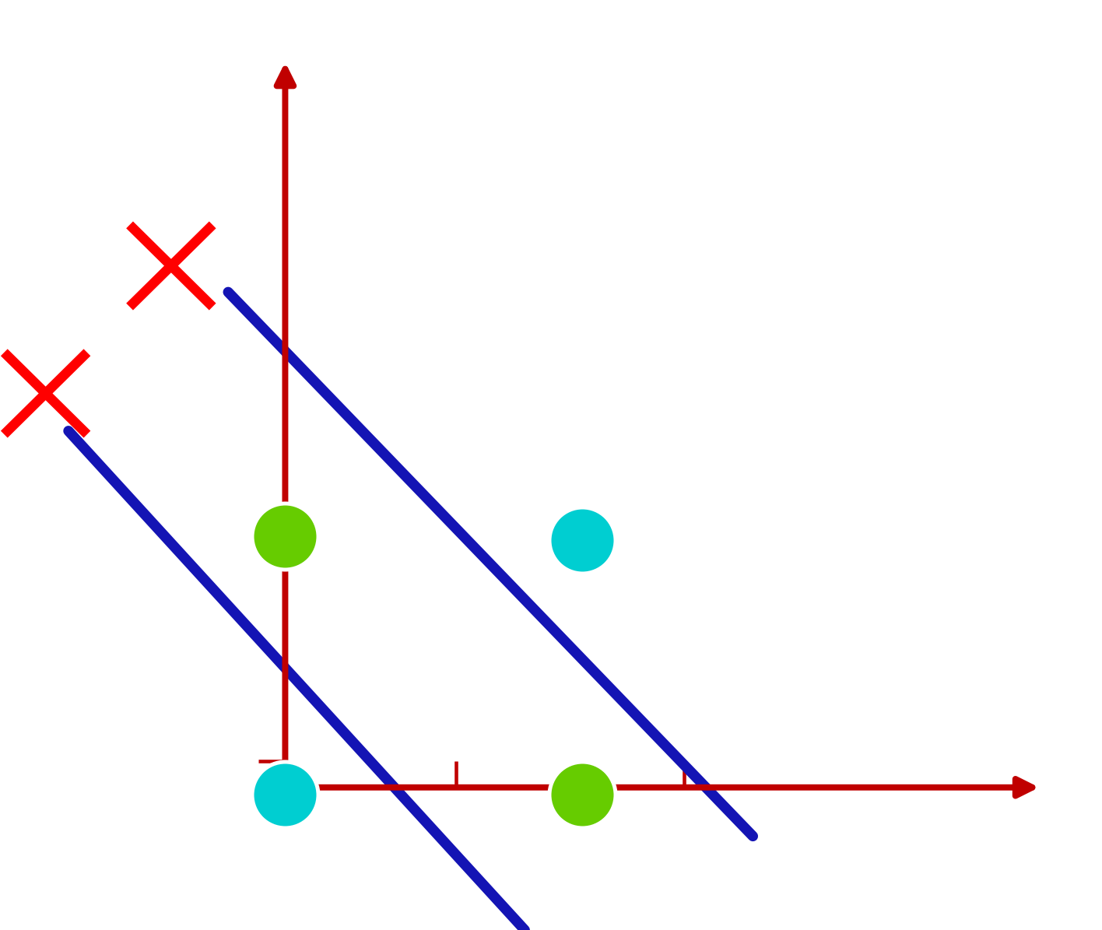
Classification of “XOR” Truth Table
13
x₂
X₁
X₂
O/P
0
0
0
0
1
1
1
0
1
1
1
0
x₁
x₁
?
x₂
Σ
O/P
Not Linearly Separable
?
1
?

Slide 14
Test Single Perceptron with
9
[AND – OR – XOR] Logic
(Binary Classification)

Slide 15
Test Single Perceptron with
9
[AND – OR – XOR] Logic
(Binary Classification)

Slide 16
Adding non-Linearity to Perceptrons
16
(Activation Functions)

Slide 17
Test Single Perceptron with
9
[AND – OR – XOR] Logic
(Binary Classification)

Slide 18
Test Single Perceptron with
9
[AND – OR – XOR] Logic
(Binary Classification)

Slide 19
Test Single Perceptron with
9
[AND – OR – XOR] Logic
(Binary Classification)

Slide 20
Test Single Perceptron with
9
[AND – OR – XOR] Logic
(Binary Classification)

Slide 21
Test Single Perceptron with
9
[AND – OR – XOR] Logic
(Binary Classification)

Slide 22
Test Single Perceptron with
9
[AND – OR – XOR] Logic
(Binary Classification)

Slide 23
Test Single Perceptron with
9
[AND – OR – XOR] Logic
(Binary Classification)

Slide 24
Test Single Perceptron with
9
[AND – OR – XOR] Logic
(Binary Classification)

Slide 25
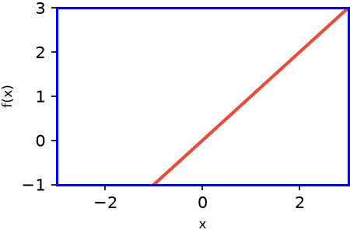
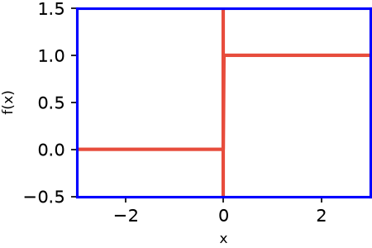
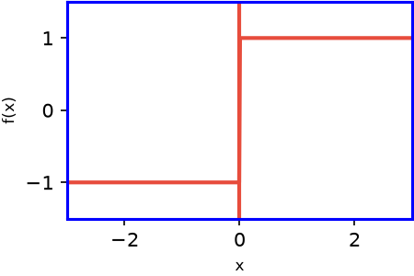
Linear and Unit Step Activation Functions
17
✕
F(x) = x
Linear (No Activation)
F(x) = Uni-polar Unit Step = { 0 for x<0 ; 1 for x ≥ 0 }
F(x) = Bi-polar Unit Step = { -1 for x<0 ; 1 for x ≥ 0 }

Slide 26
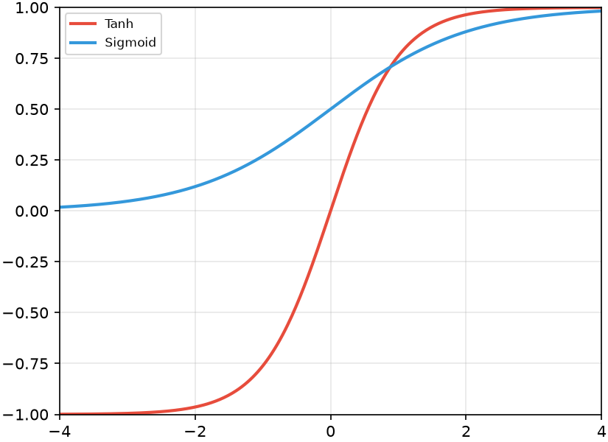
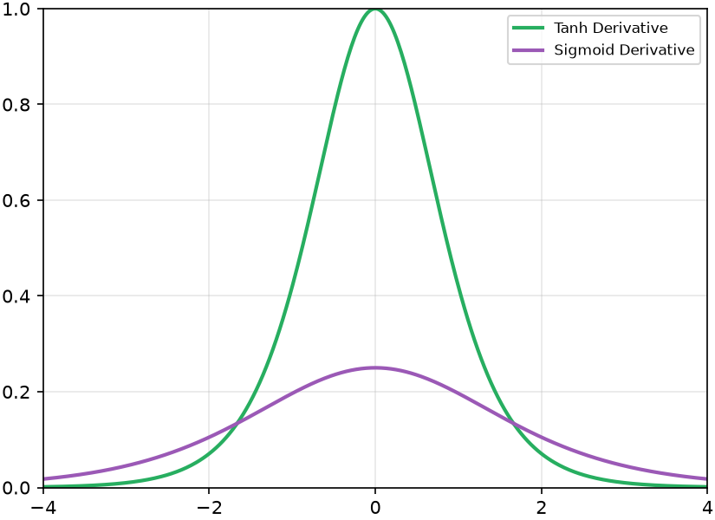
Sigmoid vs Tanh
18
f(x) = Sigmoid(x) = 1/(1+e^-x) ⇒ f'(x) = f(x)(1-f(x))
at x=0 f(0)=0.5 f'(0)=0.25
f(x) = tanh(x) = sinh x / cosh x ⇒ f'(x) = 1-f(x)^2
at x=0 f(0)=0 f'(0)=1
Sigmoid vs Tanh
[1] The range of the sigmoid function is fixed at 0 to 1, whereas the range of the tanh function is fixed at -1 to 1.
[2] The sigmoid function has a slower rate of change than the tanh function, which means that the derivative of the sigmoid function will be smaller than the derivative of the tanh function for a given input

Slide 27
Multi-Layer Neural Network
27
The complete Picture

Slide 28
Neural Network Model
28
Input
Sample
Target
Label
Net_j ⇒ Summation at Node j
O_j ⇒ Output at Node j
w_ji ⇒ Weight from Node i to Node j
Net_i
Net_i
Net_i
w_ji
w_kj
Error Error
Class 1
O_i
O_i
O_i
Output 1
Net_j
Net_j
Net_j
Output 2
Class 2
O_j
O_j
O_j
Net_k
Net_k
Net_k
Number of I/P Nodes = Input Vector Length
Number of O/P Nodes = Number of classes
O_k
O_k
O_k
Output m
Class m
Previous Layer
Layer (i)
Current Layer
(You are here)
Next Layer
Layer (K)
I/P Layer
Hidden Layer(s)
O/P Layer

Slide 29
Neural Network Model
29
Input
Sample
Target
Label
Net_j
Net_j
Net_j
Net_j ⇒ Summation at Node j
O_j ⇒ Output at Node j
w_ji ⇒ Weight from Node i to Node j
~
w_ji
~
~
Output 1
Error Error Error
Class 1
Σ
Net_j
o o o
Σ
Σ
O_j
Net_j
●
O_j
●
Net_j
O_j
Σ
~
o o o
w_ji
Σ
~
Σ
~
Output 2
Class 2
Net_j
O_j
Net_j
●
O_j
●
Net_j
O_j
Σ
~
o o o
w_ji
Σ
~
Σ
~
Output m
O_j
●
O_j
●
O_j
Class m
Number of I/P Nodes = Input Vector Length
Number of O/P Nodes = Number of classes
Previous Layer
Layer (i)
Current Layer
(You are here)
For Layer "j"
O_j = f(Net_j) = 1 / (1 + e^{-Net_j})
If Layer "j" is Output Layer:
Net_j = Σ_j (w_ji O_i)
E = ½ Σ_j (t_j - O_j)²

Slide 30
Example
30
Bad Weights
O3
Output
Target
[7]
[4]
0.1 0.2 0.3
3
0.3 0.4 0.5
x1
O4
6
O6
[0] t6
0.4 0.5 0.6
4
x2
O5
[1] t7
5
7
O7
Forward
Net3 = 7 * 0.1 + 4 * 0.4 = 2.3
Net4 = 7 * 0.2 + 4 * 0.5 = 3.4
Net5 = 7 * 0.3 + 4 * 0.6 = 4.5
Net3
O3 = 1 / (1 + e^-2.3) = 0.909
O4 = 1 / (1 + e^-3.4) = 0.968
O5 = 1 / (1 + e^-4.5) = 0.989
O3
Net4
O4
Net5
O5
Net6 = 0.909 * 0.3 + 0.968 * 0.4 + 0.989 * 0.5 = 1.1544
Net7 = 0.909 * 0.3 + 0.968 * 0.4 + 0.989 * 0.5 = 1.1544
Net6
O6 = 1 / (1 + e^-1.1544) = 0.76
O7 = 1 / (1 + e^-1.1544) = 0.76
O6
Net7
O7

Slide 31
Example
31
Better Weights
O3
Output
Target
| 7 |
| 4 |
0.121 0.405
3
-0.399 0.598
x1
O4
6
O6
[0] t6
0.101 0.305
4
-0.288 0.696
x2
O5
[1] t7
0.099 0.295
5
-0.187 0.795
7
O7
Forward
Net3 = 7 * 0.121 + 4 * 0.405 = 2.146
Net4 = 7 * 0.101 + 4 * 0.305 = 1.626
Net5 = 7 * 0.099 + 4 * 0.295 = 1.574
Net3
O3 = 1 / (1 + e^2.146) = 0.895
O4 = 1 / (1 + e^1.626) = 0.836
O5 = 1 / (1 + e^1.574) = 0.828
O3
Net4
O4
Net5
O5
Net6 = 0.895 * (-0.399) + 0.836 * (-0.288) + 0.828 * (-0.187) = -0.753
Net7 = 0.895 * 0.598 + 0.836 * 0.696 + 0.828 * 0.795 = 1.775
Net6
O6 = 1 / (1 + e^-0.753) = 0.32
O7 = 1 / (1 + e^1.775) = 0.855
O6
Net7
O7

Slide 32
How to Update Weights in order to
minimize Error ?
32
Move in the opposite direction of the gradients
Of the whole NN
(Back Propagation Algorithm)

