Slide 1














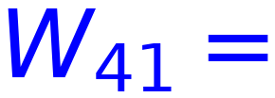

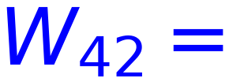

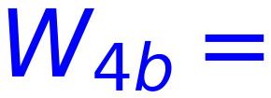






Example
31
O3
Input
3
-0.29
0.1
Output
Target
[
]
x1(1)
0.458
1
O4
6
O6
0.4
4
-0.218
t6
[
0
]
0.2
-0.445
5
x2(5)
O5
0.565
t7
1
7
O7
0.3
0.5
5
-0.134
-0.375
0.669
Bias
1
0.6
Backward (Update hidden Layer Weights)
η= 5

